Slide 1
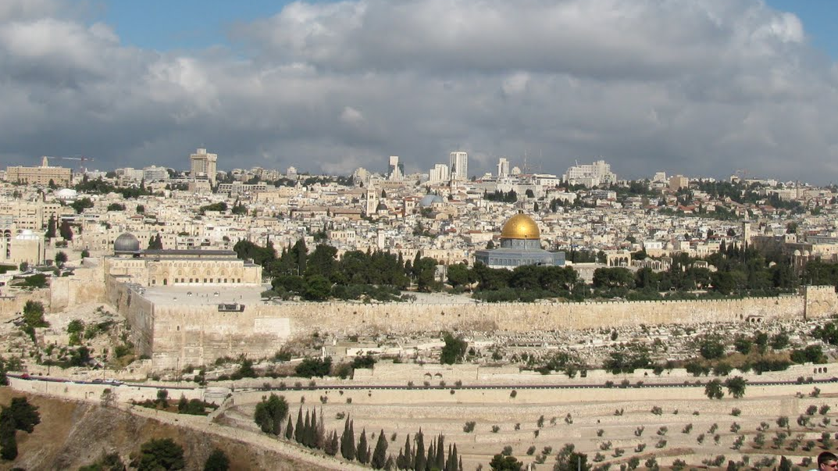
Jerusalem in New Testament Times
September 15, 2017

Slide 2
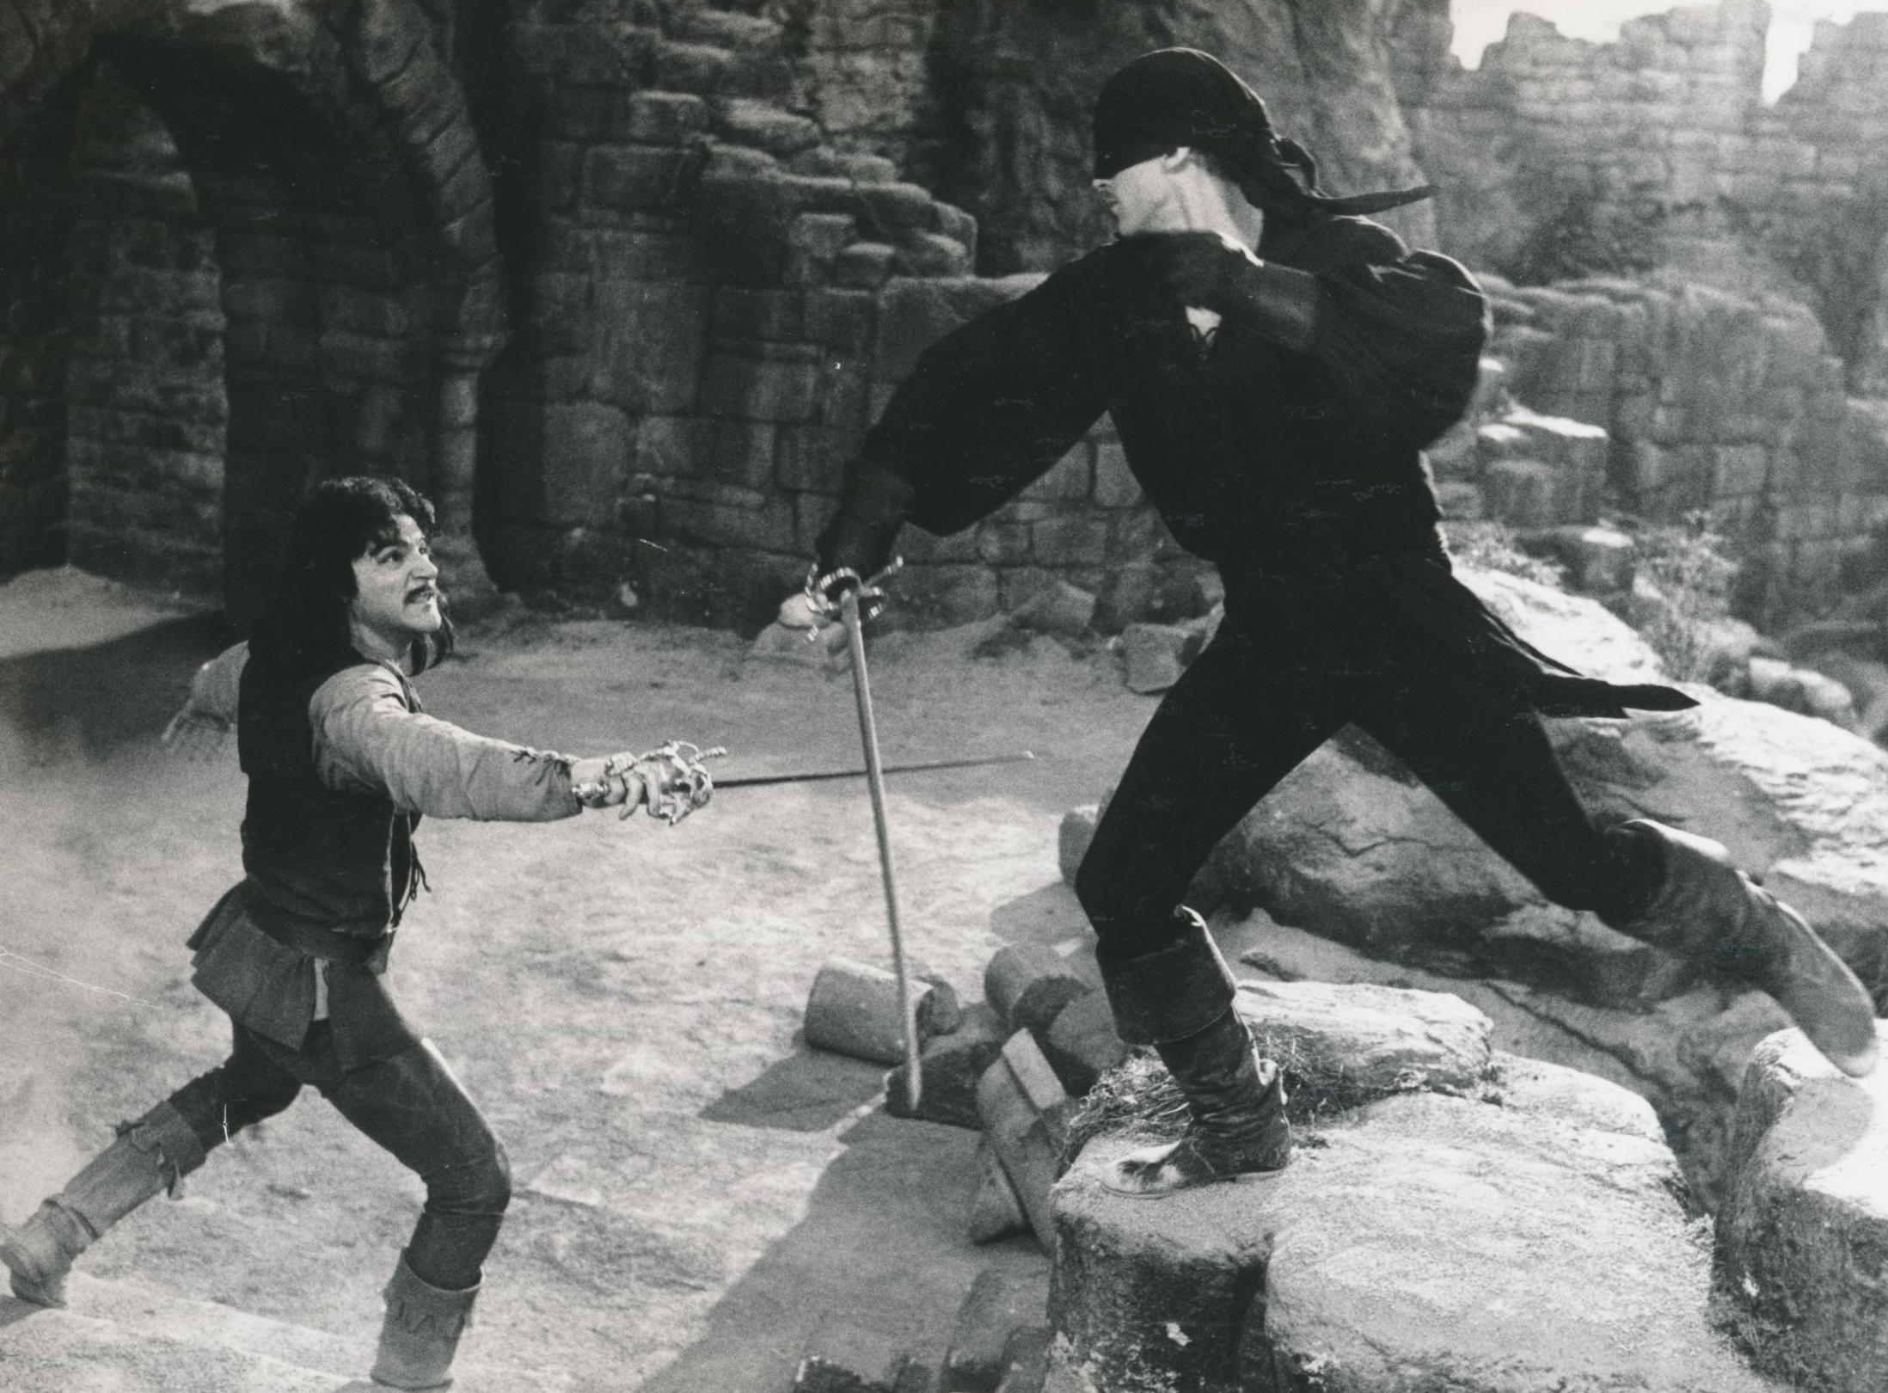
Who are you?
No one of consequence.
I must know!
Get used to disappointment.

Slide 3

“Jerusalem” occurs 142 times in New Testament
“Mount of Olives” or “Olivet” occurs 12 times
“Hell” (actually “Gehenna”) occurs 12 times
“Zion” occurs 7 times
“Kidron” appears once
Geographical references
ABOUND

Slide 4
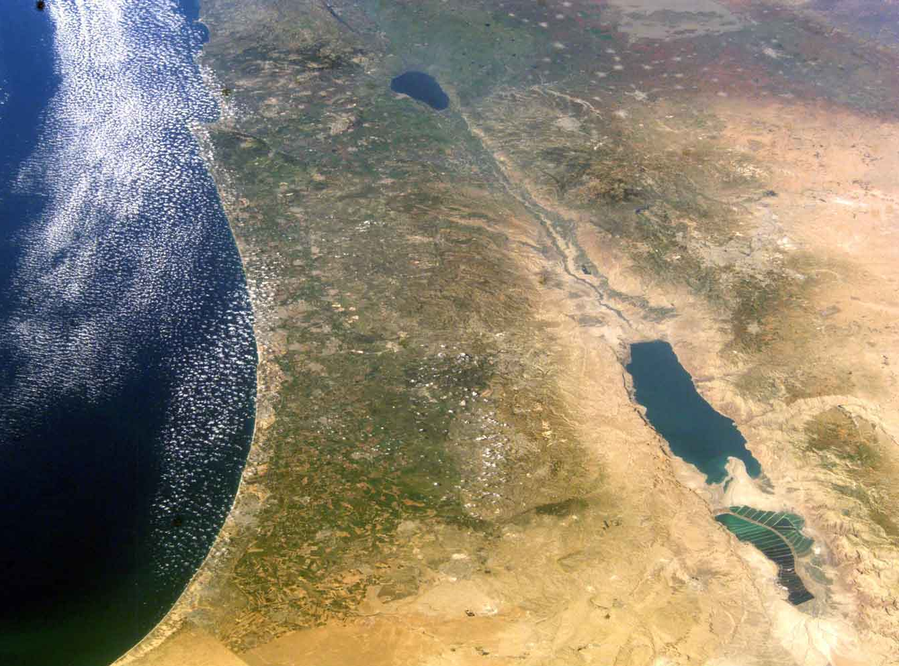
65 Miles = 200 Miles
50 Miles

Slide 5
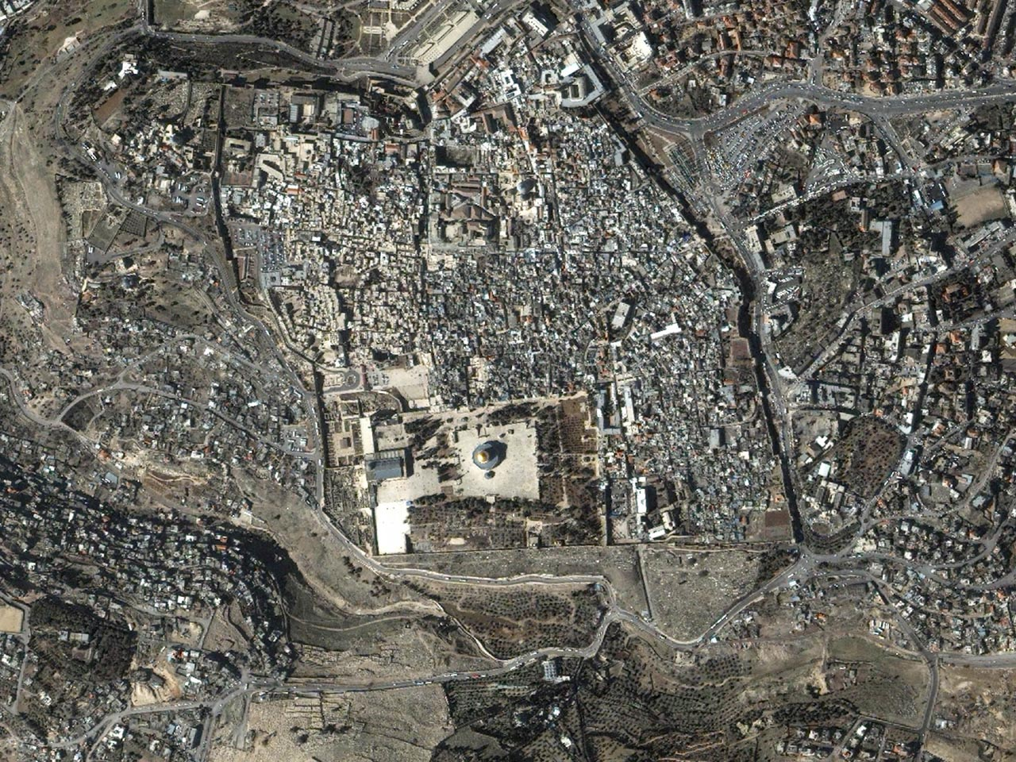
Mt. Zion
West
Temple Mount
South
North
East
Kidron
Olivet

Slide 6
North
South

Slide 7
3/4 of a mile
6 tenths of a mile
9/10 of a mile

Slide 8
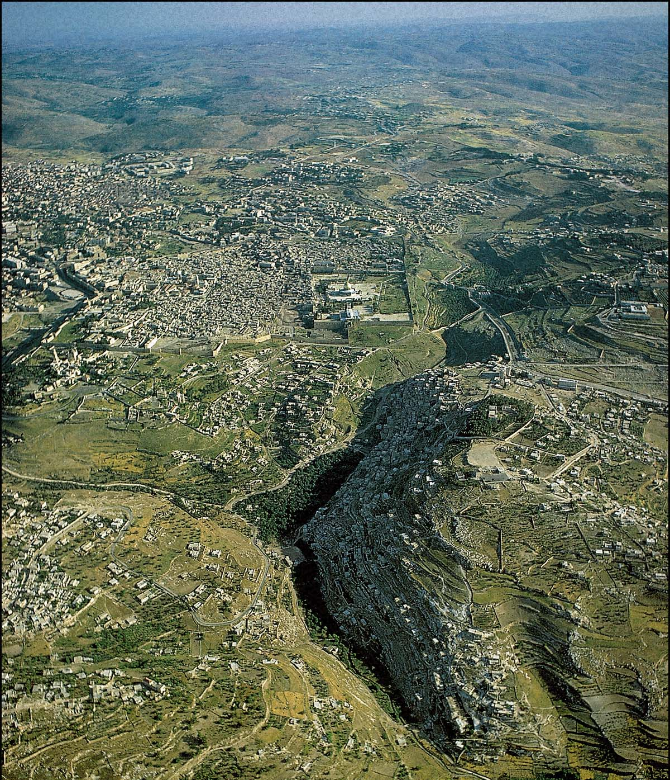
Jerusalem
(looking North)
Psalm 125:1f
Those who trust in the Lord are as Mount Zion, which cannot be moved but abides forever. As the mountains surround Jerusalem, so the Lord surrounds His people from this time forth and forever.

Slide 9
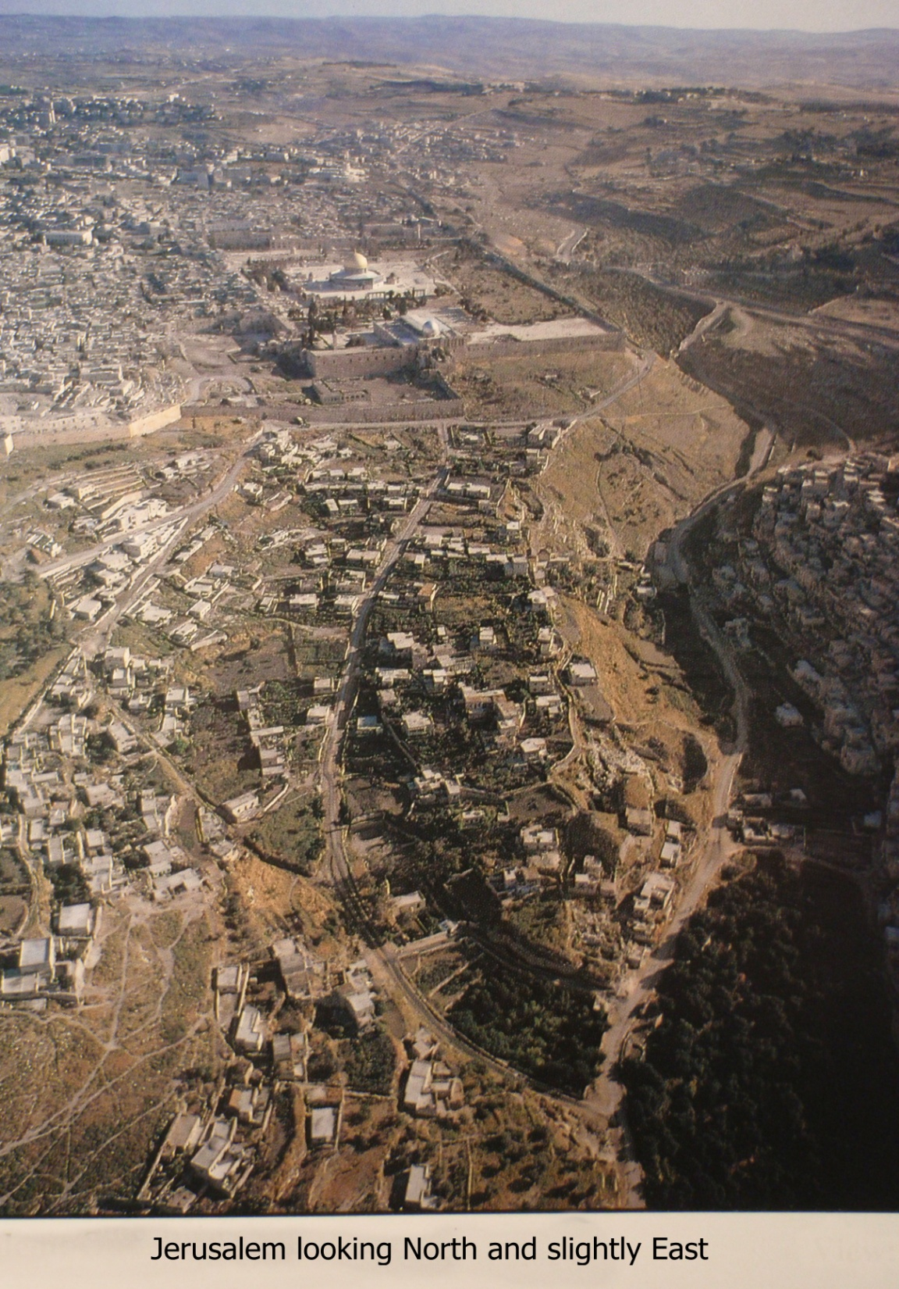
Psalms of Ascent (120 – 134)
sung ascending these hills

Slide 10
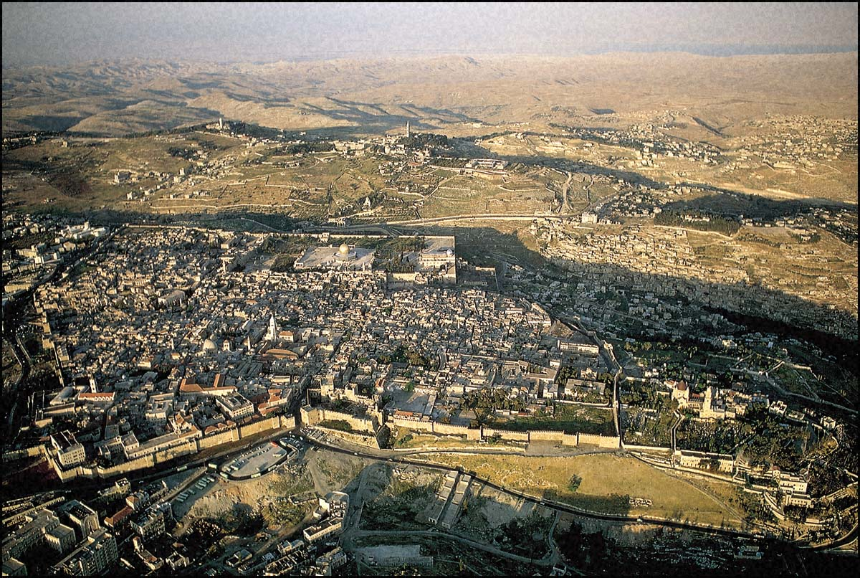
Wilderness of Judea where Jesus fasted 40 days
House of Caiaphas

Slide 11
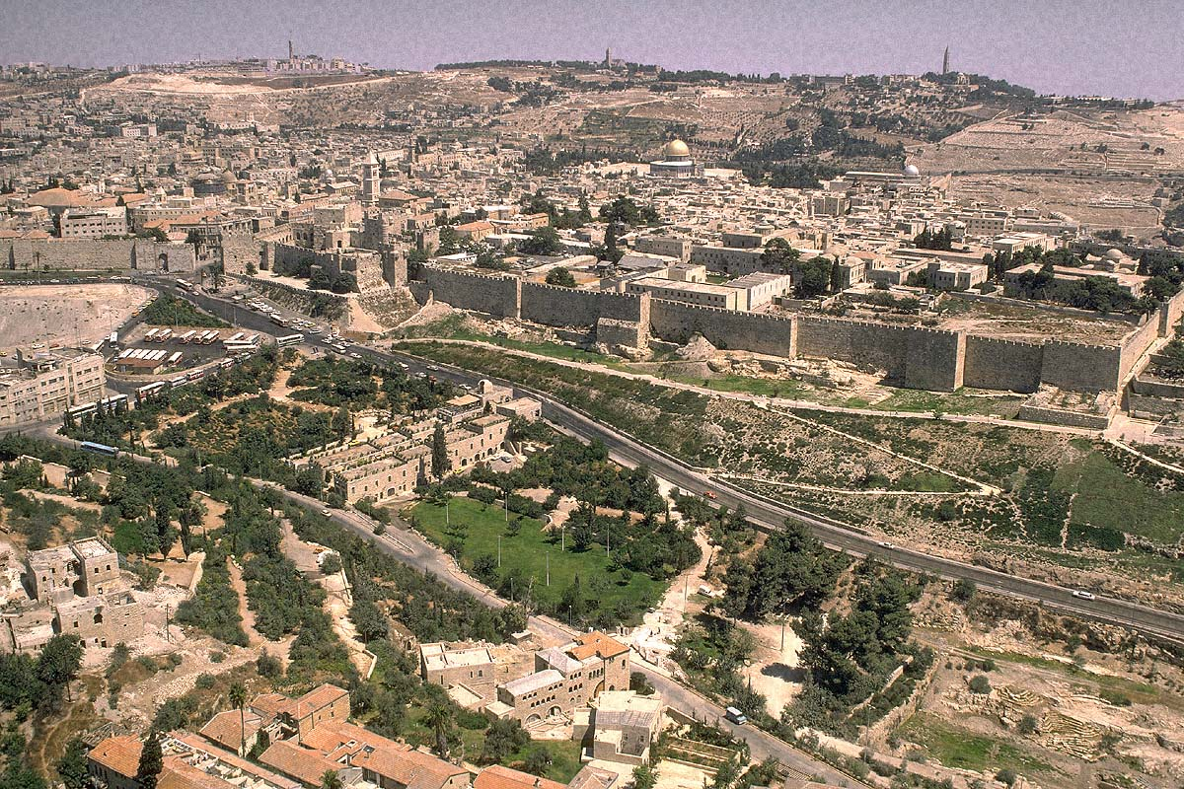
Olivet: Scene of prayer and betrayal
Matthew 23:33
You serpents, you brood of vipers,
how will you escape the sentence
of Gehenna?
Valley of Topheth, Hinnom, Gehenna

Slide 12
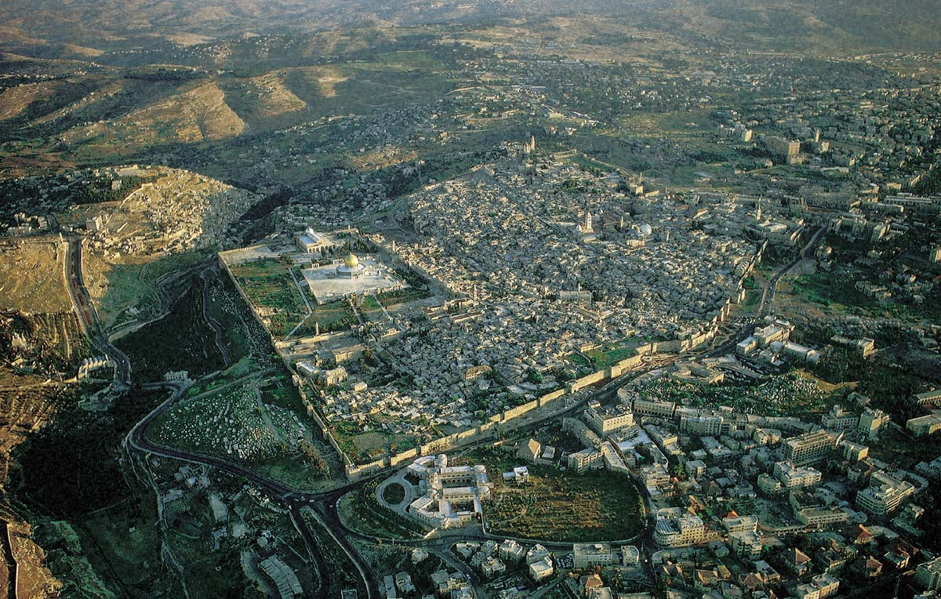
Gethsemane

Slide 13
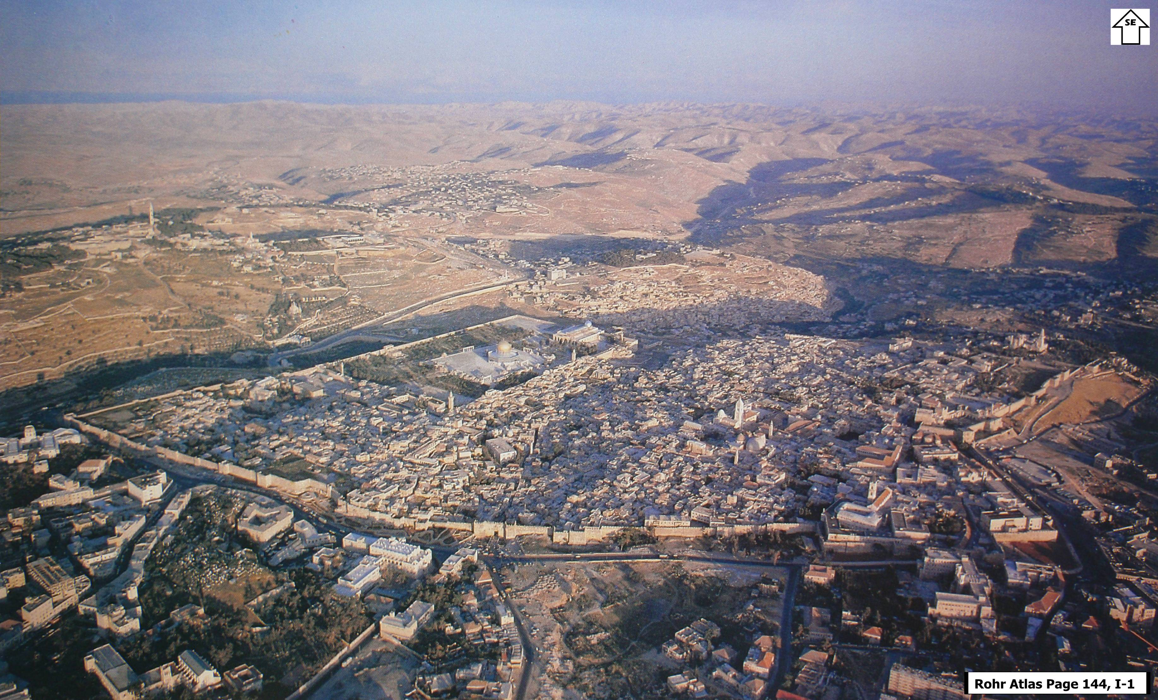

Slide 14
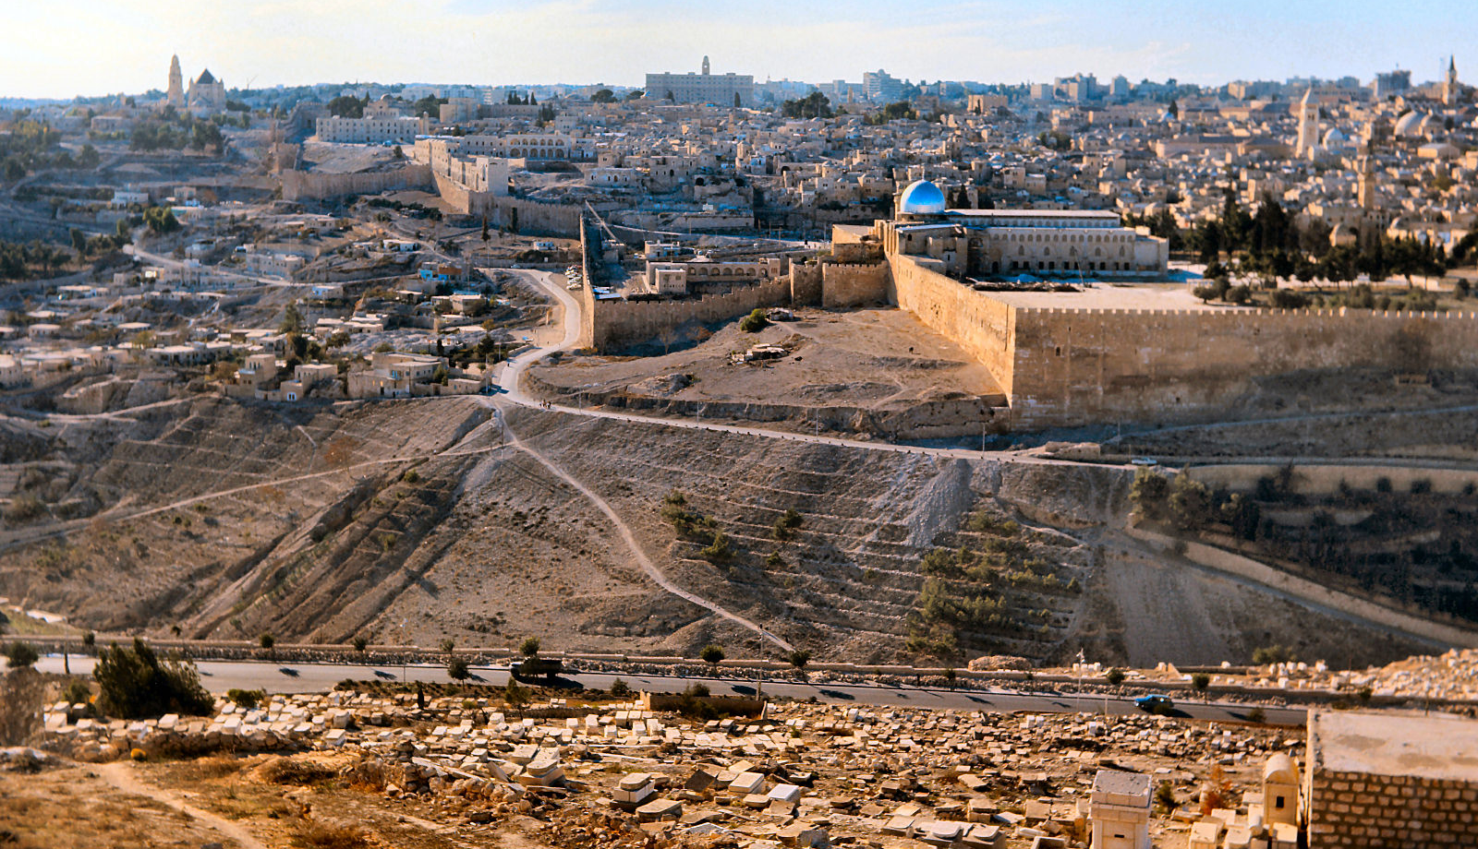
Looking West at the Temple Mount from the Mount of Olives.
Matthew 23:37-39
Jerusalem, Jerusalem, who kills the prophets and stones those who are sent to her! How often I wanted to gather your children together, the way a hen gathers her chicks under her wings, and you were unwilling. Behold, your house is being left to you desolate!

Slide 15
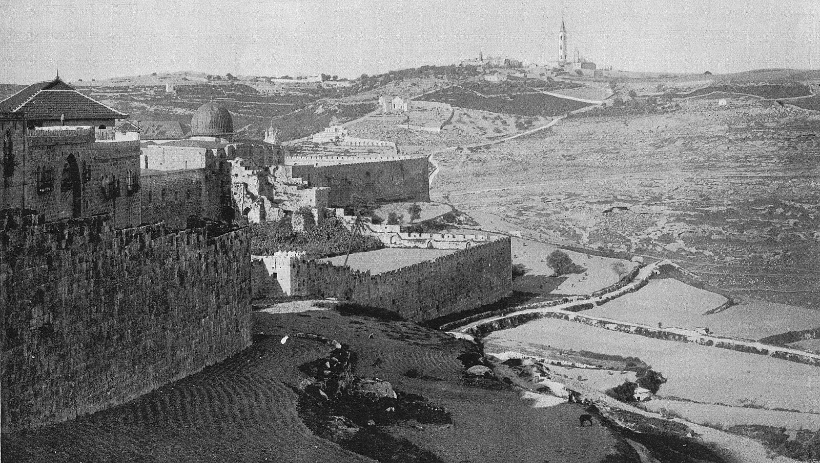
Last Supper thought to have taken place close to photographers location

Slide 16
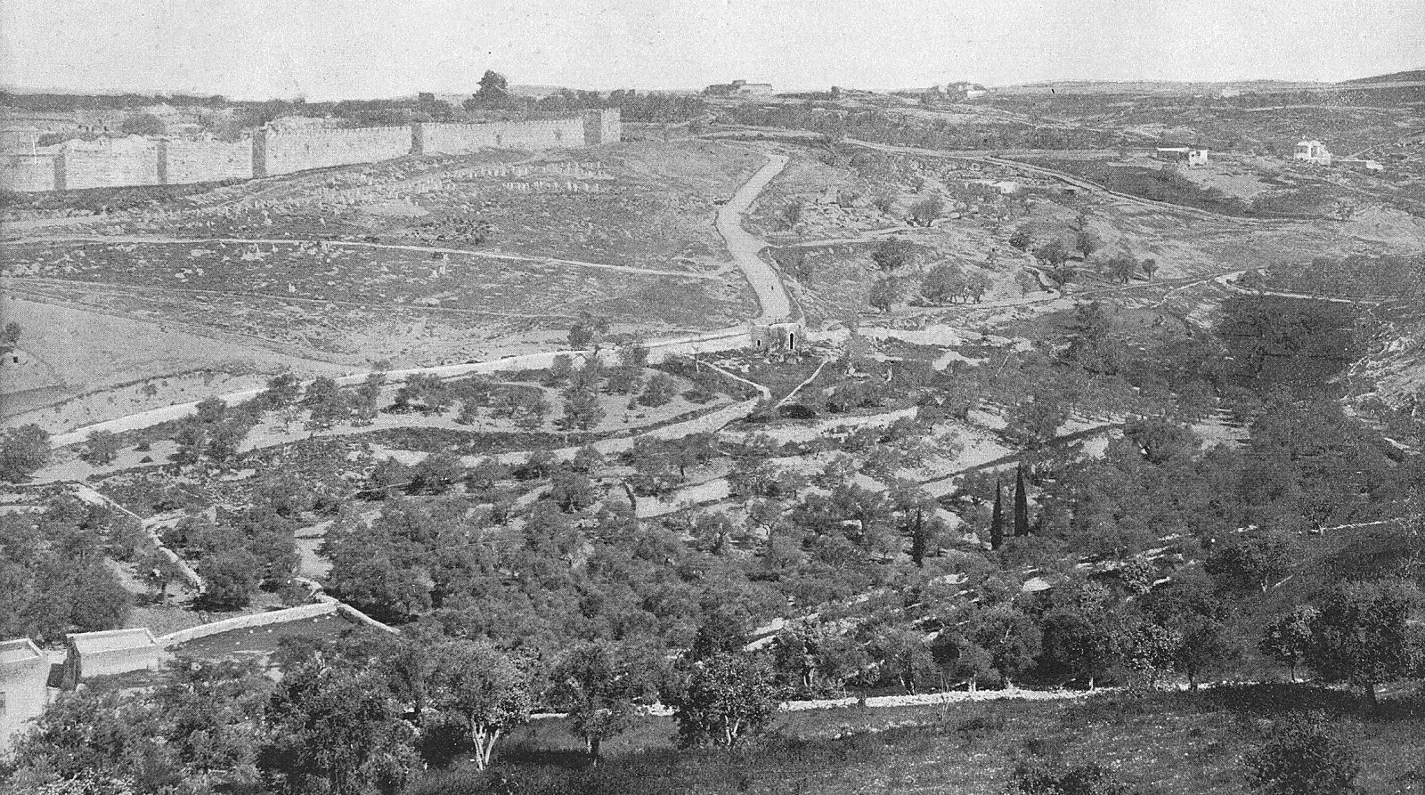
Kidron Valley and Jerusalem from the Mount of Olives looking Northwest

Slide 17
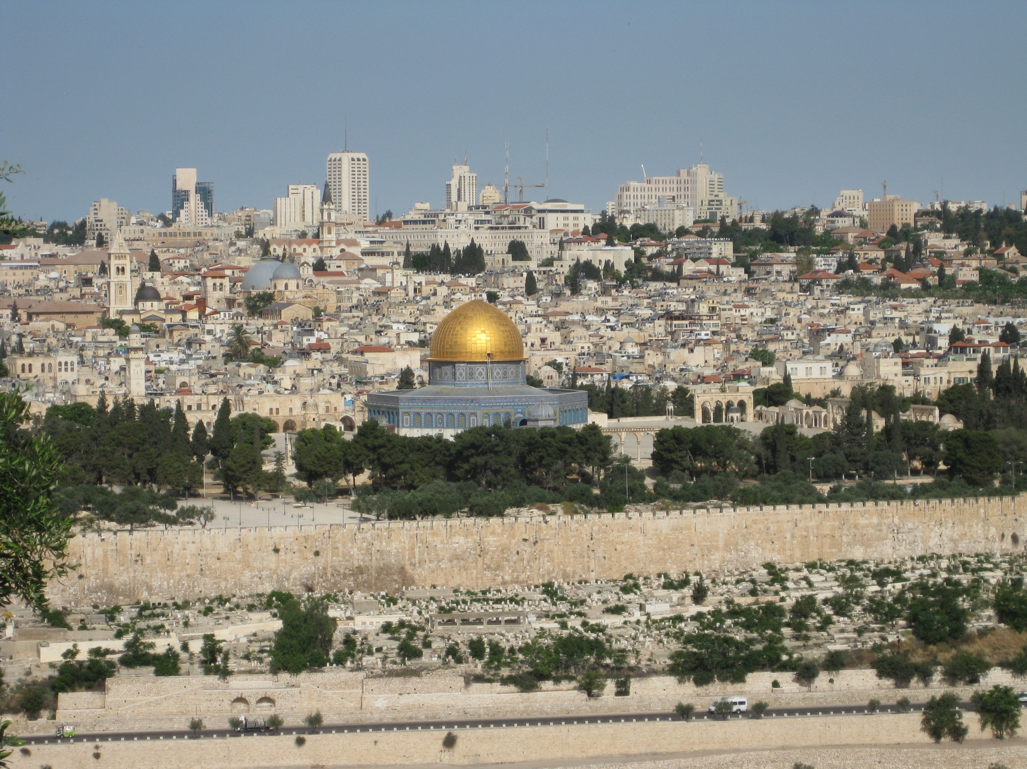

Slide 18
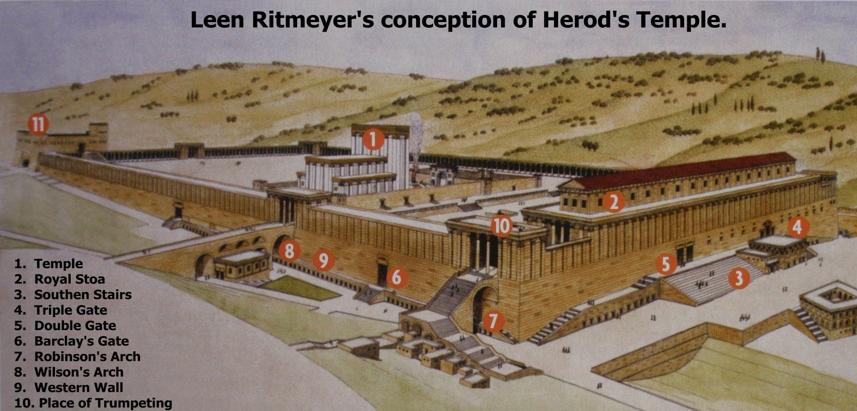

Slide 19
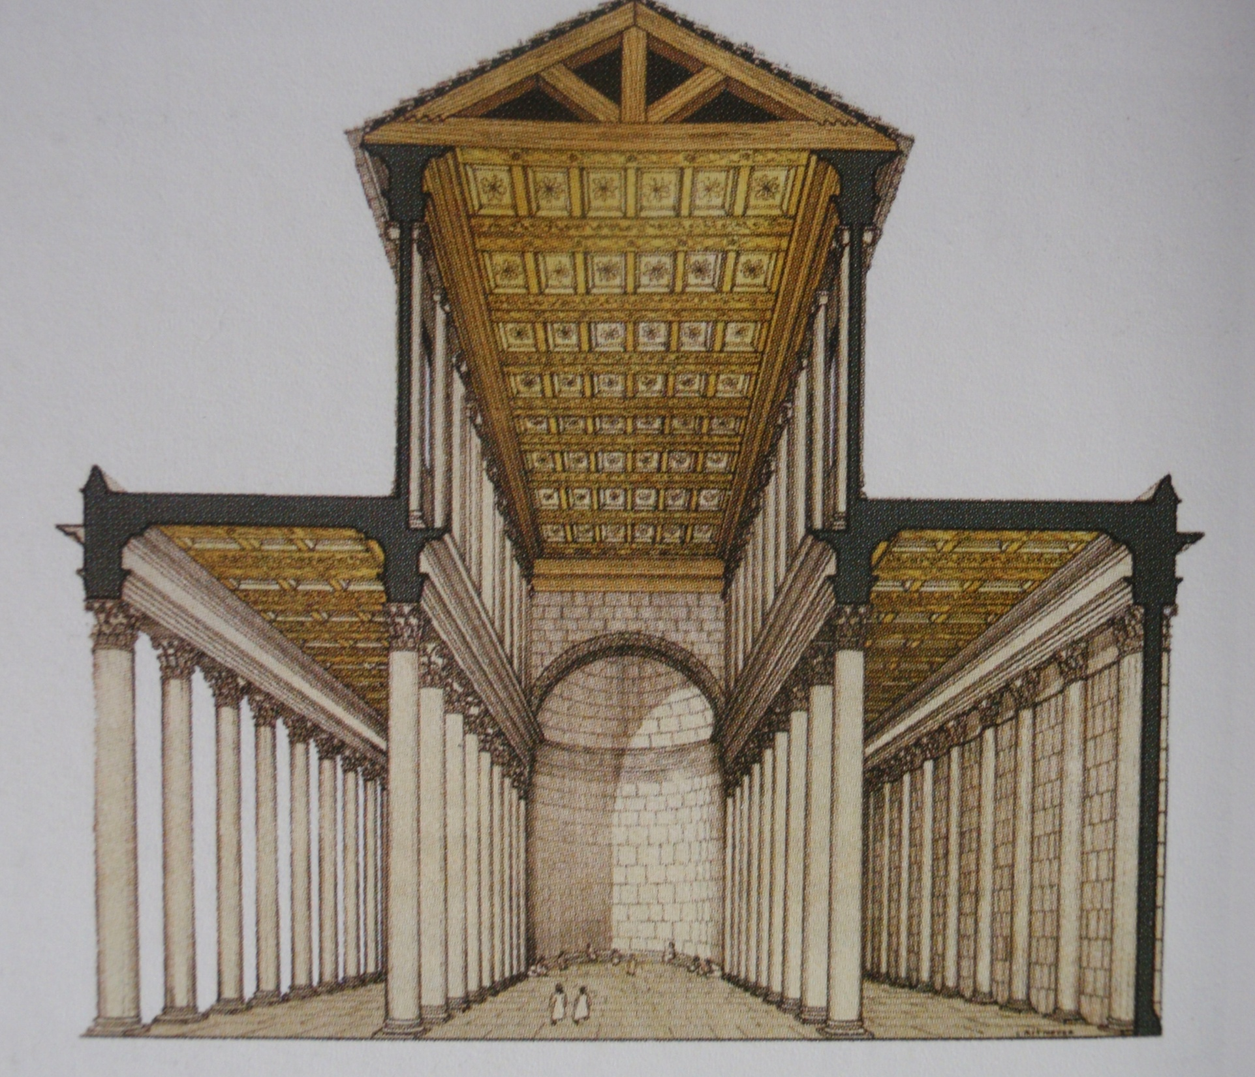

Slide 20
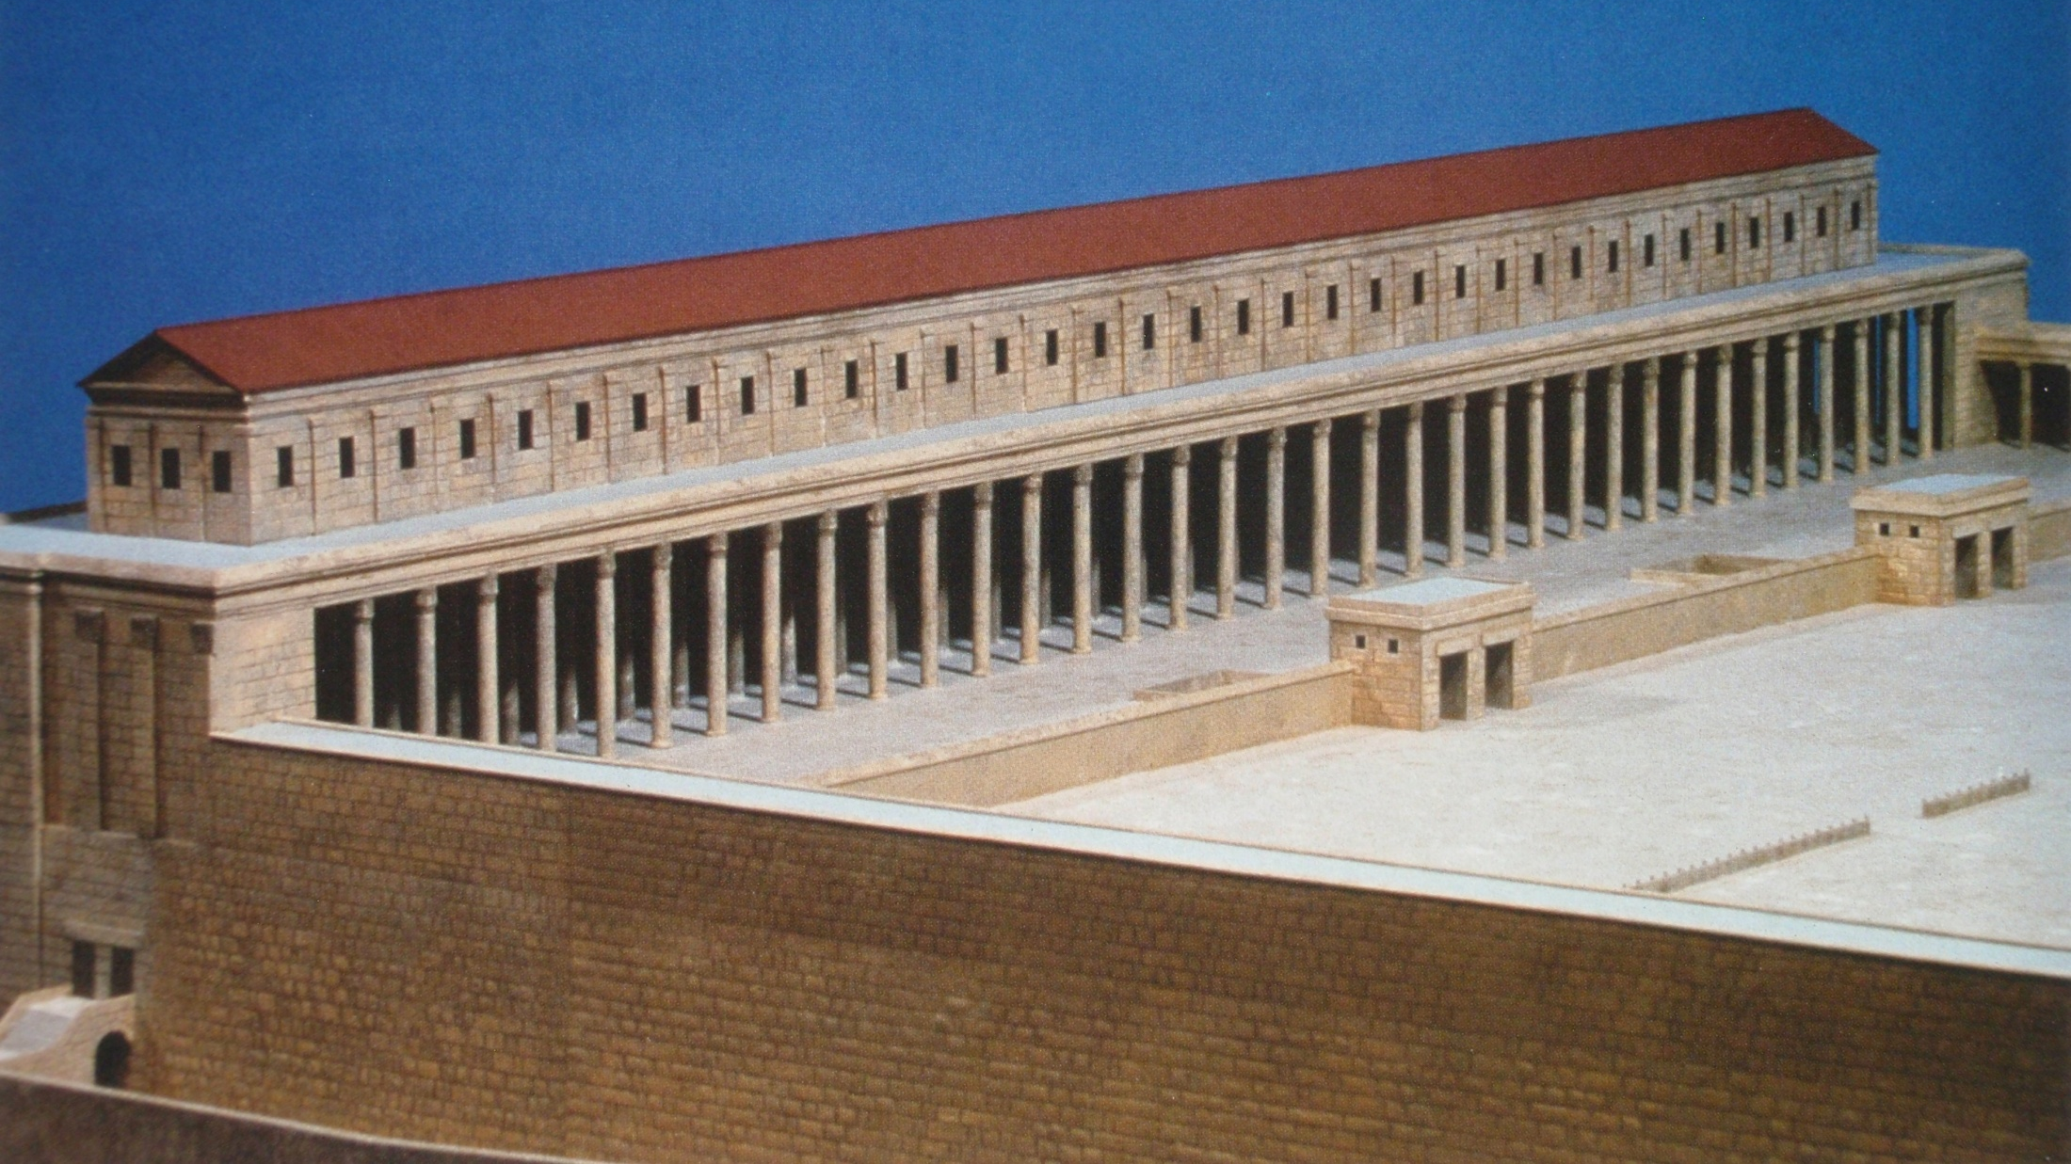
Royal Stoa where Jesus could preach to several thousand

Slide 21
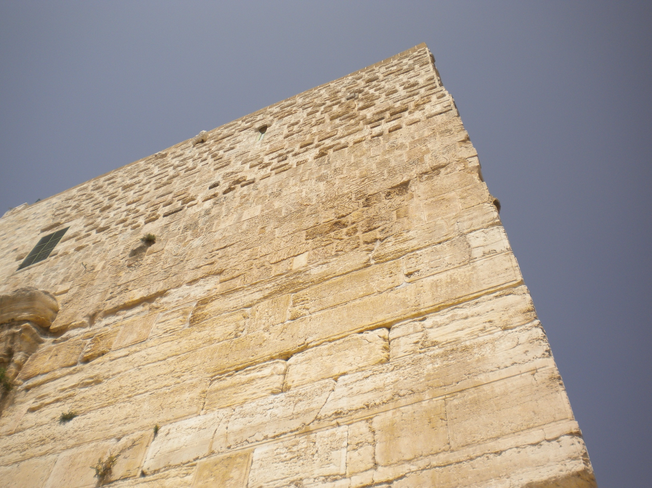
Matthew 4:5-7
The devil took Him into the holy city and had Him stand on the pinnacle of the temple, and said to Him, "If You are the Son of God, throw Yourself down; for it is written, “He will command His angels to bear you up lest you strike your foot against a stone.” Jesus said to Him, “On the other hand it is written, ‘You shall not put he Lord your God to the test.’”

Slide 22
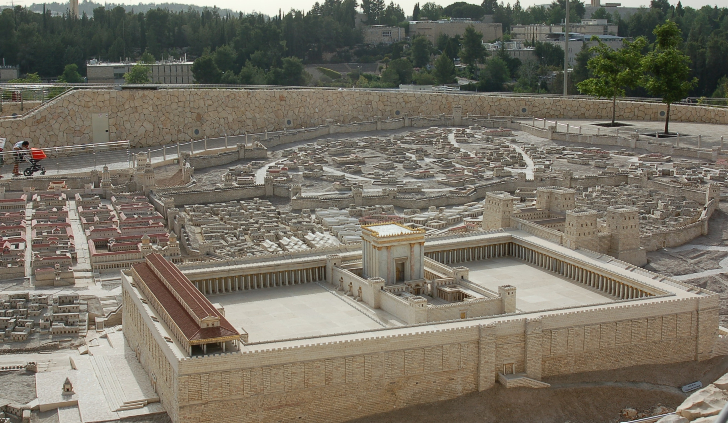
Matthew 12:6
I say to you that something greater than the temple is here.

Slide 23
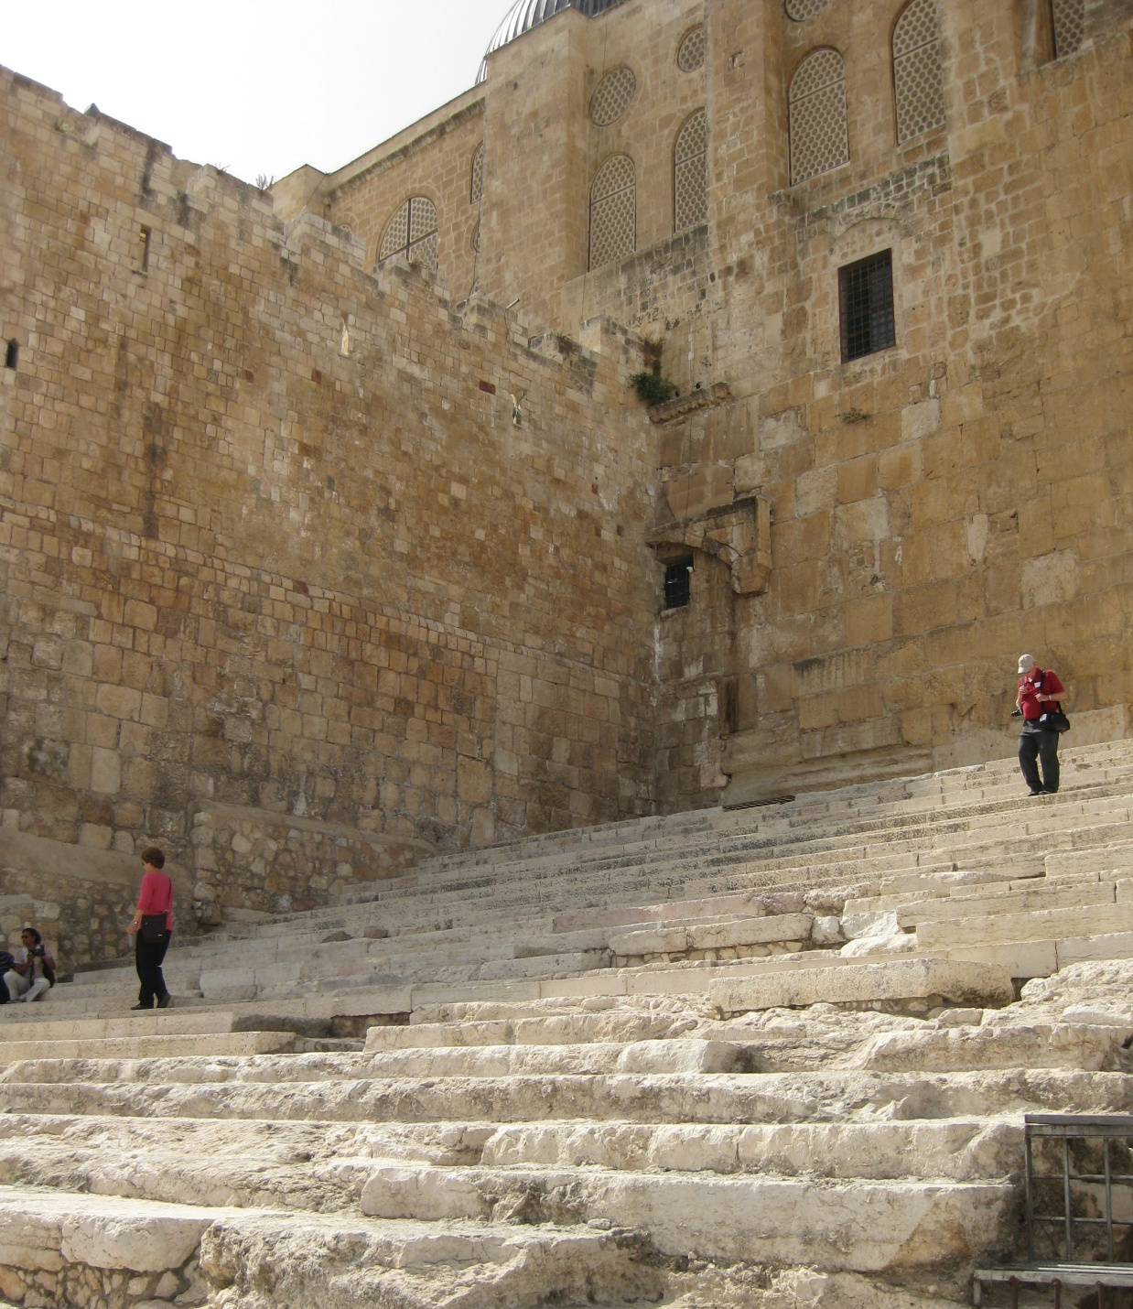

Slide 24
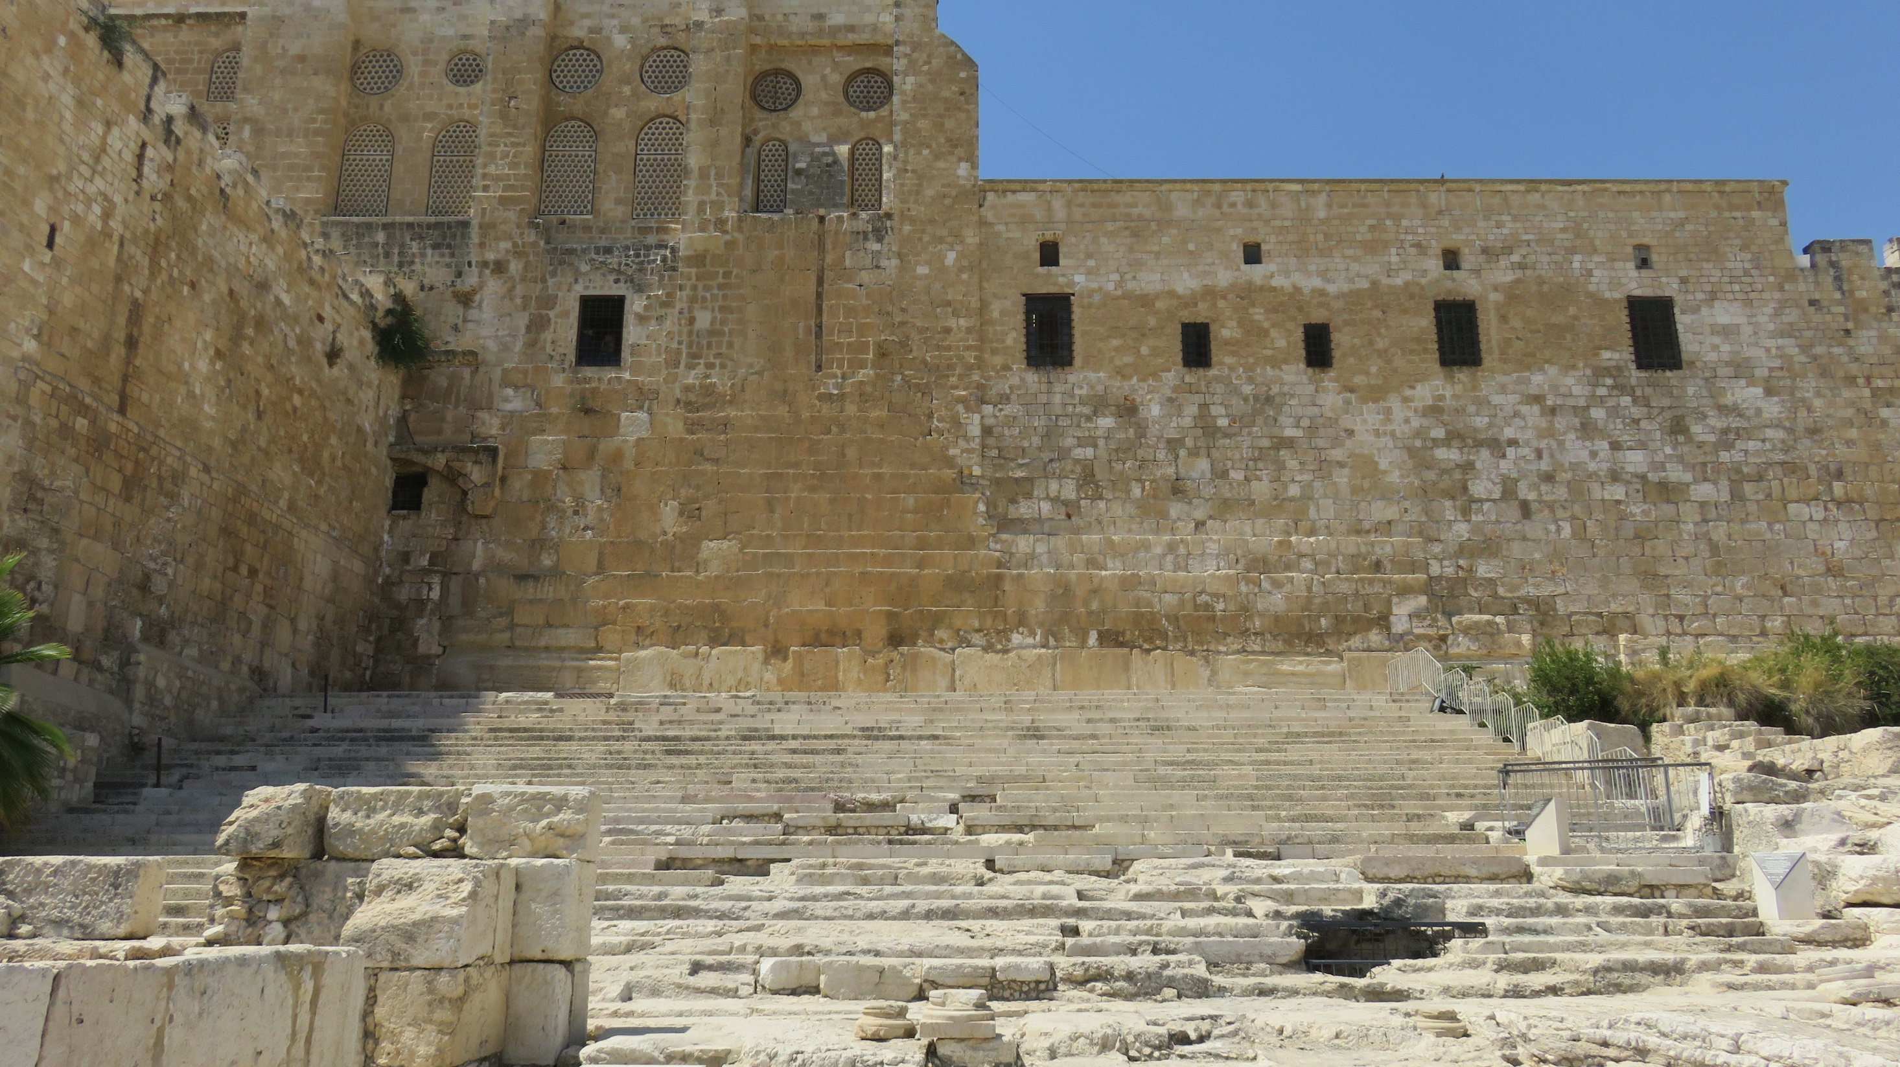

Slide 25
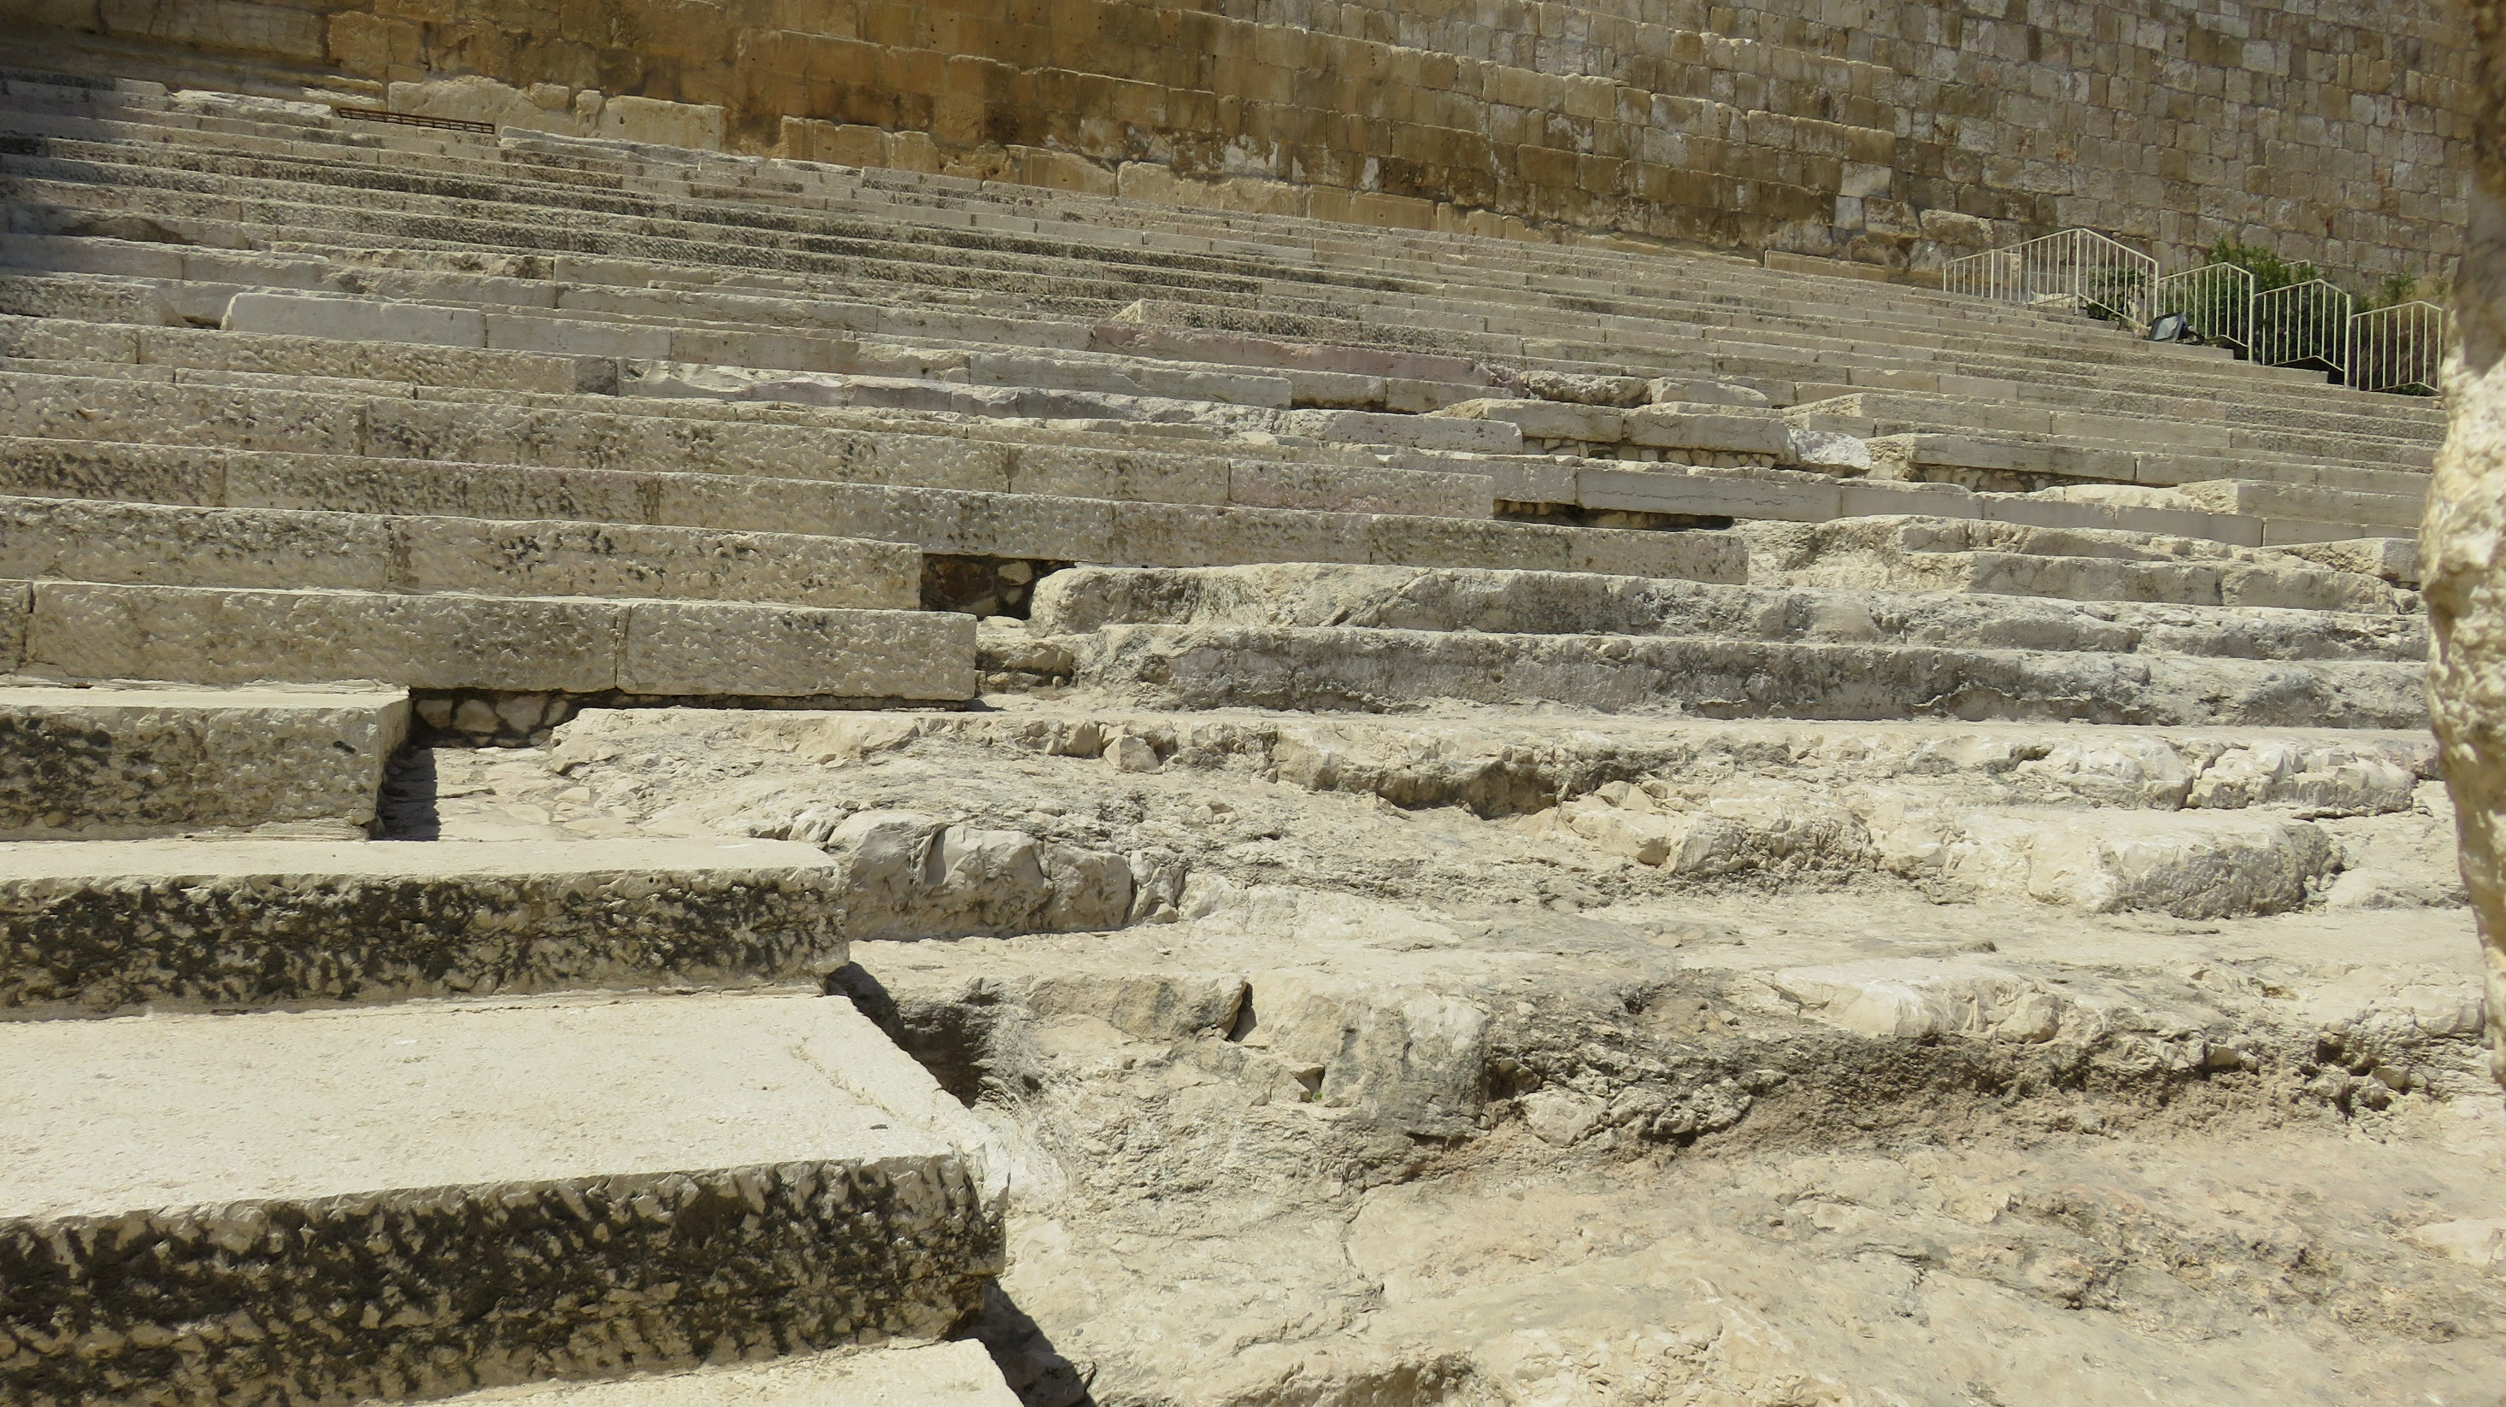

Slide 26
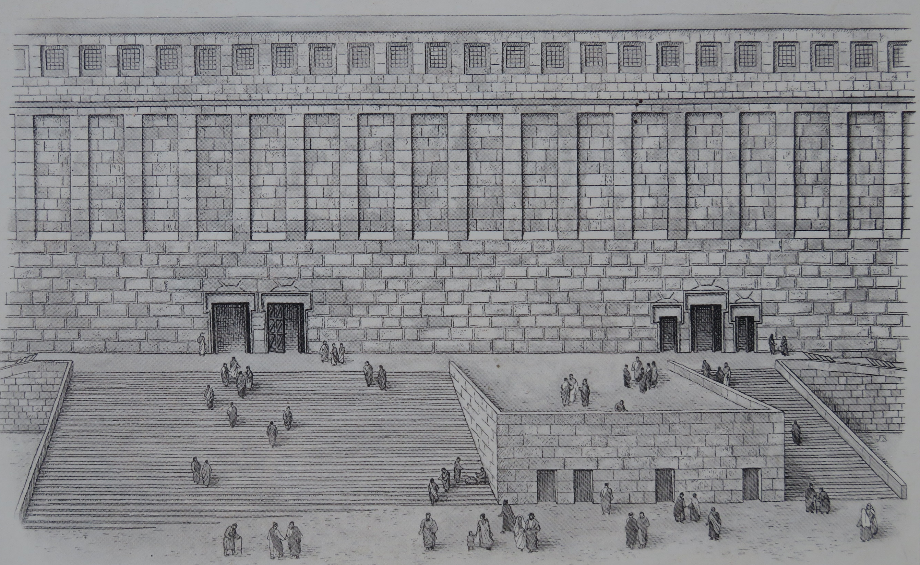

Slide 27
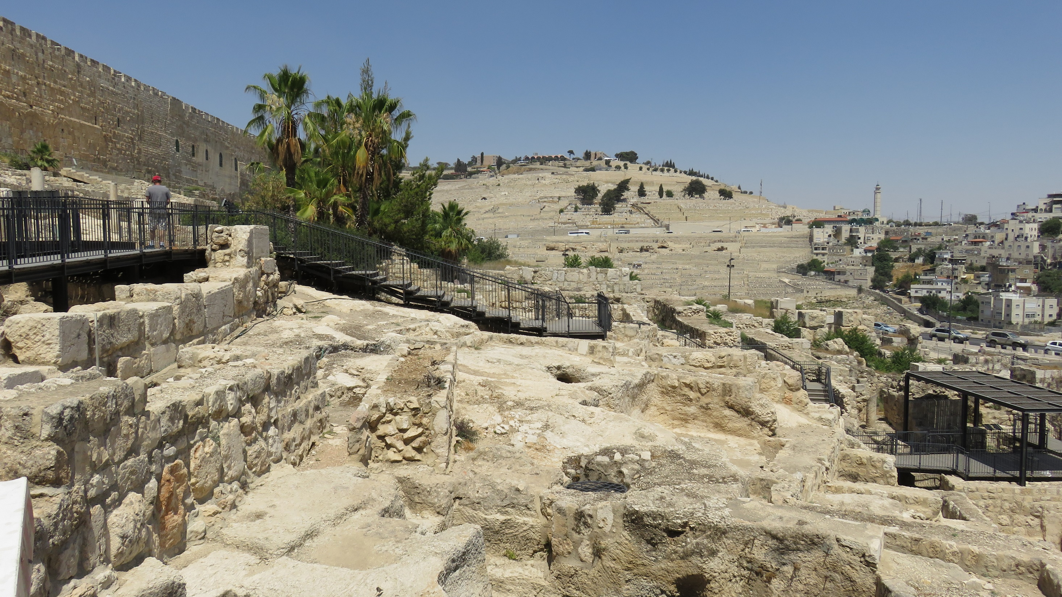

Slide 28
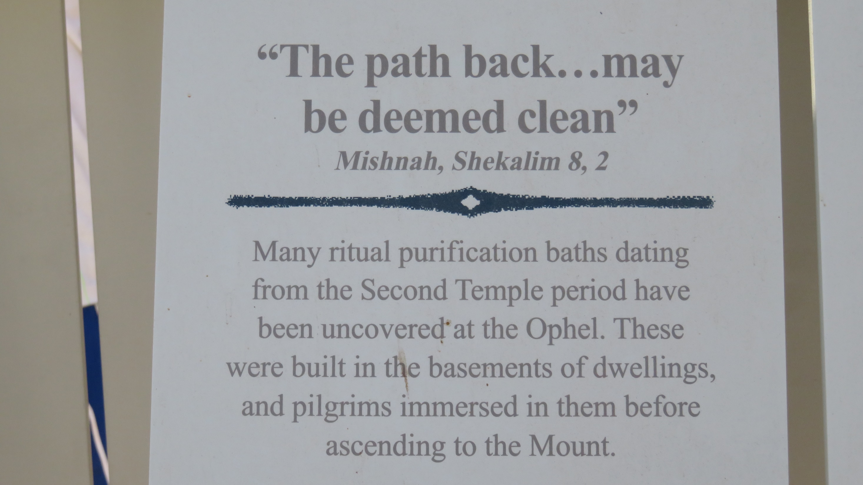

Slide 29
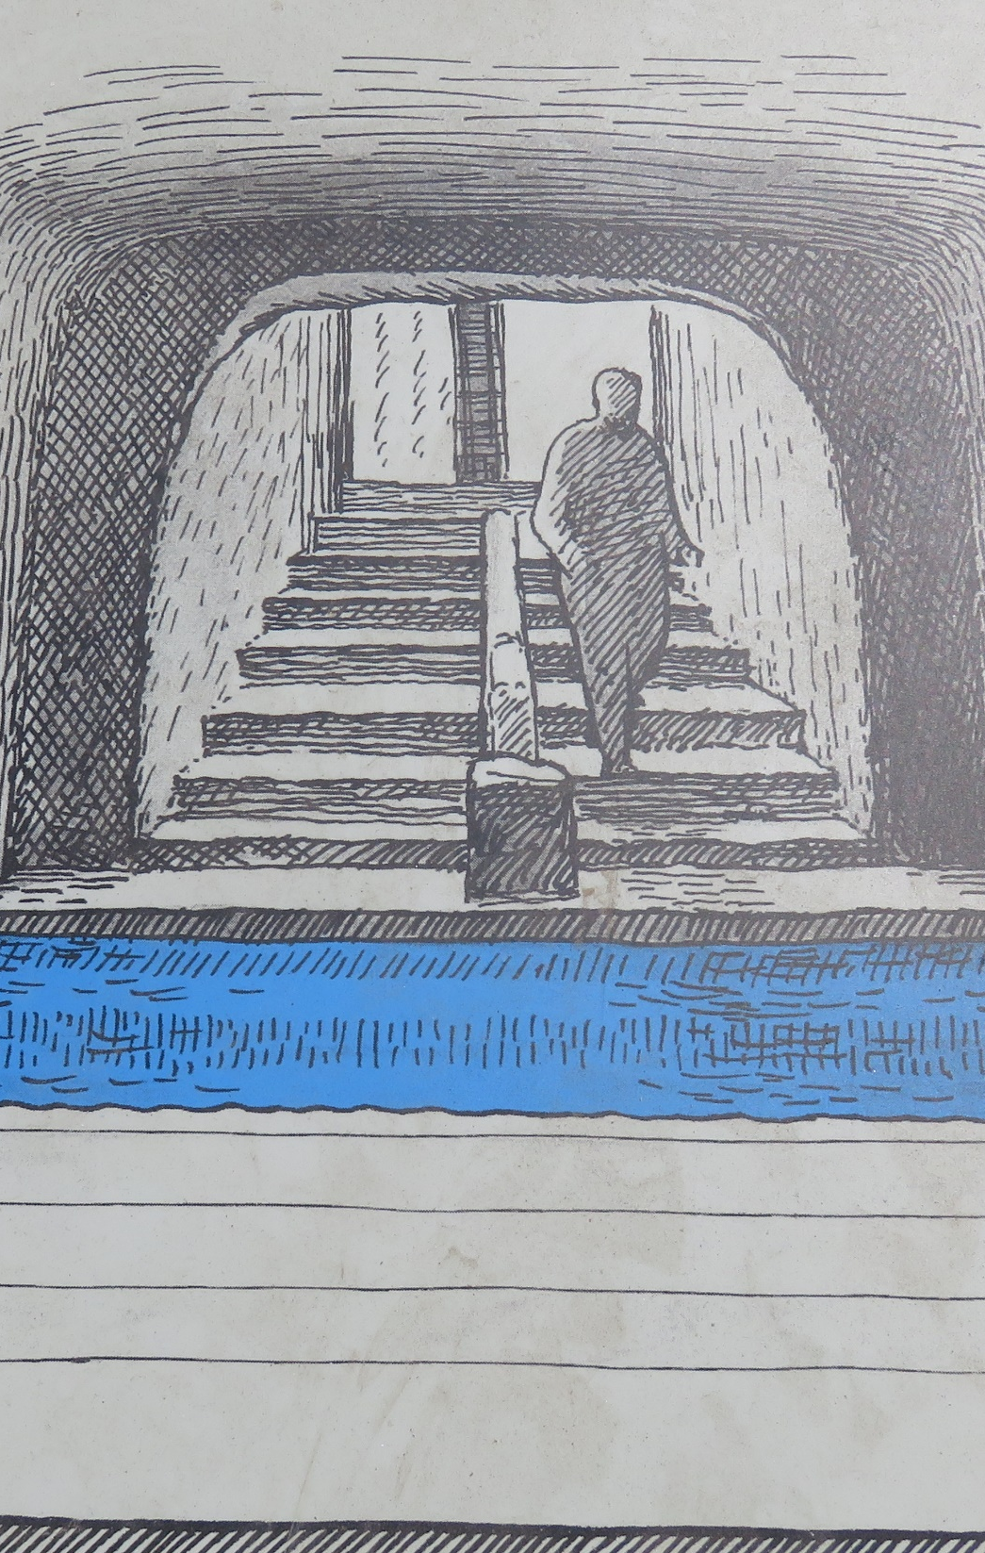
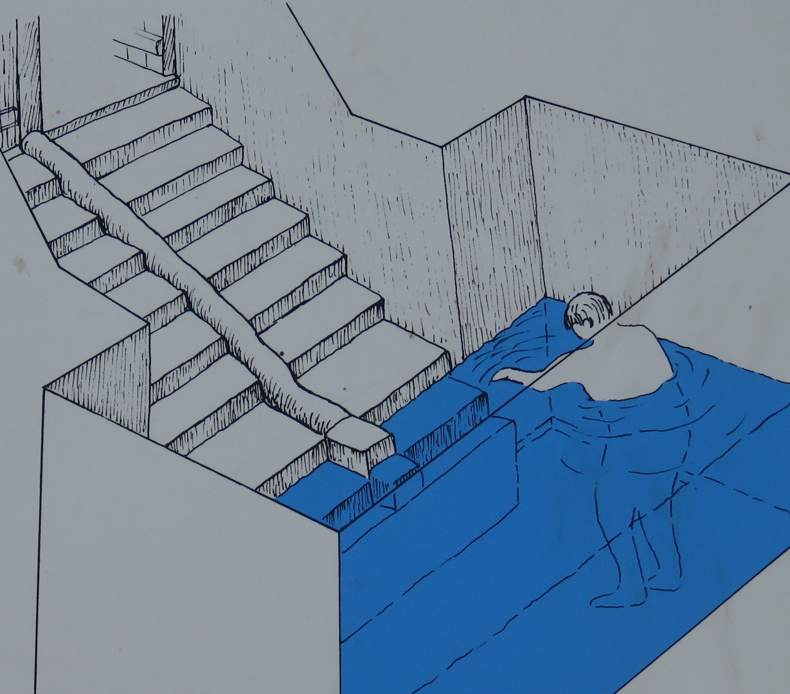

Slide 30
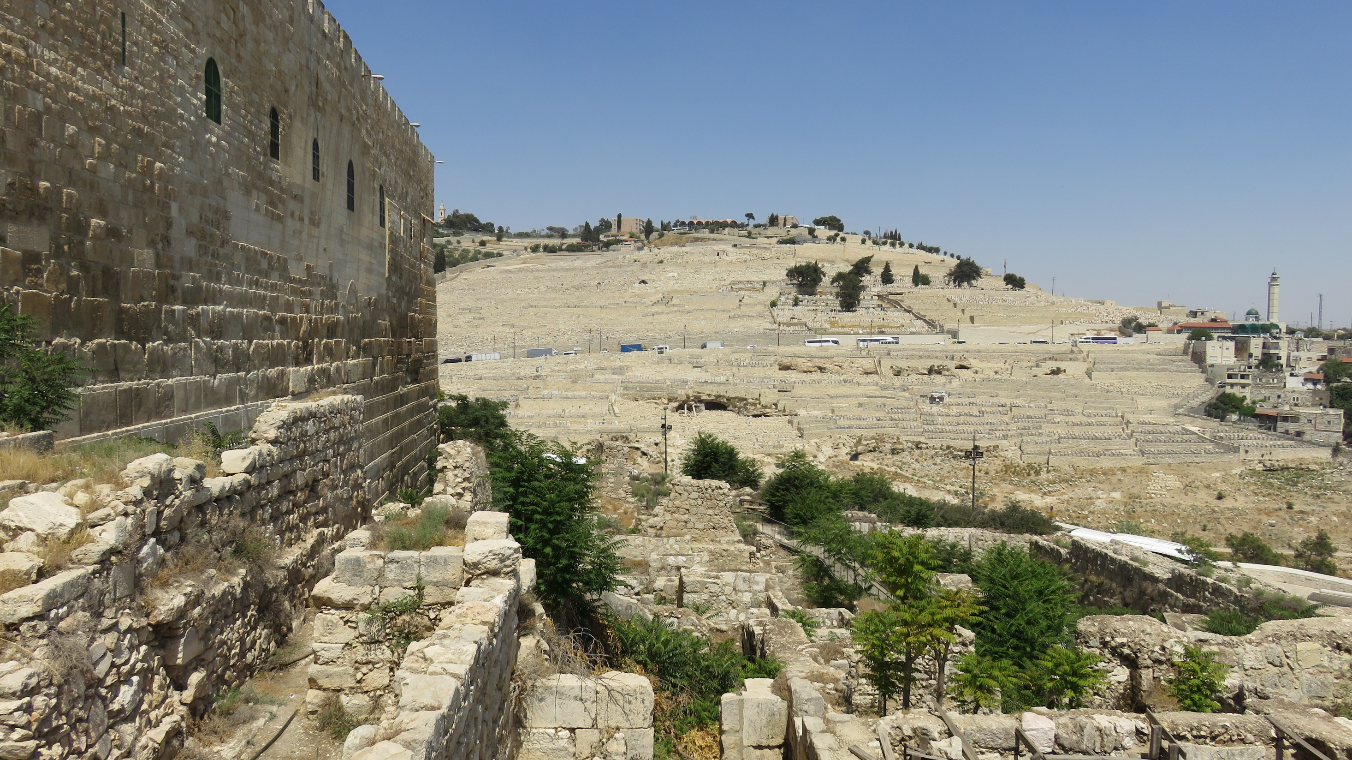

Slide 31
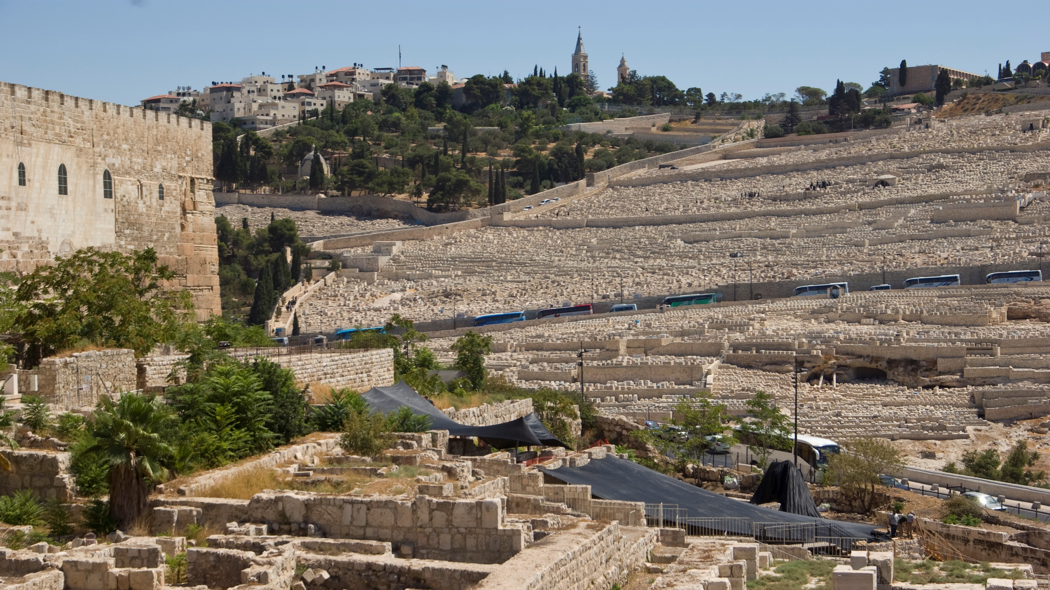

Slide 32
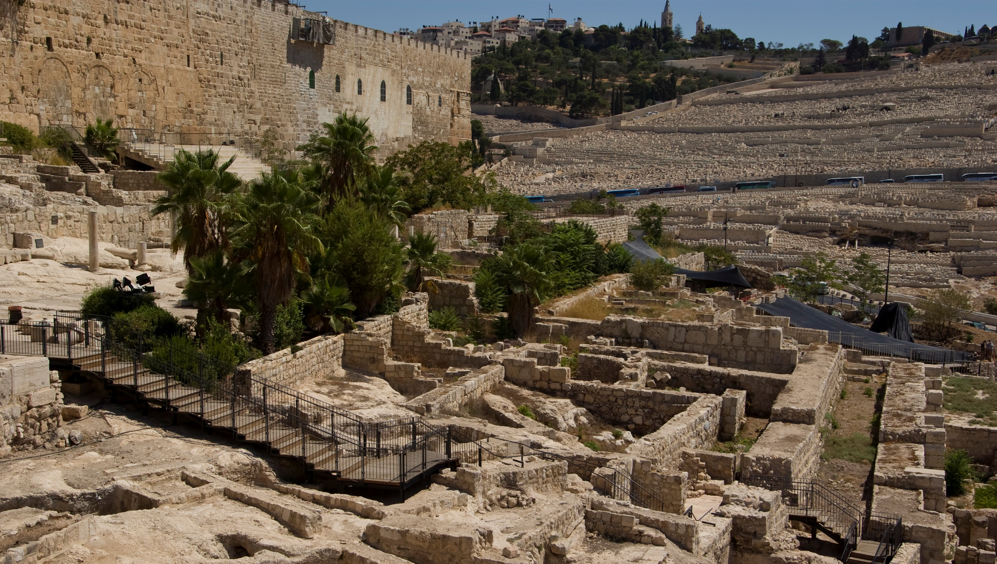

Slide 33
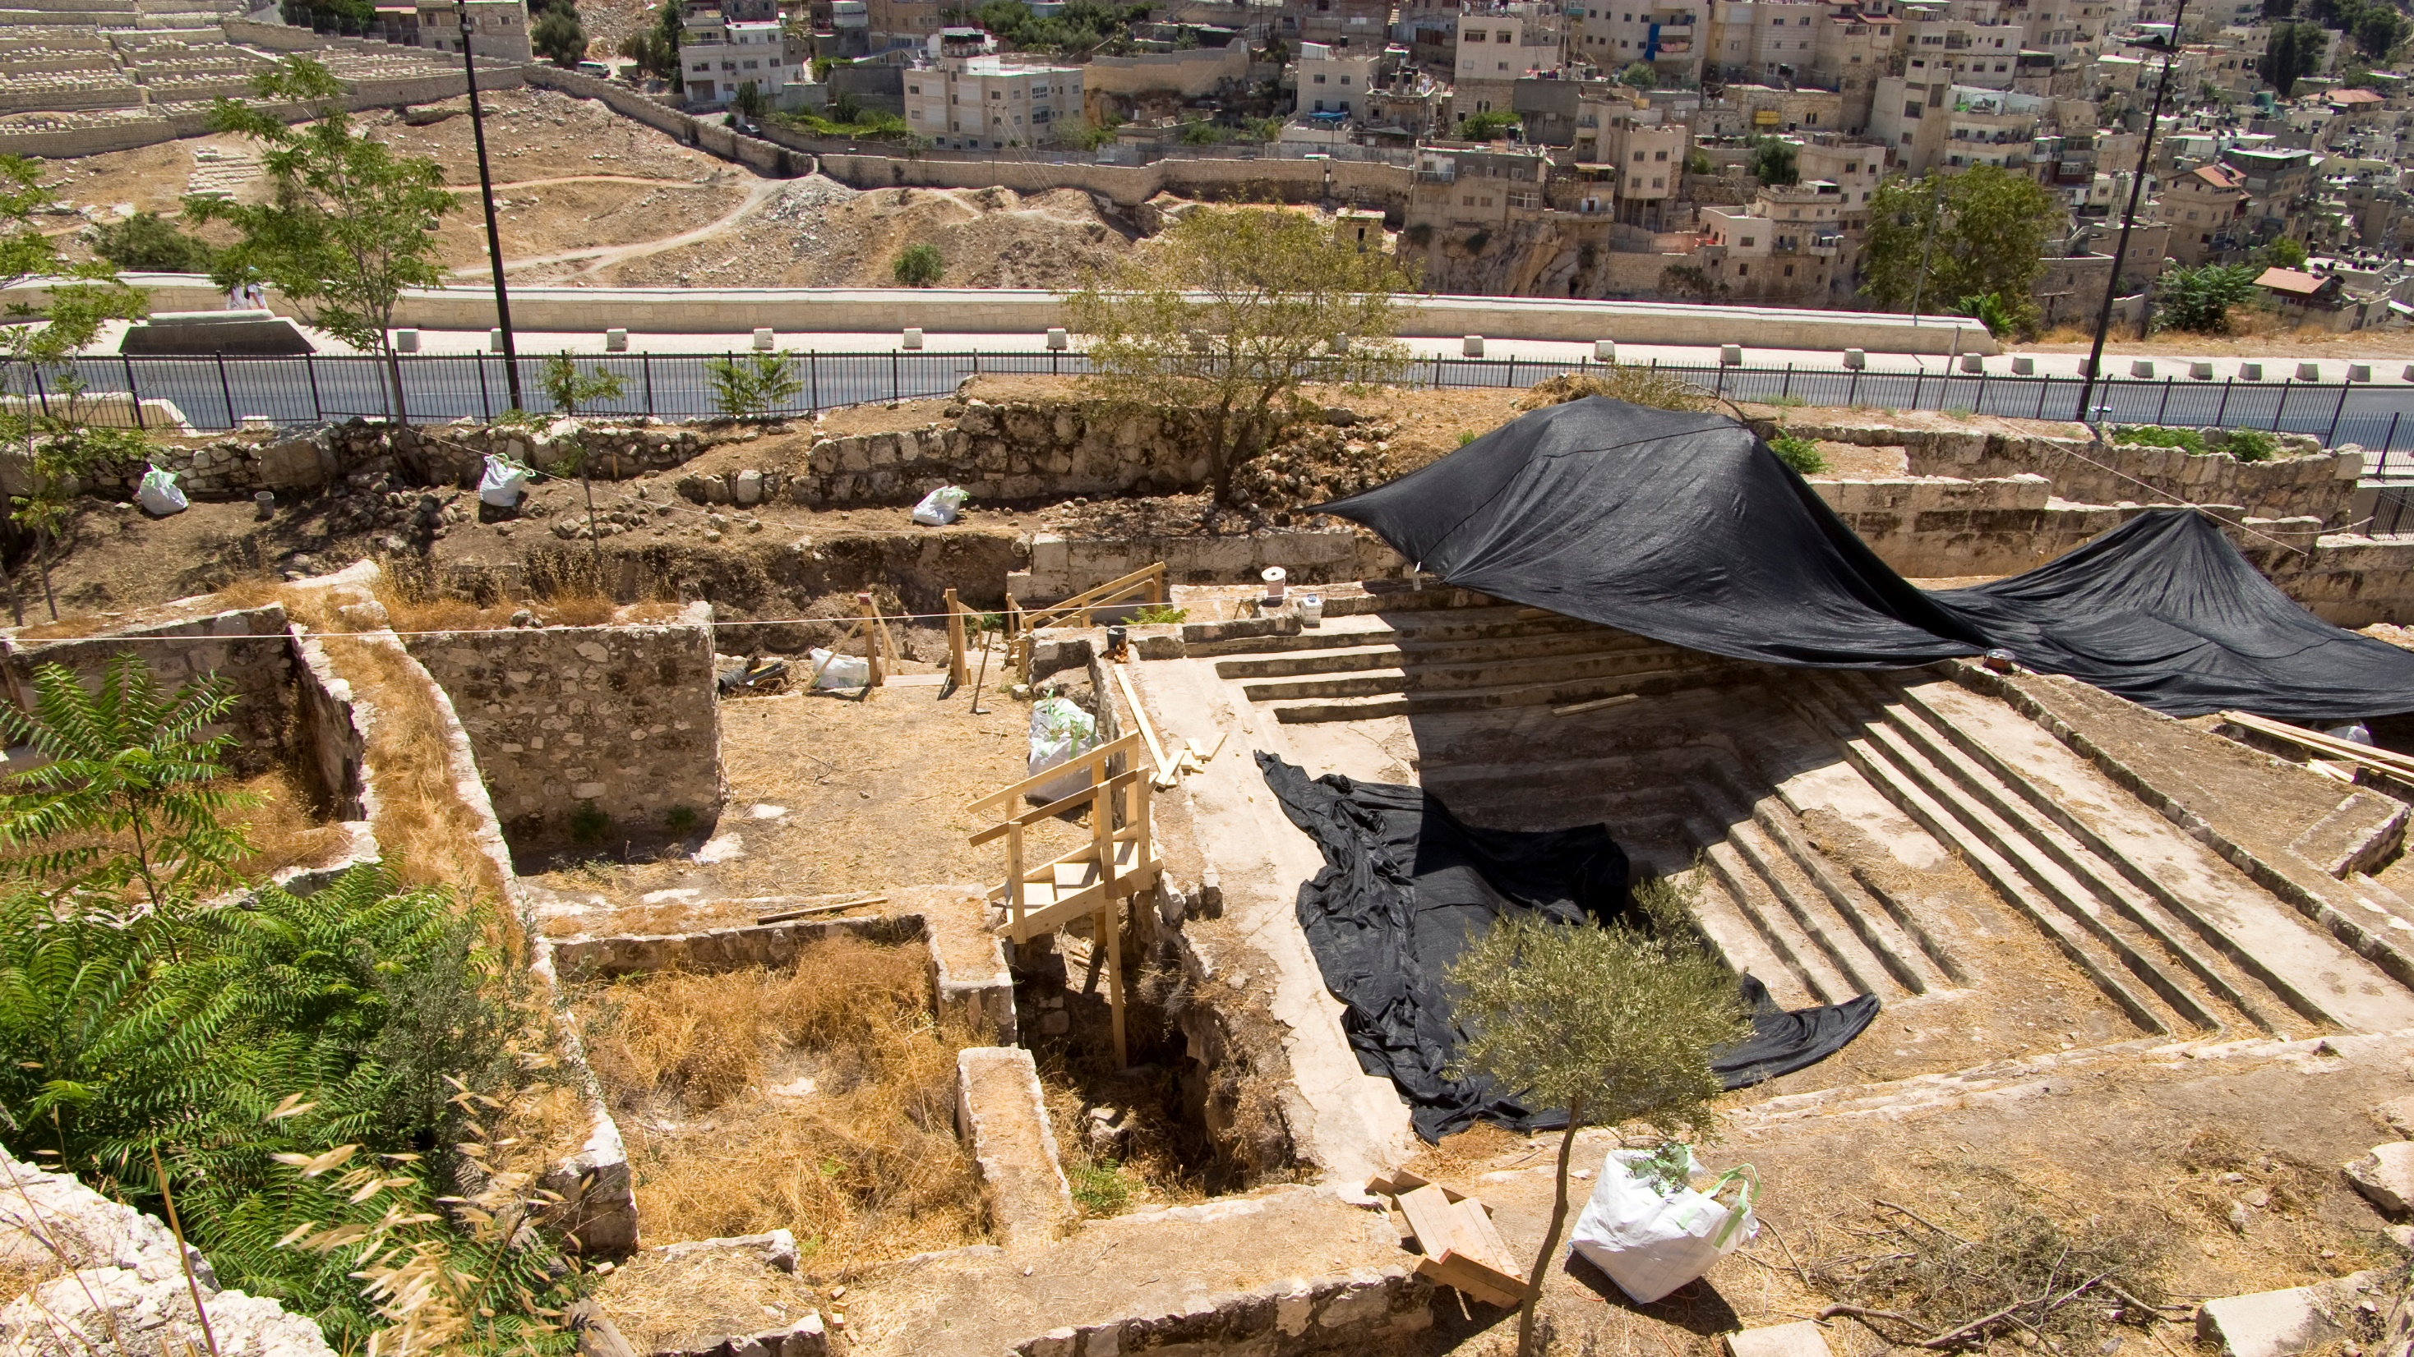

Slide 34
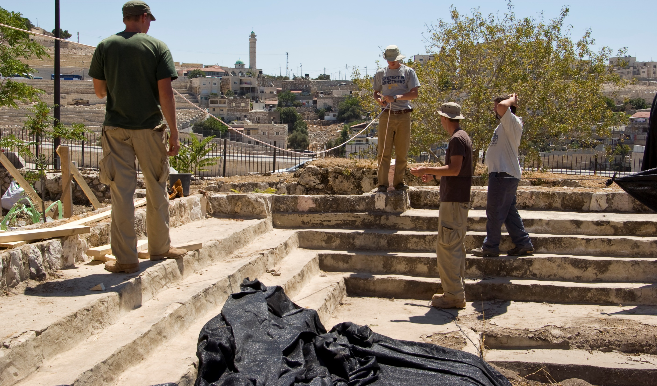
Four more steps down

Slide 35
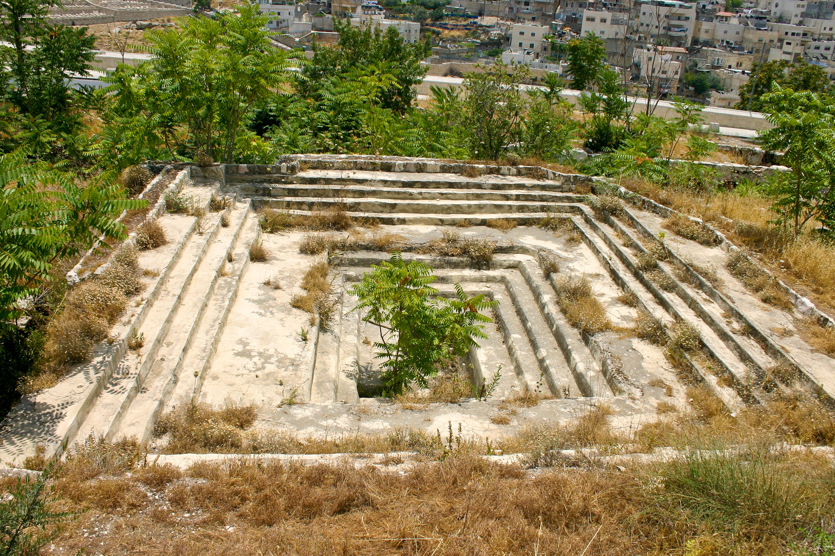
Room to baptize at least three people at a time

Slide 36
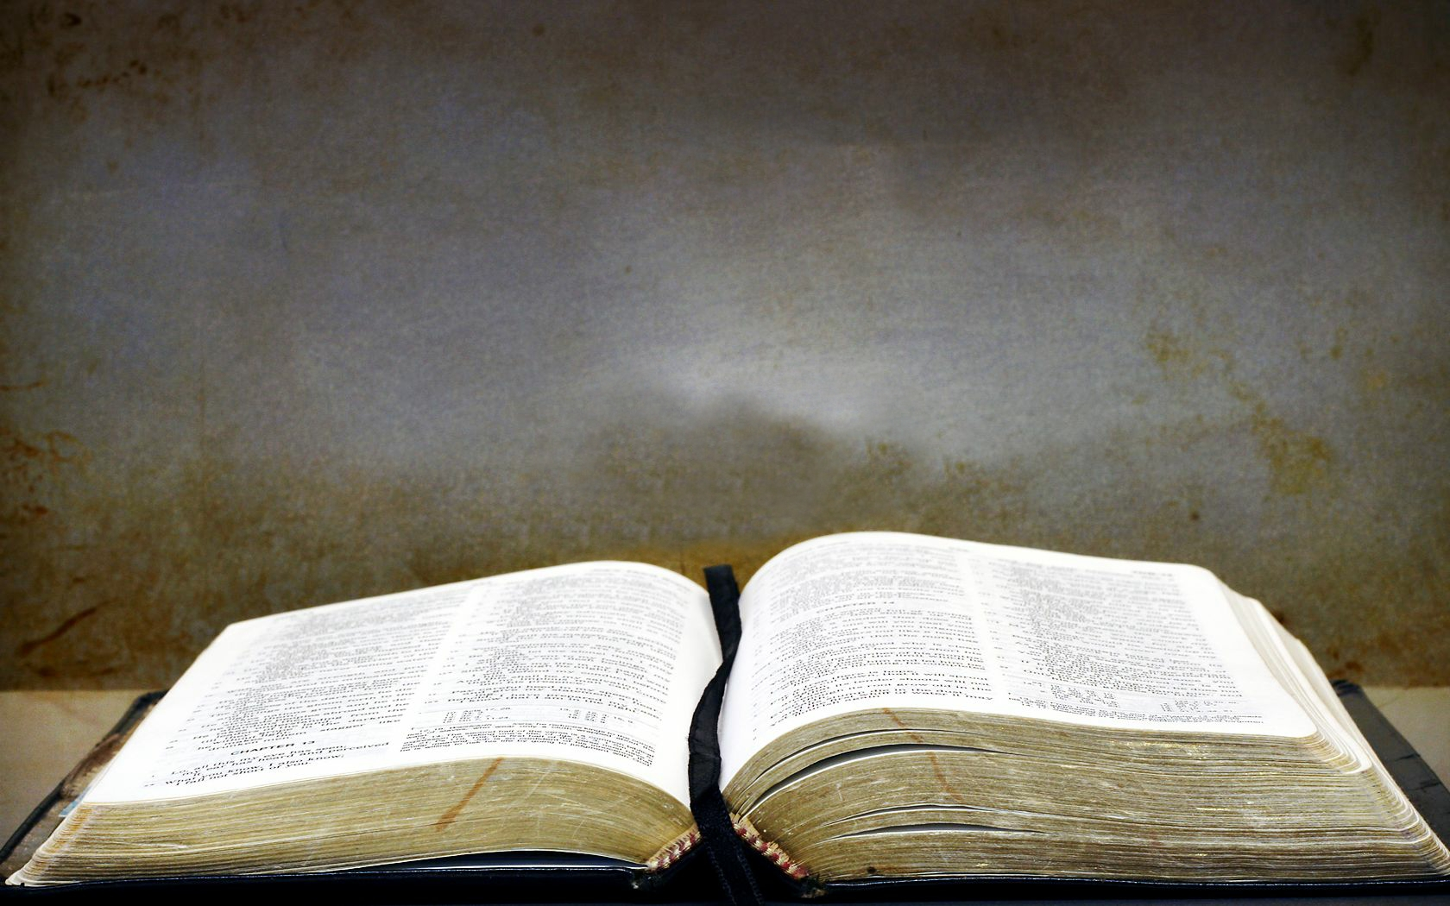
Acts 2:37f
They were pierced to the heart, and said to Peter and the rest of the apostles, "Brethren, what shall we do?" Peter said to them, "Repent, and each of you be baptized in the name of Jesus Christ for the forgiveness of your sins; and you will receive the gift of the Holy Spirit.

Slide 37
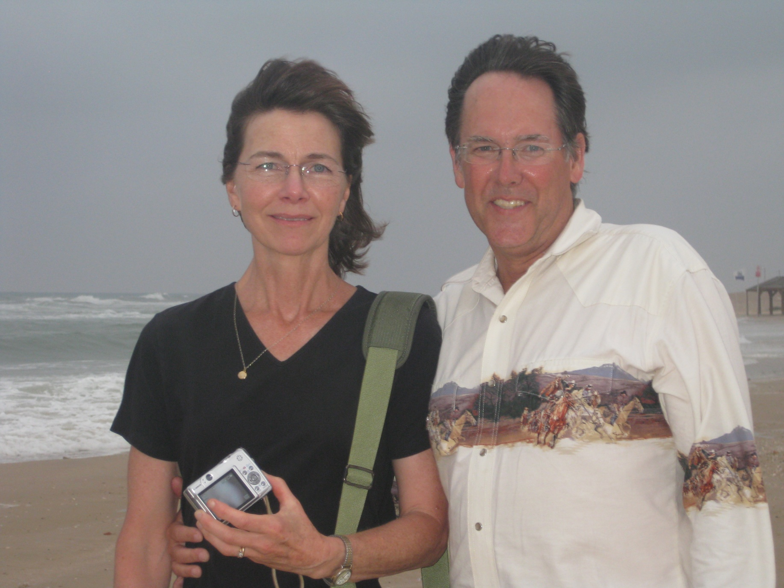

Slide 38
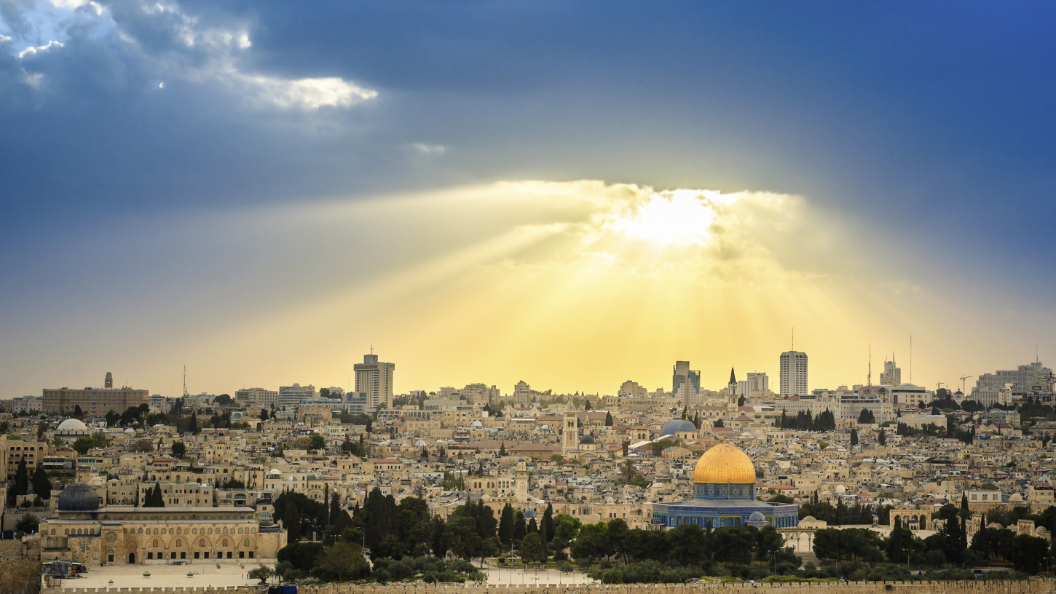
God be with you ‘til we meet again

