Slide 1
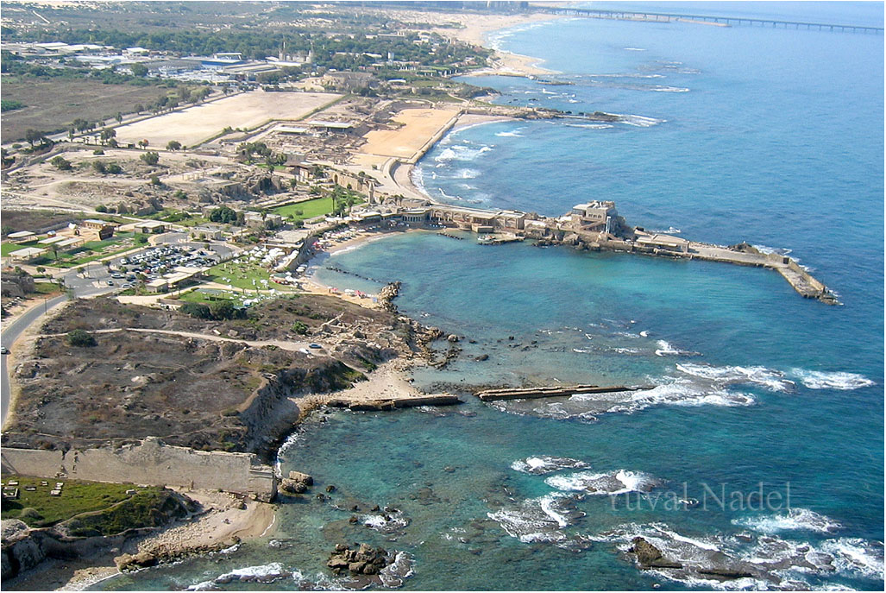
Caesarea Maritima - September 13, 2017

Slide 2
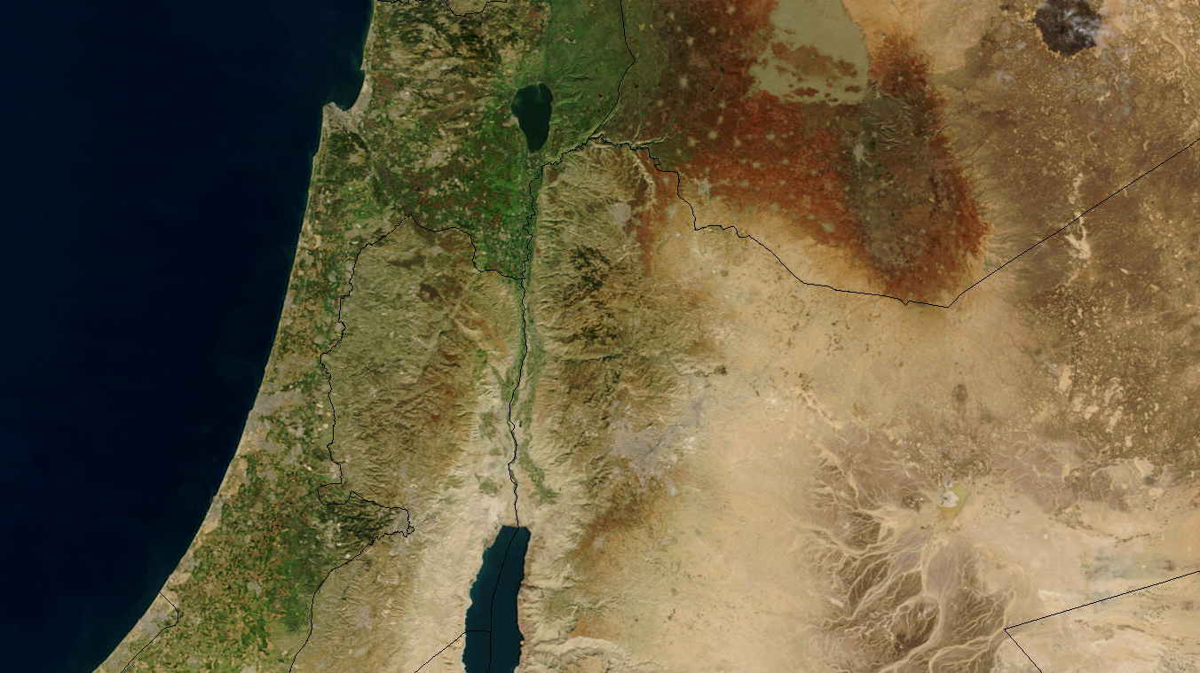
Jerusalem ?
Sorek & Elah Valleys ?
Philistines ?
Jezreel Valley ?
Capernaum ?

Slide 3
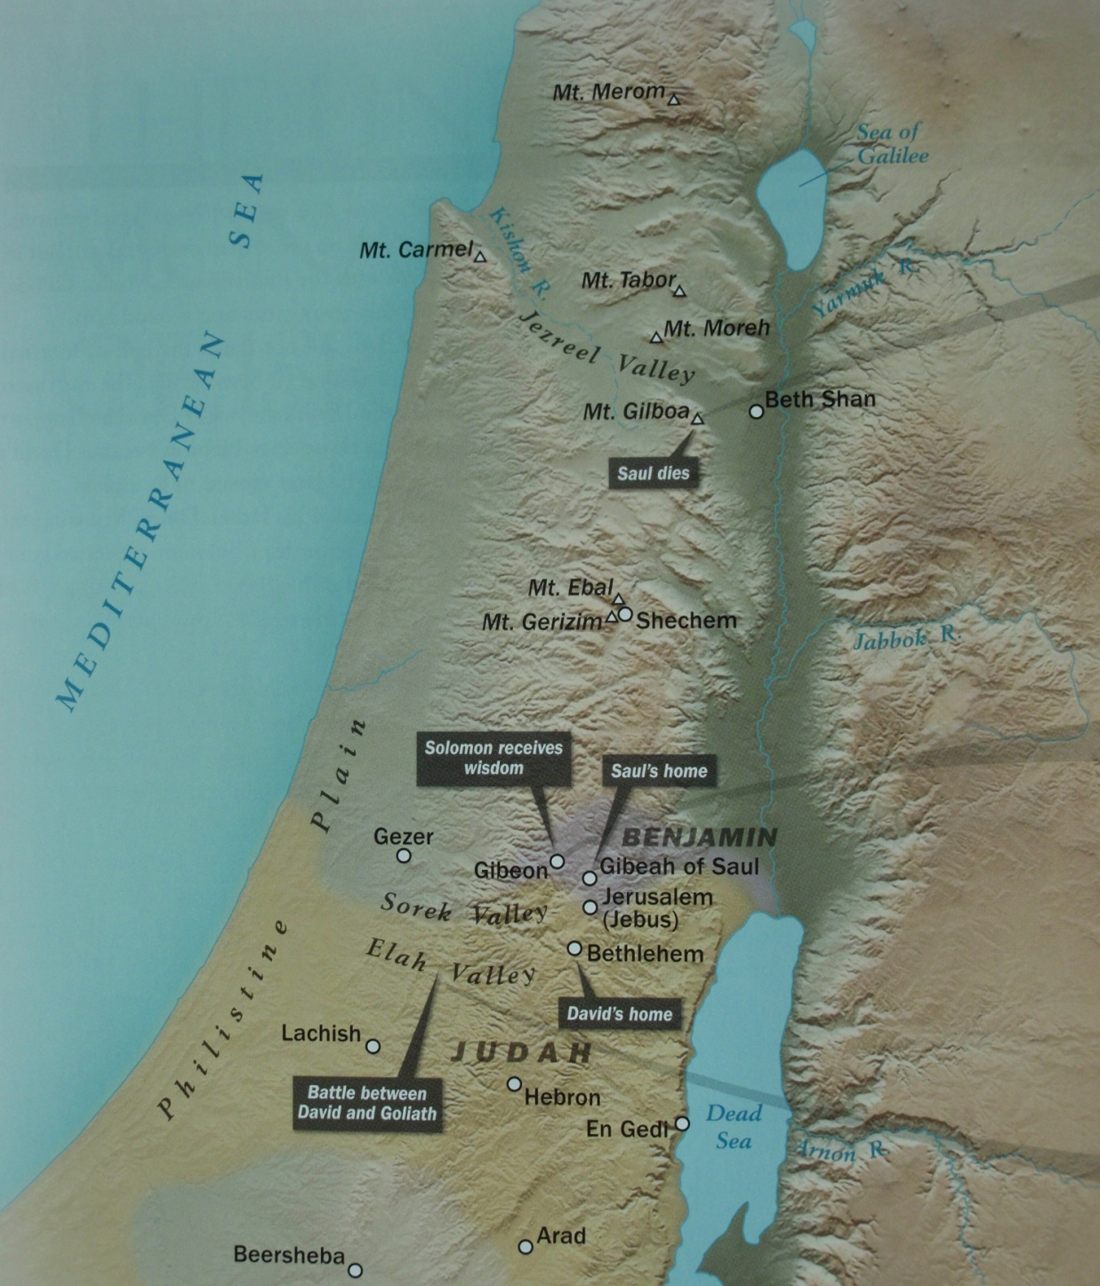
Galilee
Samaria
Judea

Slide 4

Acts 8:36-40
As they went along the road they came to some water; and the eunuch said, "Look! Water! What prevents me from being baptized?" And he ordered the chariot to stop; and they both went down into the water, Philip as well as the eunuch, and he baptized him. When they came up out of the water, the Spirit of the Lord snatched Philip away; and the eunuch no longer saw him, but went on his way rejoicing. But Philip found himself at Azotus, and as he passed through he kept preaching the gospel to all the cities until he came to Caesarea.

Slide 5
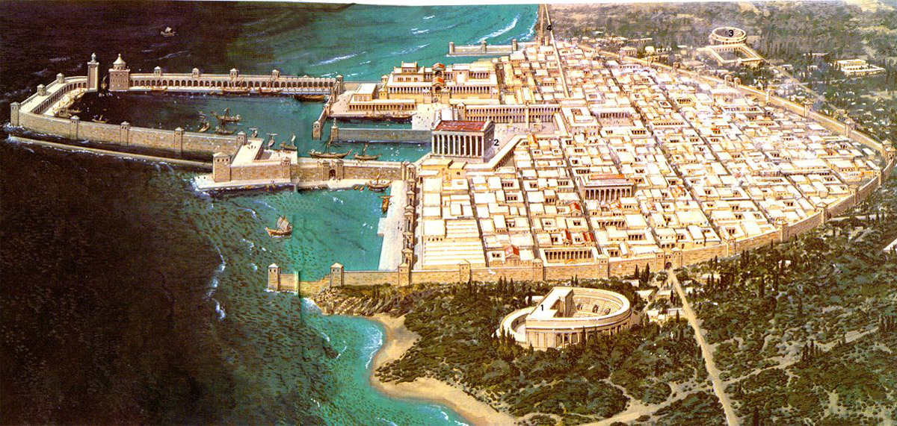

Slide 6
Acts 9:26-30
When Paul came to Jerusalem, he was trying to associate with the disciples; but they were all afraid, not believing he was a disciple. But Barnabas brought him to the apostles and described how he had seen the Lord, and had spoken out boldly in the name of Jesus. He was moving about freely in Jerusalem, speaking boldly in the name of the Lord. He was arguing with the Hellenistic Jews; but they were attempting to put him to death. When the brethren learned of it, they brought him down to Caesarea and sent him away to Tarsus.

Slide 7
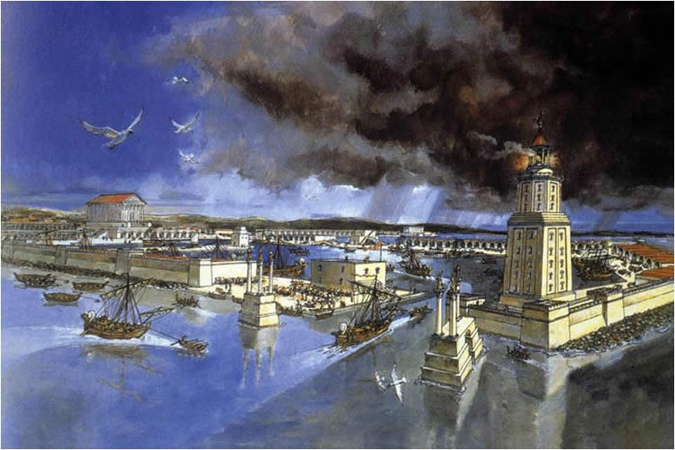

Slide 8
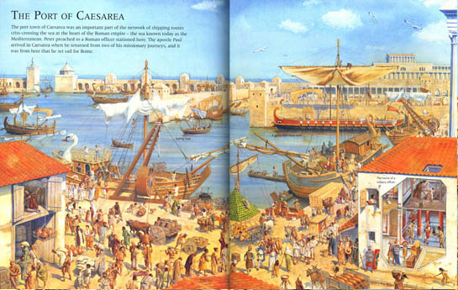

Slide 9
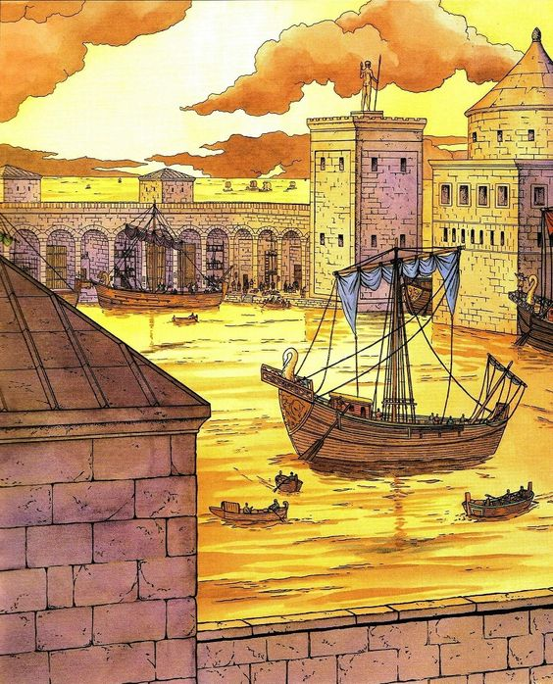

Slide 10
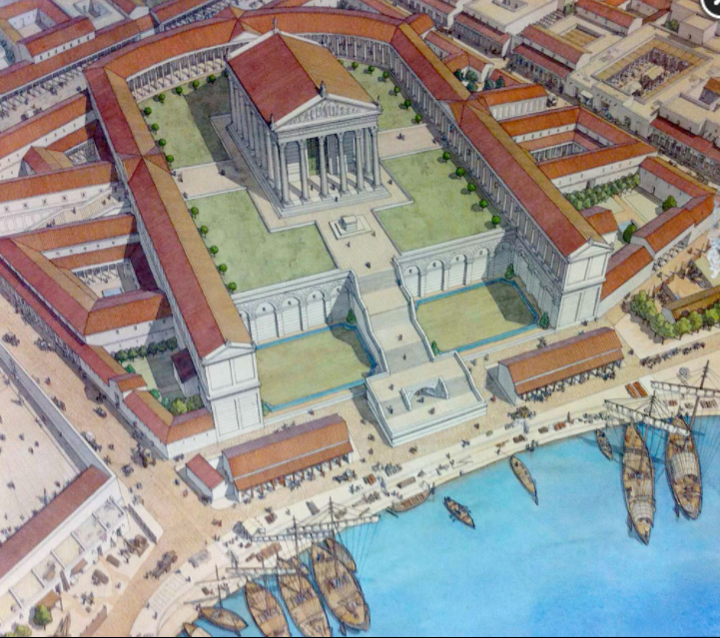

Slide 11
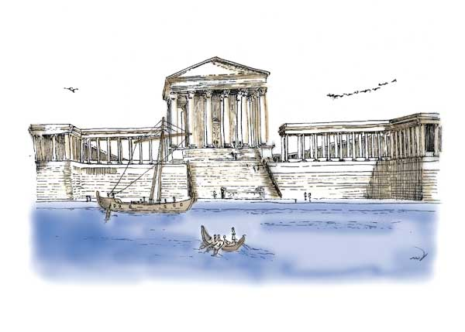

Slide 12
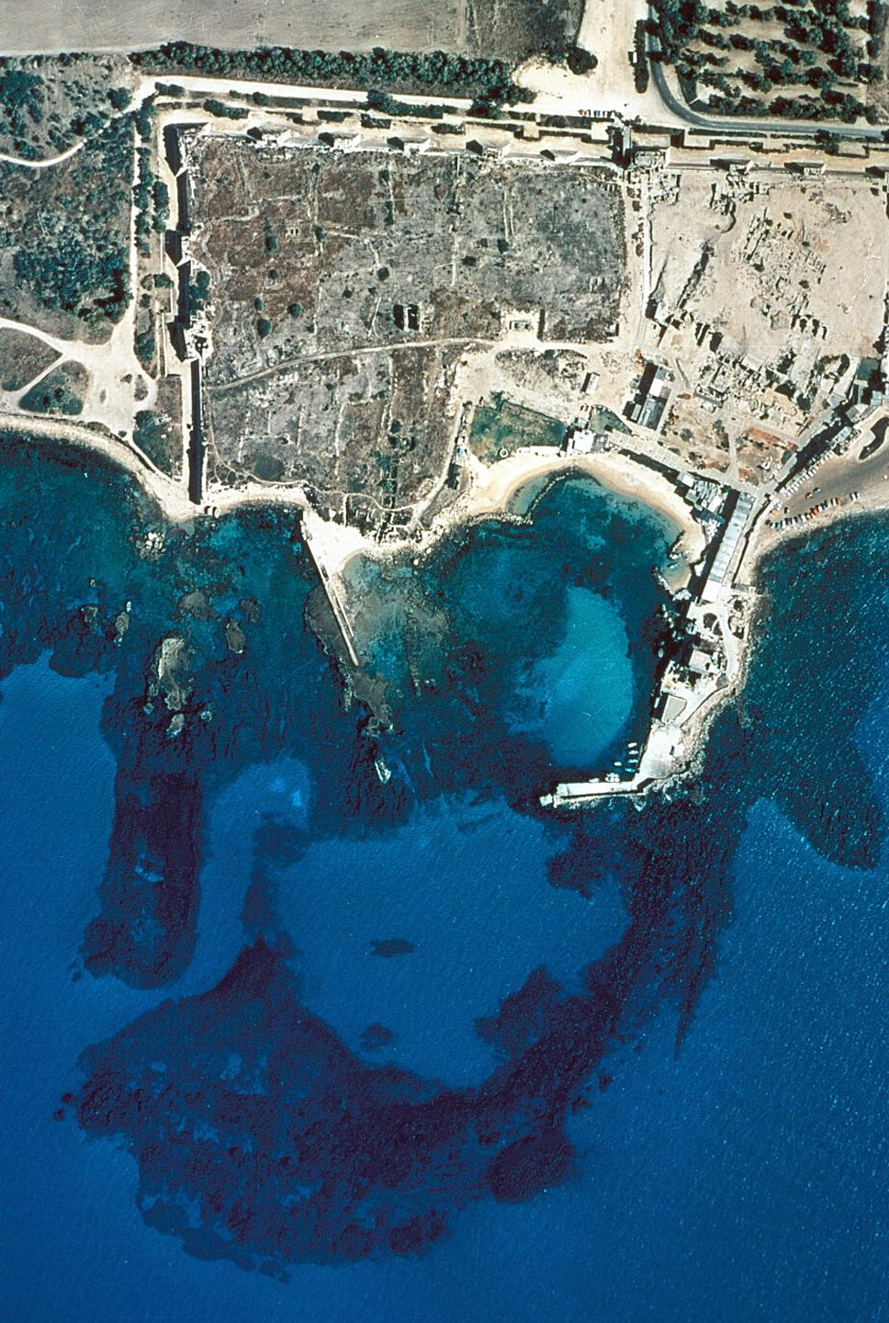

Slide 13
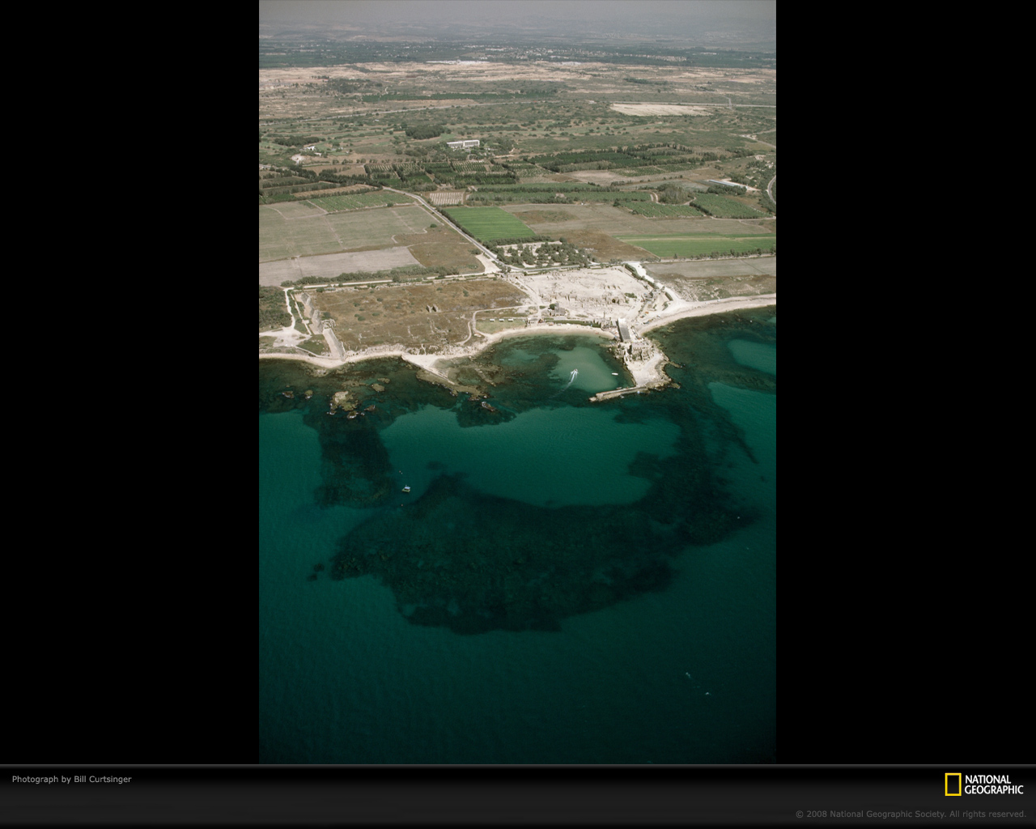

Slide 14
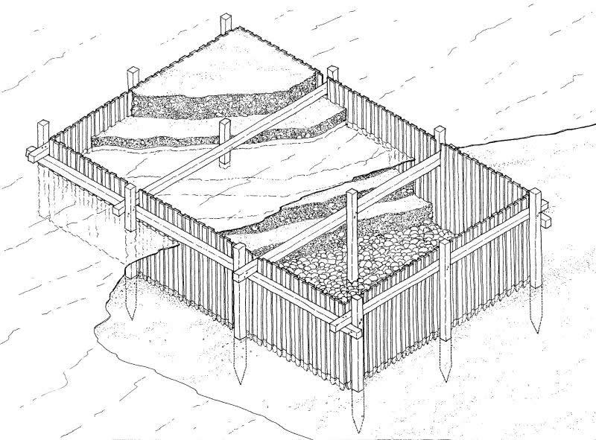

Slide 15
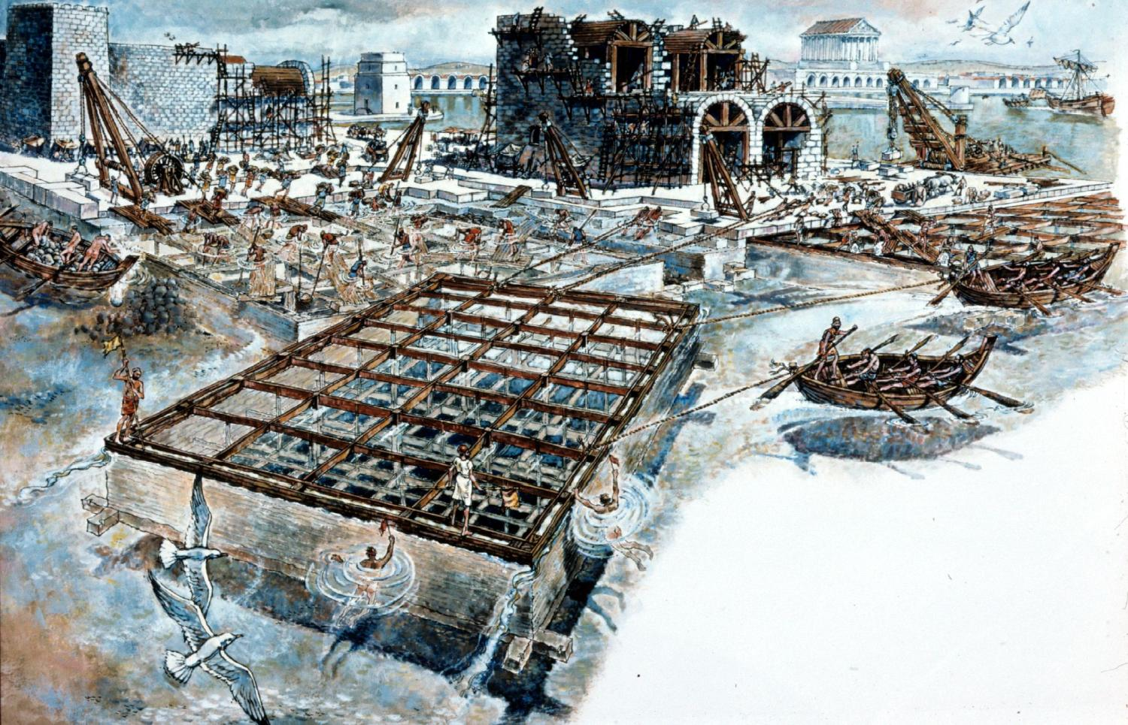

Slide 16
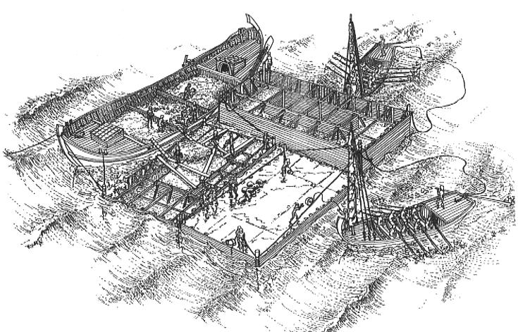

Slide 17
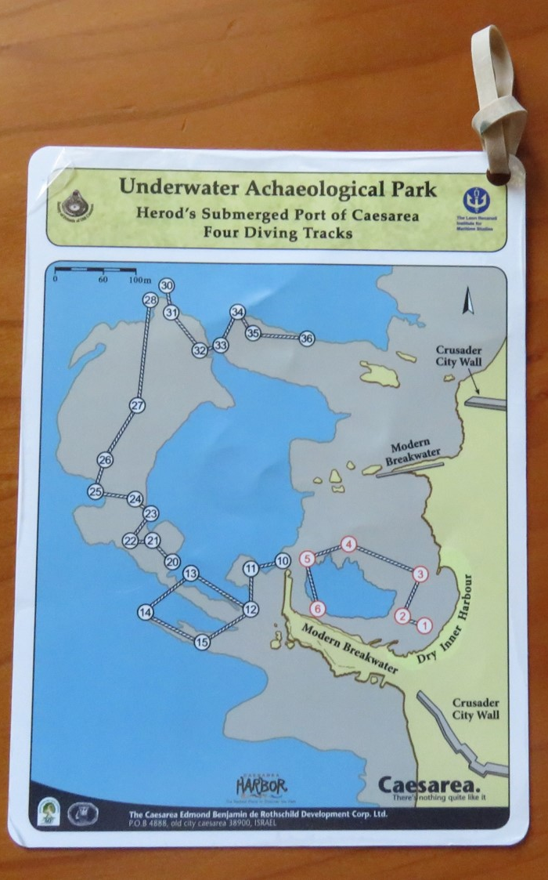
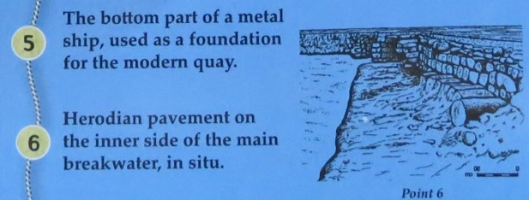

Slide 18
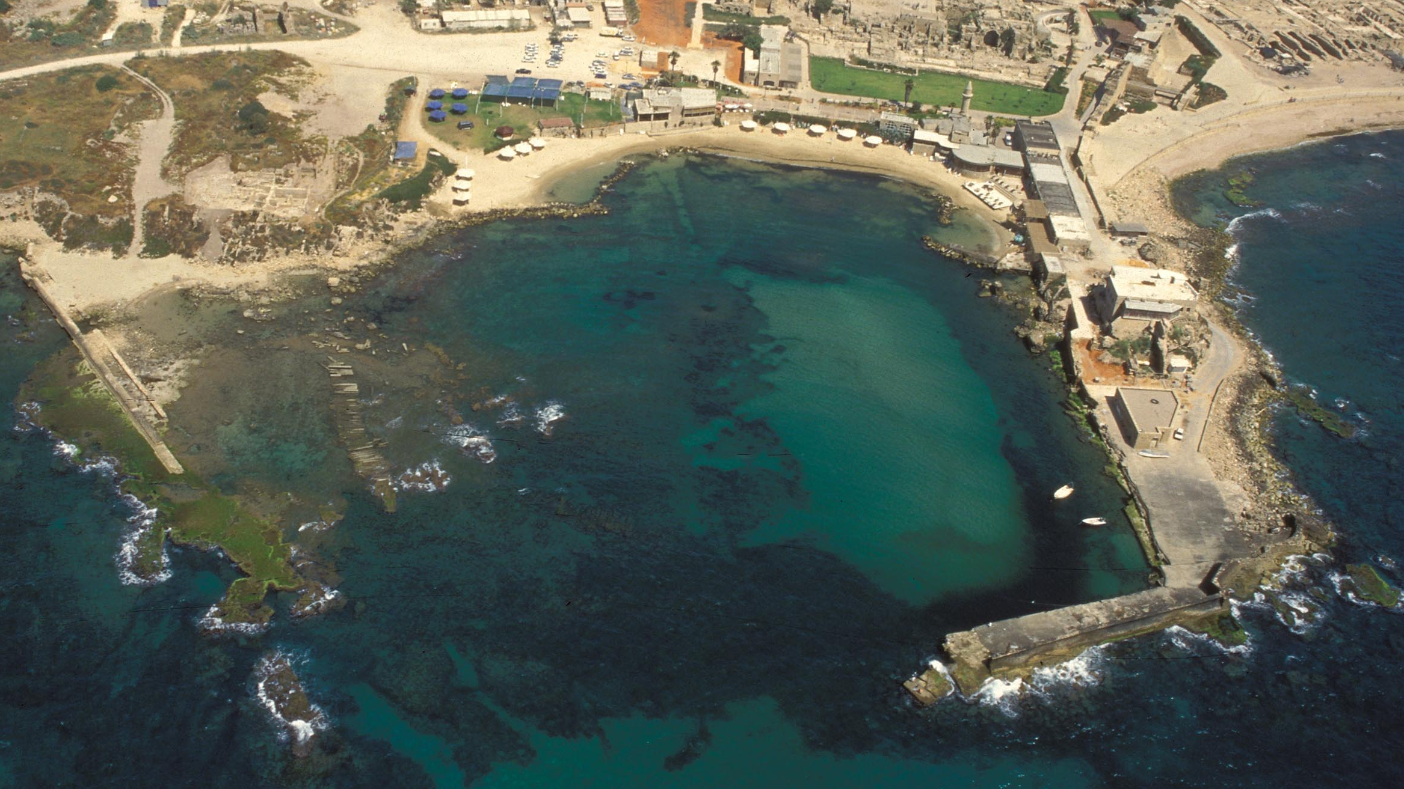

Slide 19
Acts 10 Excerpts
There was a man at Caesarea named Cornelius, a centurion and he said to him, "Your prayers and alms have ascended as a memorial before God. Now dispatch men to Joppa and send for a man named Peter; he is staying with a tanner named Simon, whose house is by the sea…” On the following day he entered Caesarea… While Peter was still speaking these words, the Holy Spirit fell upon all those who were listening. The circumcised believers were amazed, because the gift of the Holy Spirit had been poured out on the Gentiles also. Then Peter answered, "Surely no one can refuse the water for these to be baptized who have received the Holy Spirit just as we did, can he?“ And he ordered them to be baptized in the name of Jesus Christ.

Slide 20
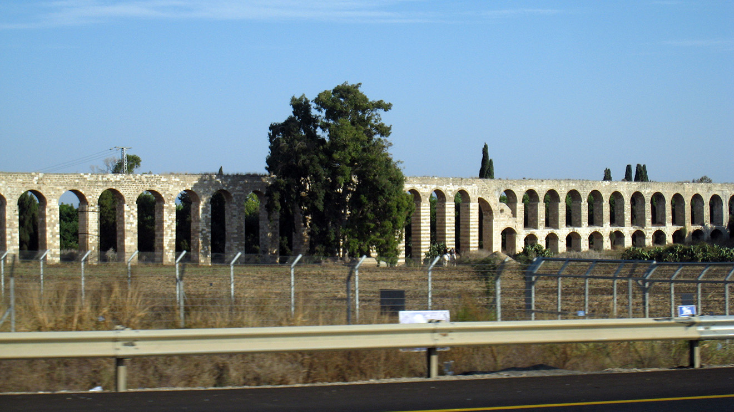

Slide 21
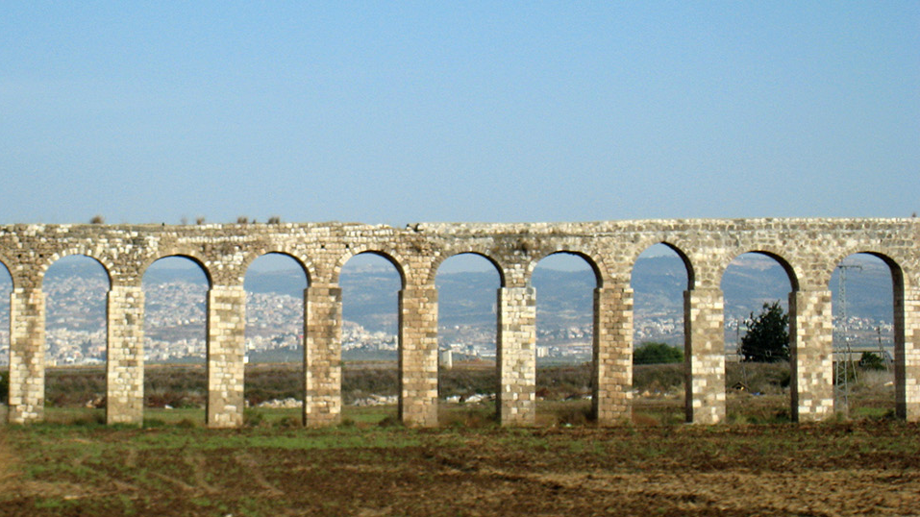

Slide 22
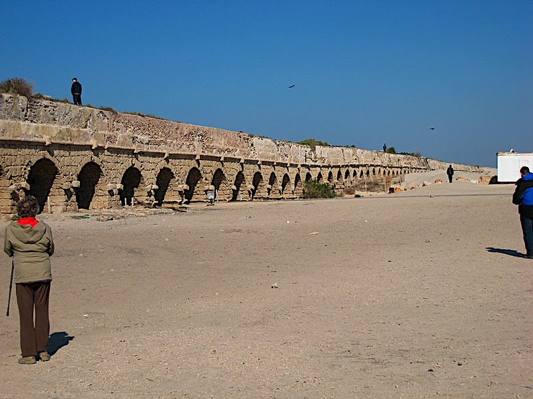

Slide 23
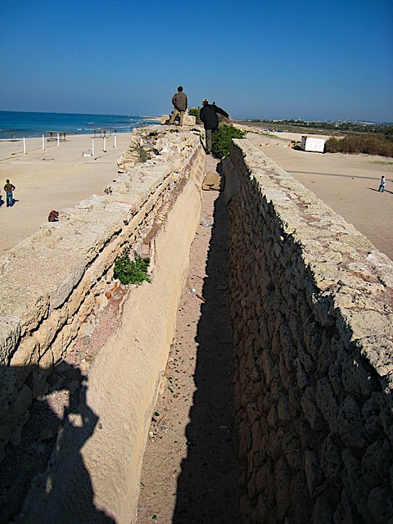

Slide 24
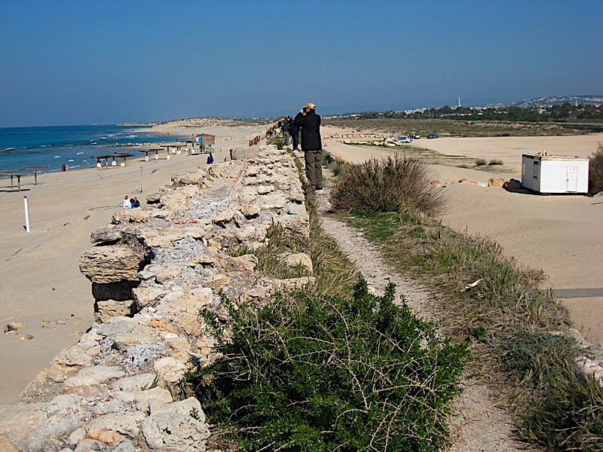

Slide 25
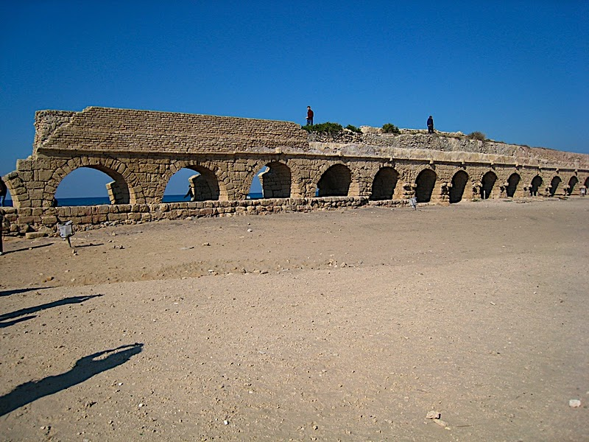

Slide 26
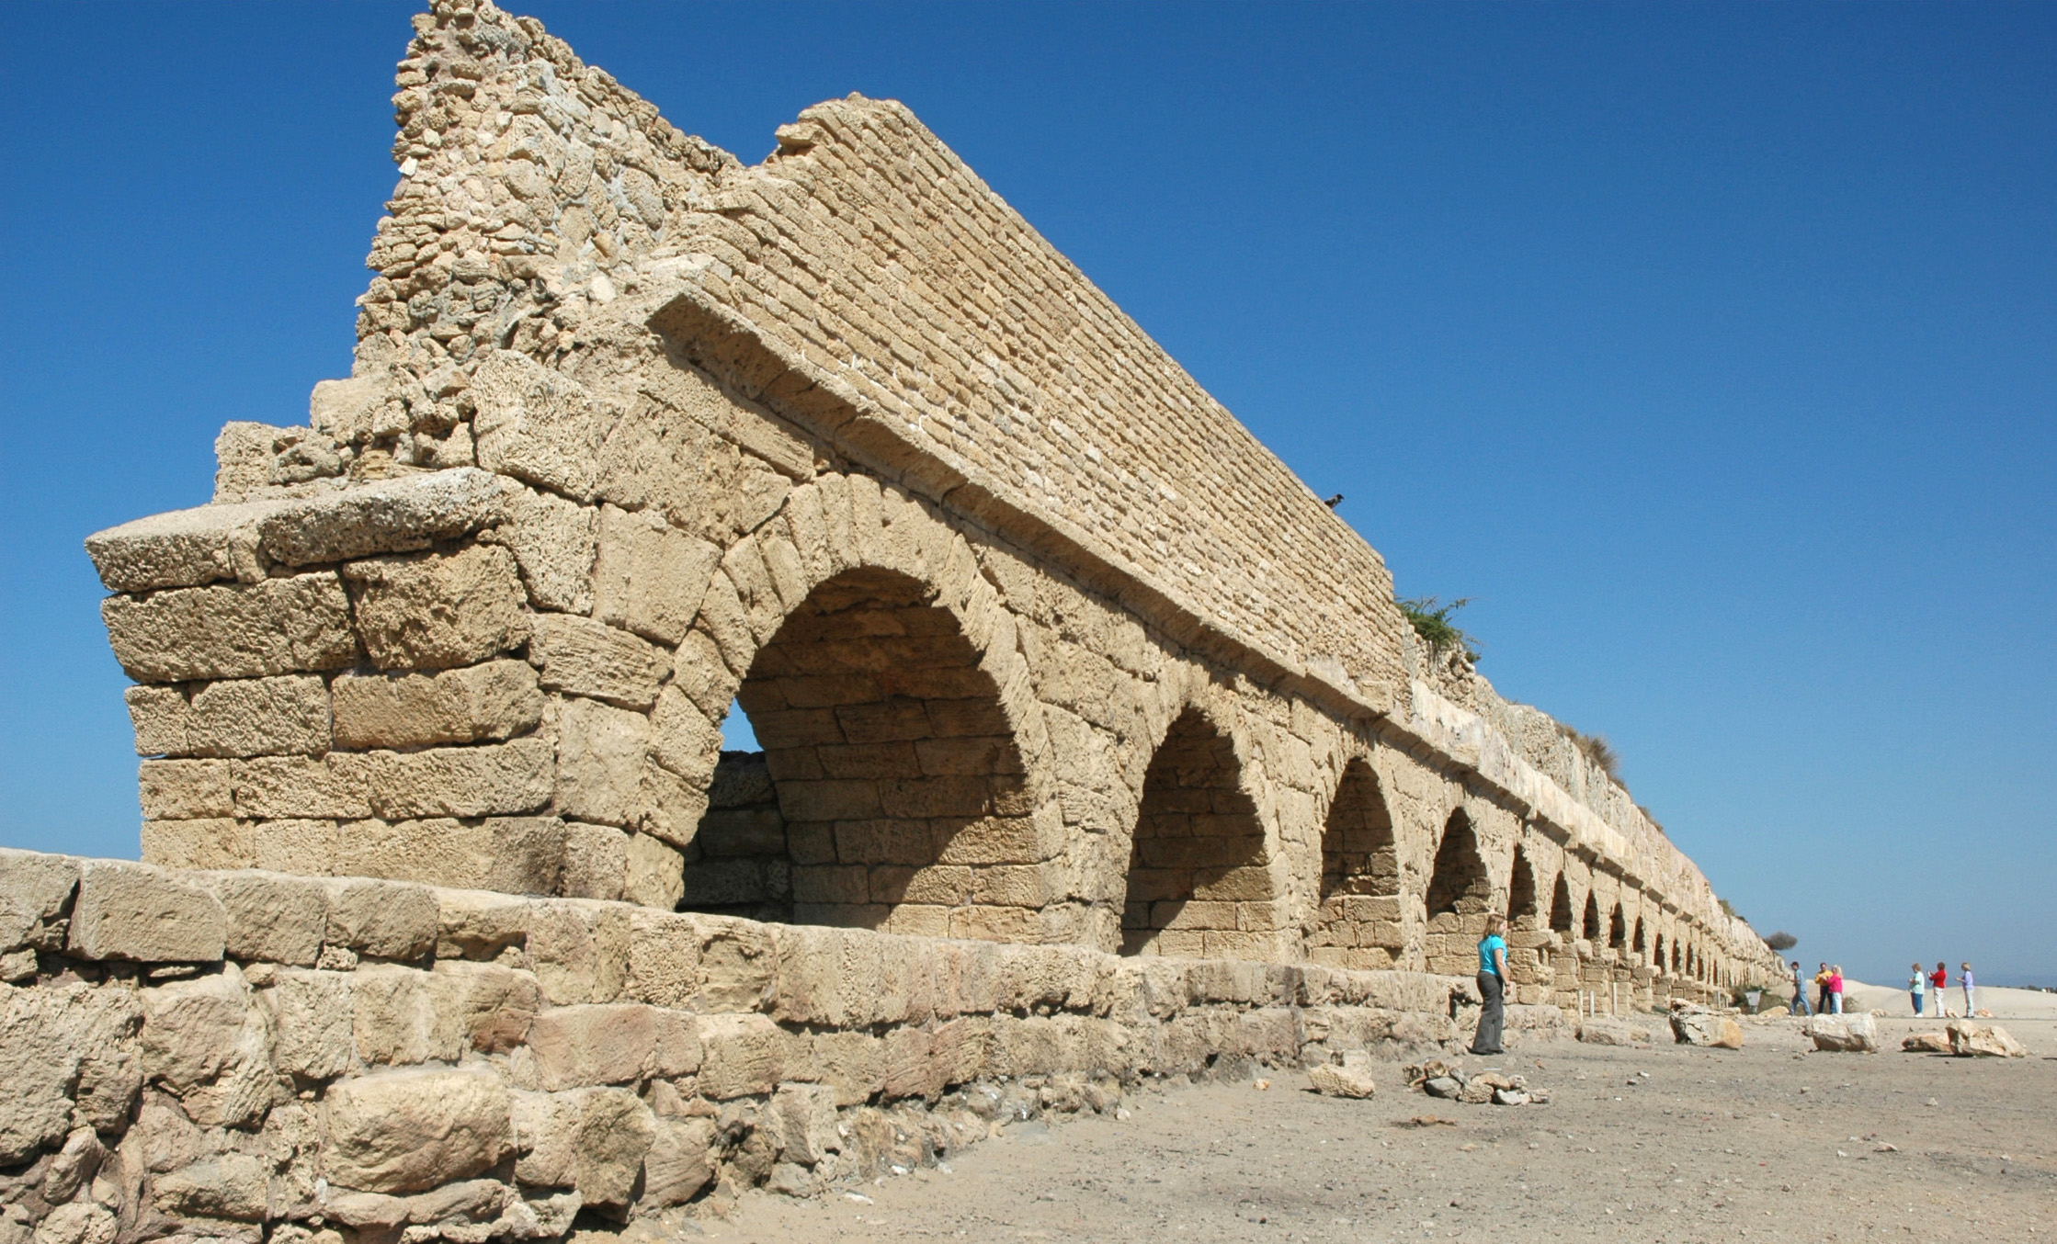

Slide 27
Acts 12 Excerpts
Herod (Agrippa I – grandson of Herod the great) went from Judea to Caesarea and was spending time there…. On an appointed day Herod, having put on his royal apparel, took his seat on the rostrum and began delivering an address to them. The people kept crying out, "The voice of a god and not of a man!" And immediately an angel of the Lord struck him because he did not give God the glory, and he was eaten by worms and died.

Slide 28
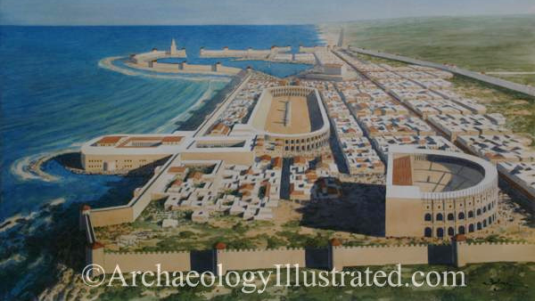

Slide 29
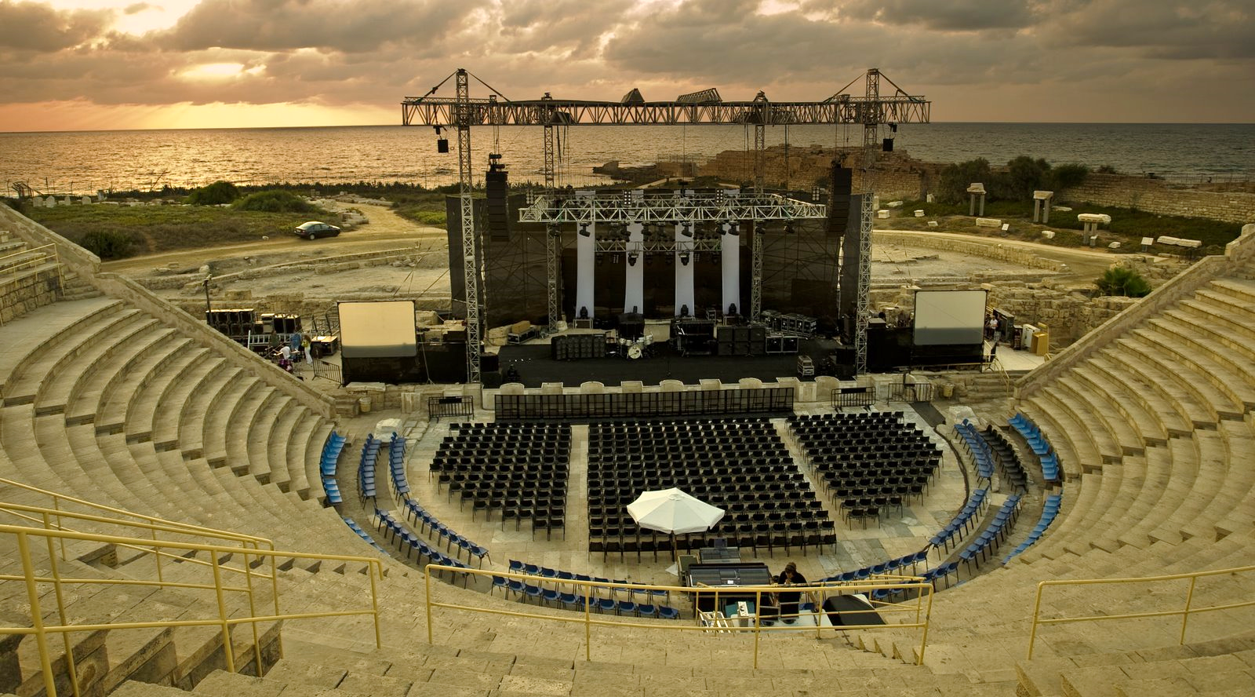
Seats 3,500

Slide 30
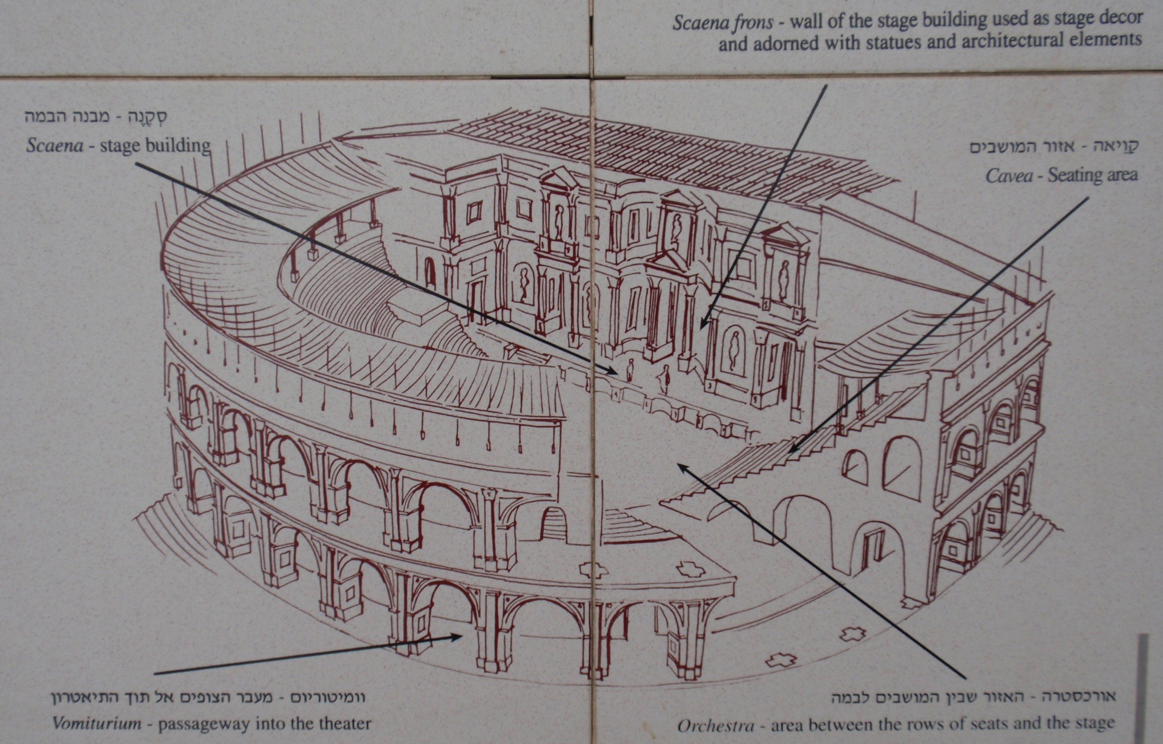

Slide 31
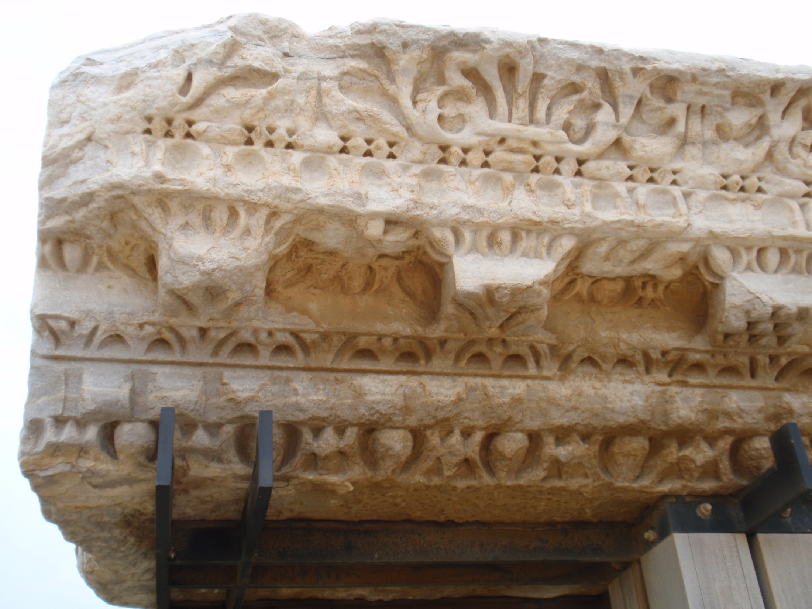

Slide 32
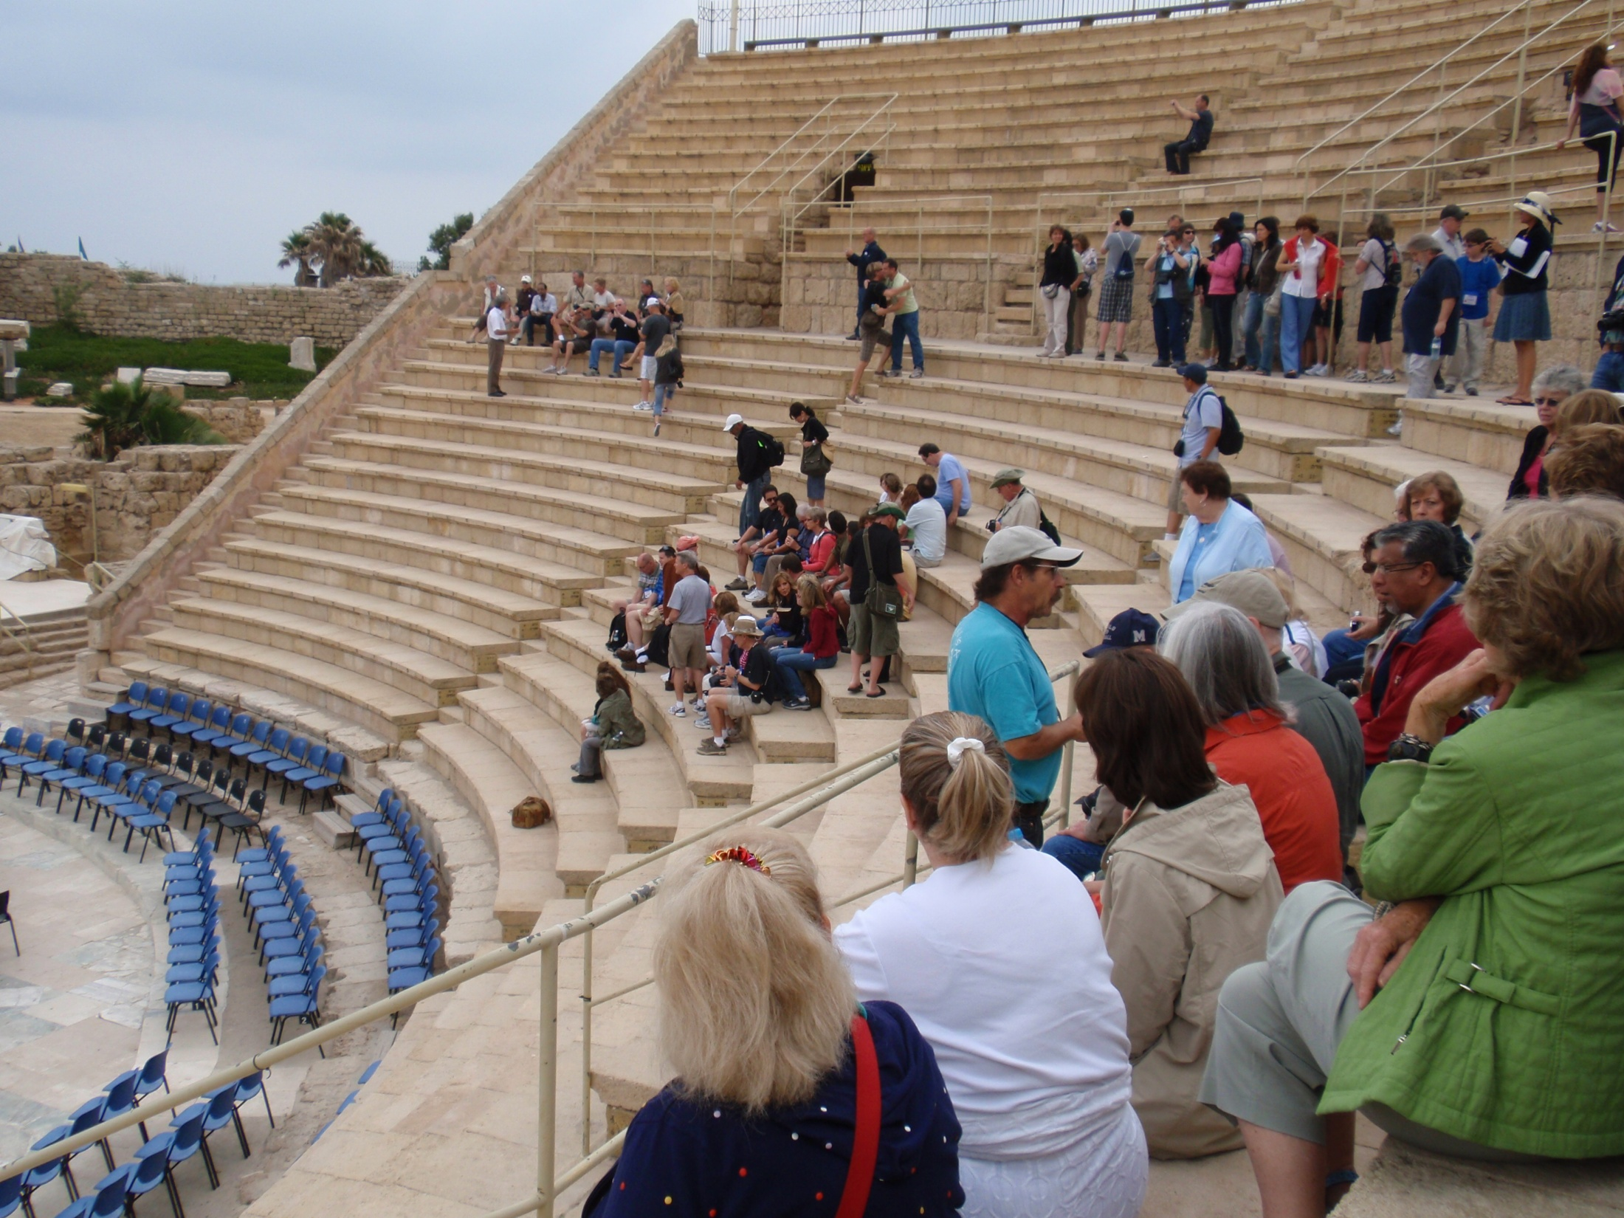

Slide 33
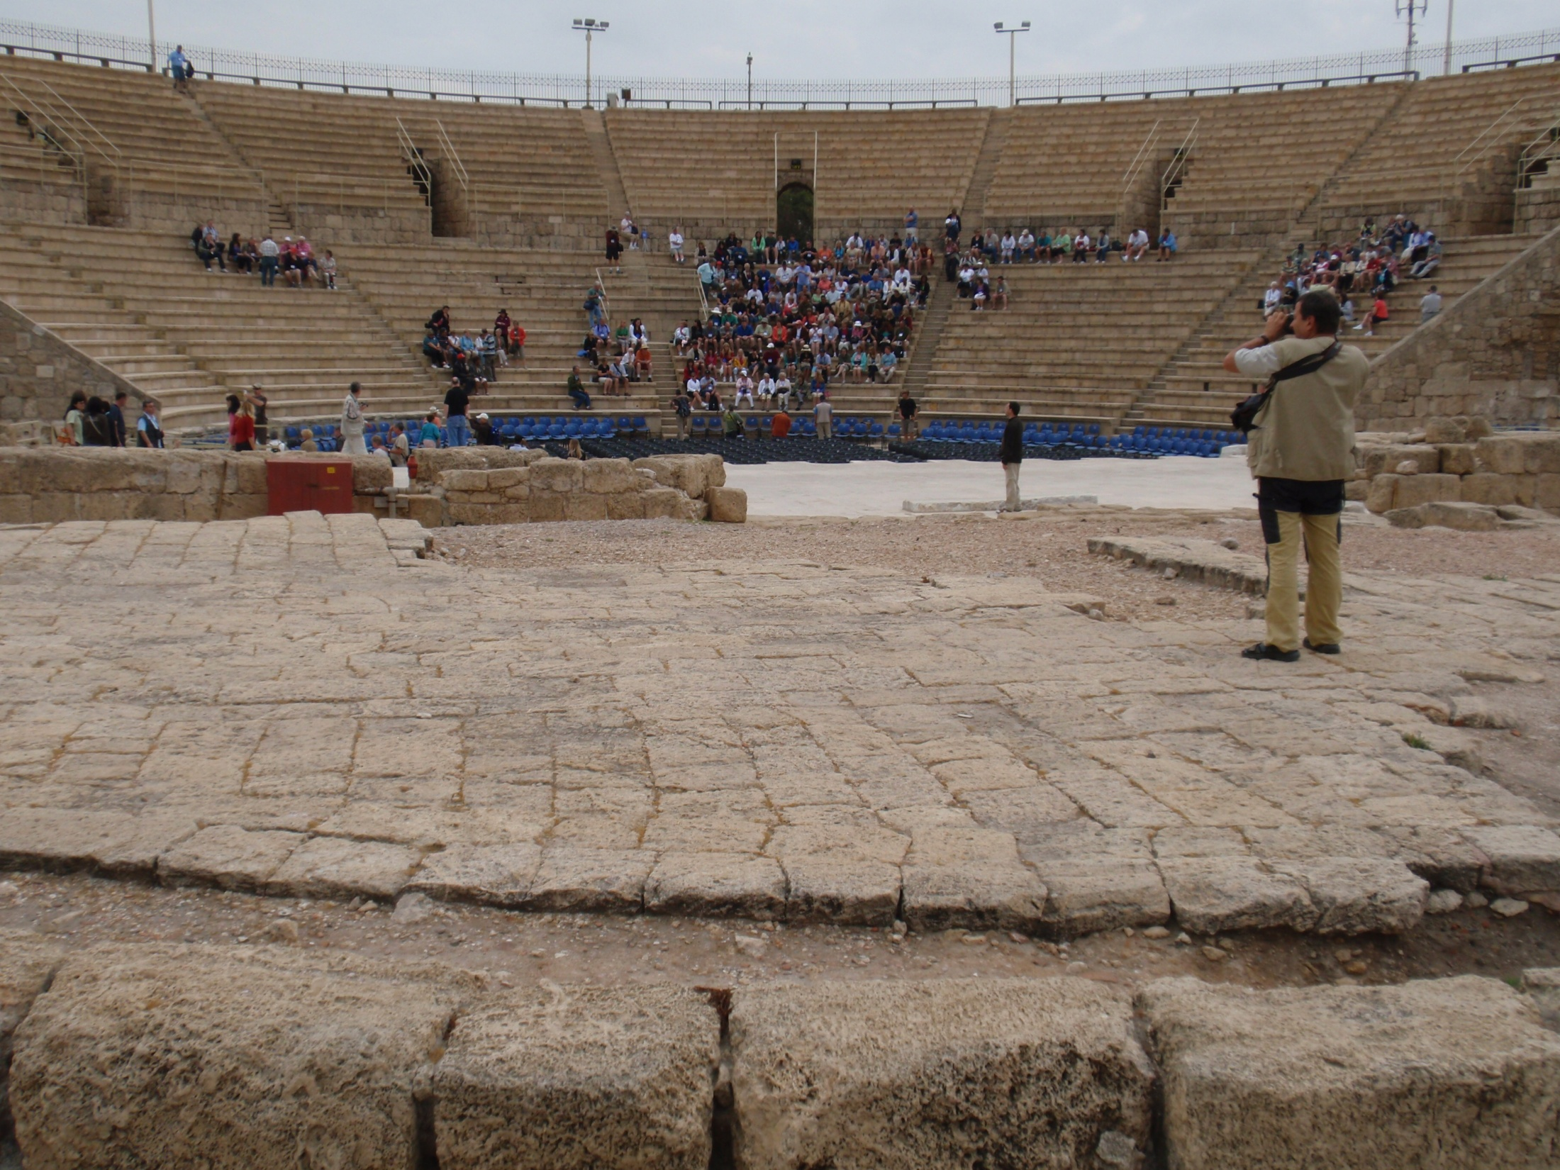

Slide 34
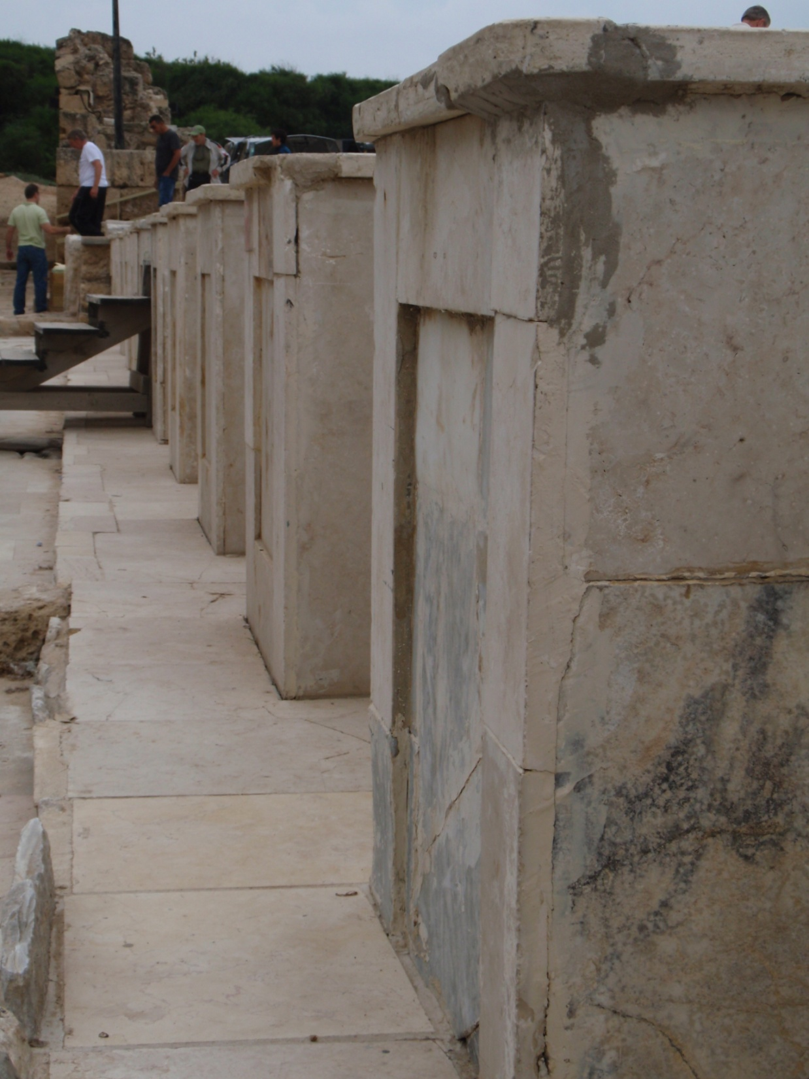

Slide 35
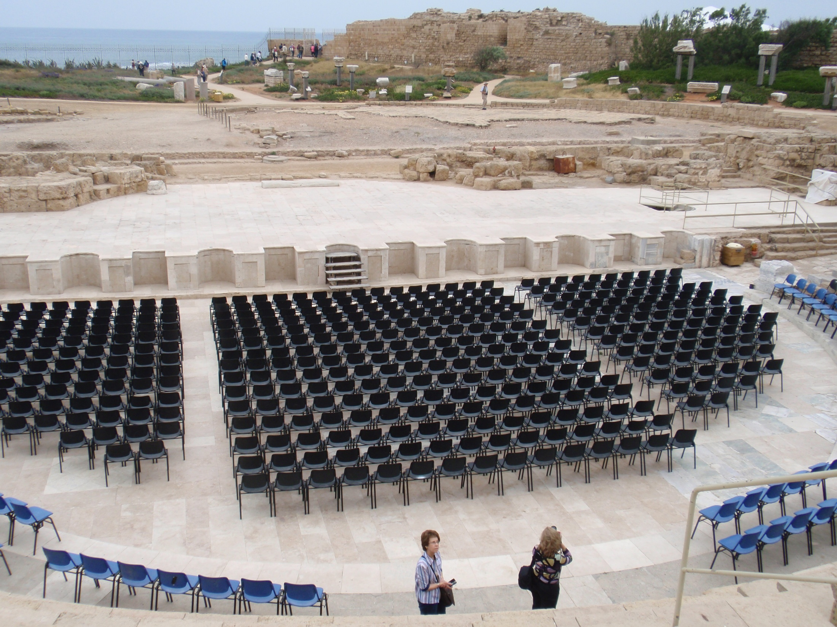

Slide 36
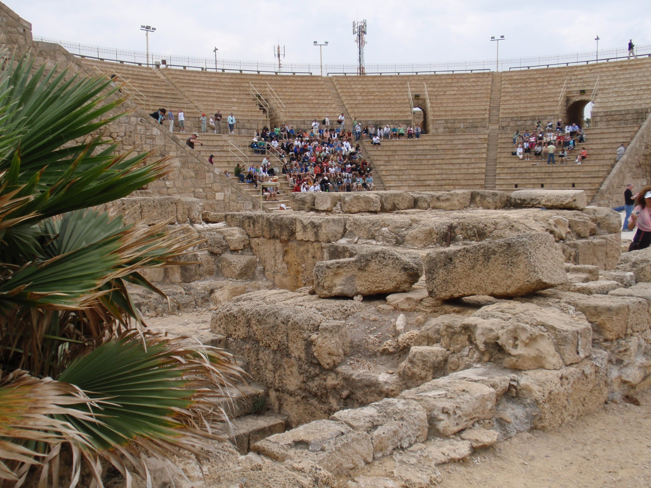

Slide 37
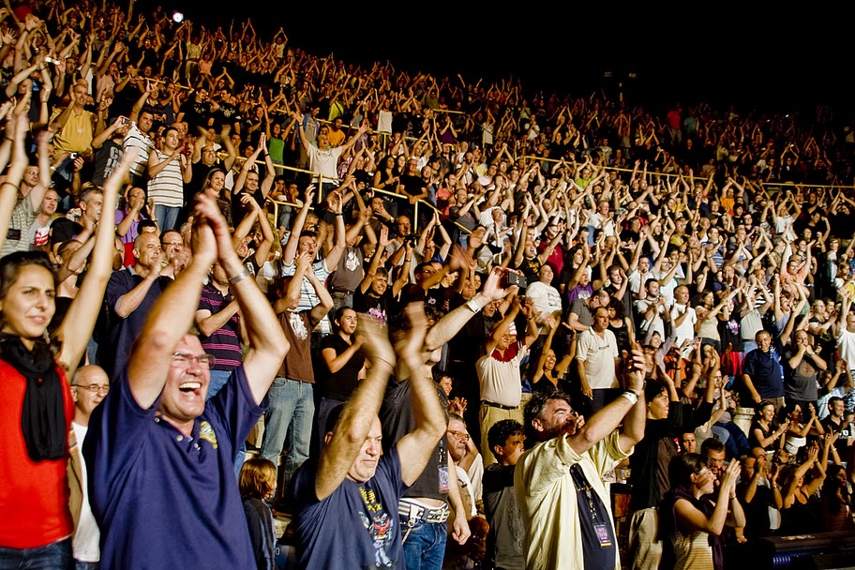

Slide 39
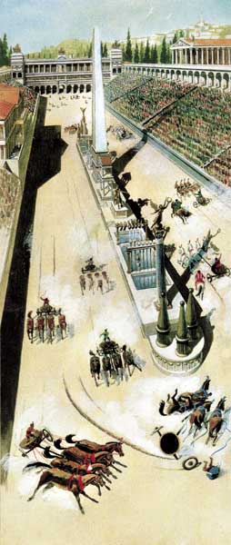

Slide 40
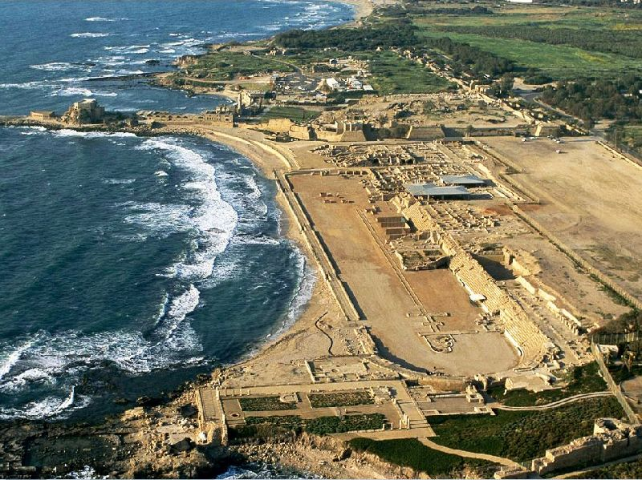

Slide 41
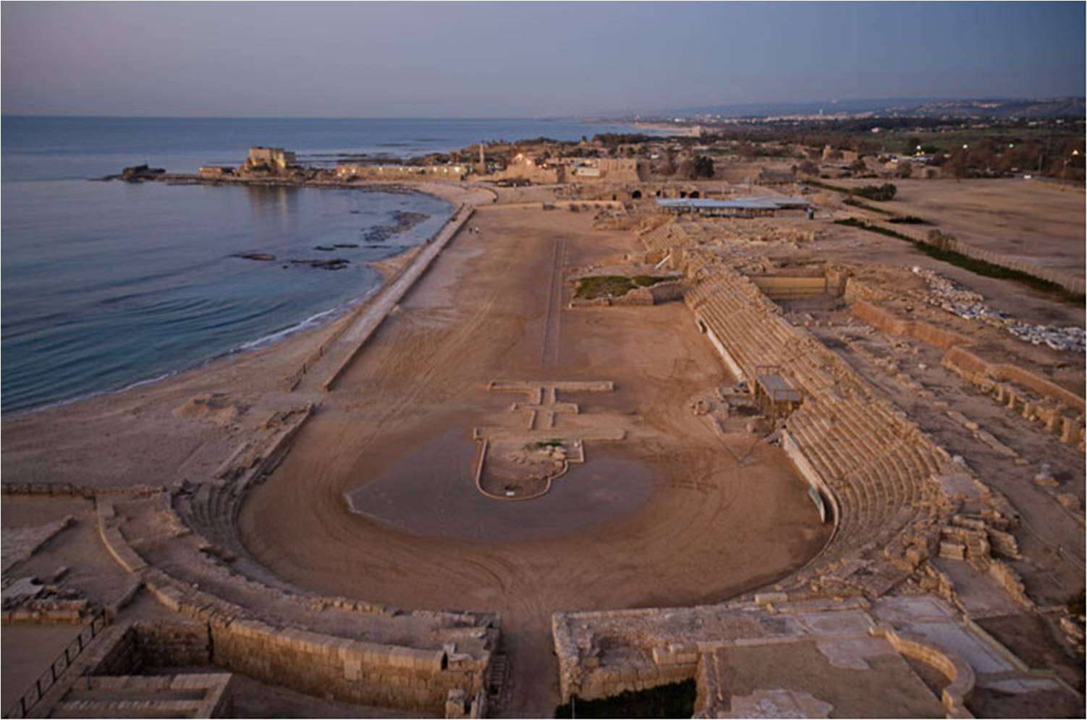

Slide 42
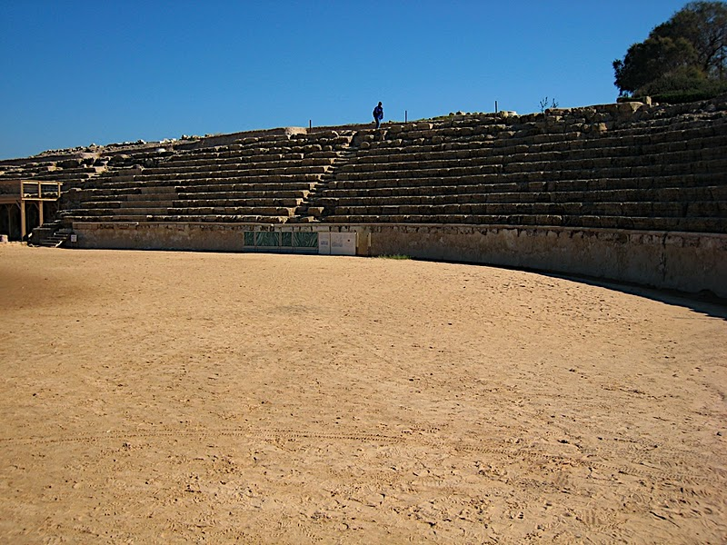

Slide 43
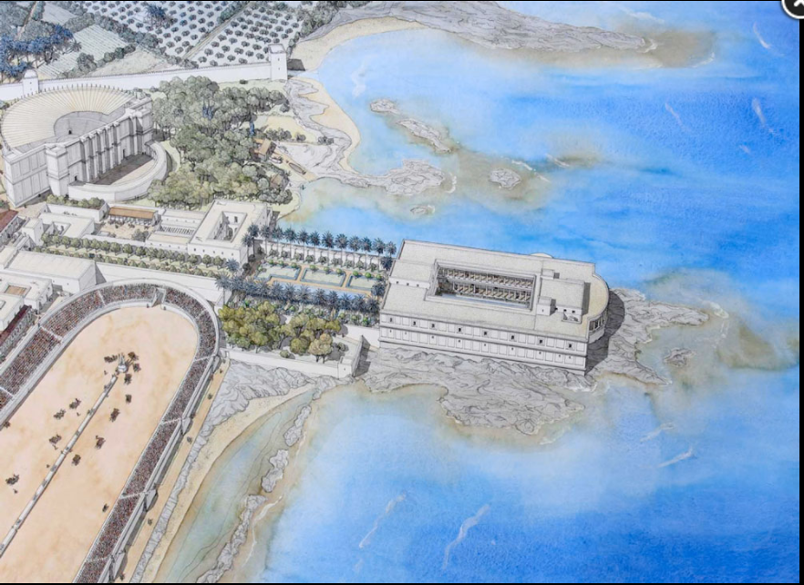

Slide 44
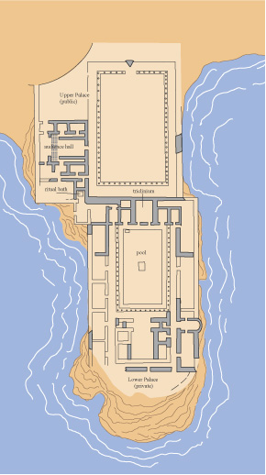
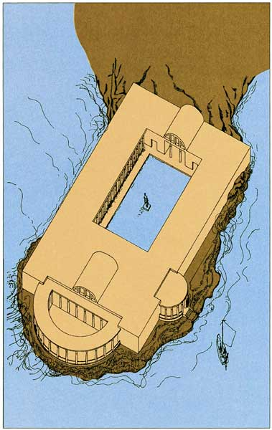

Slide 45
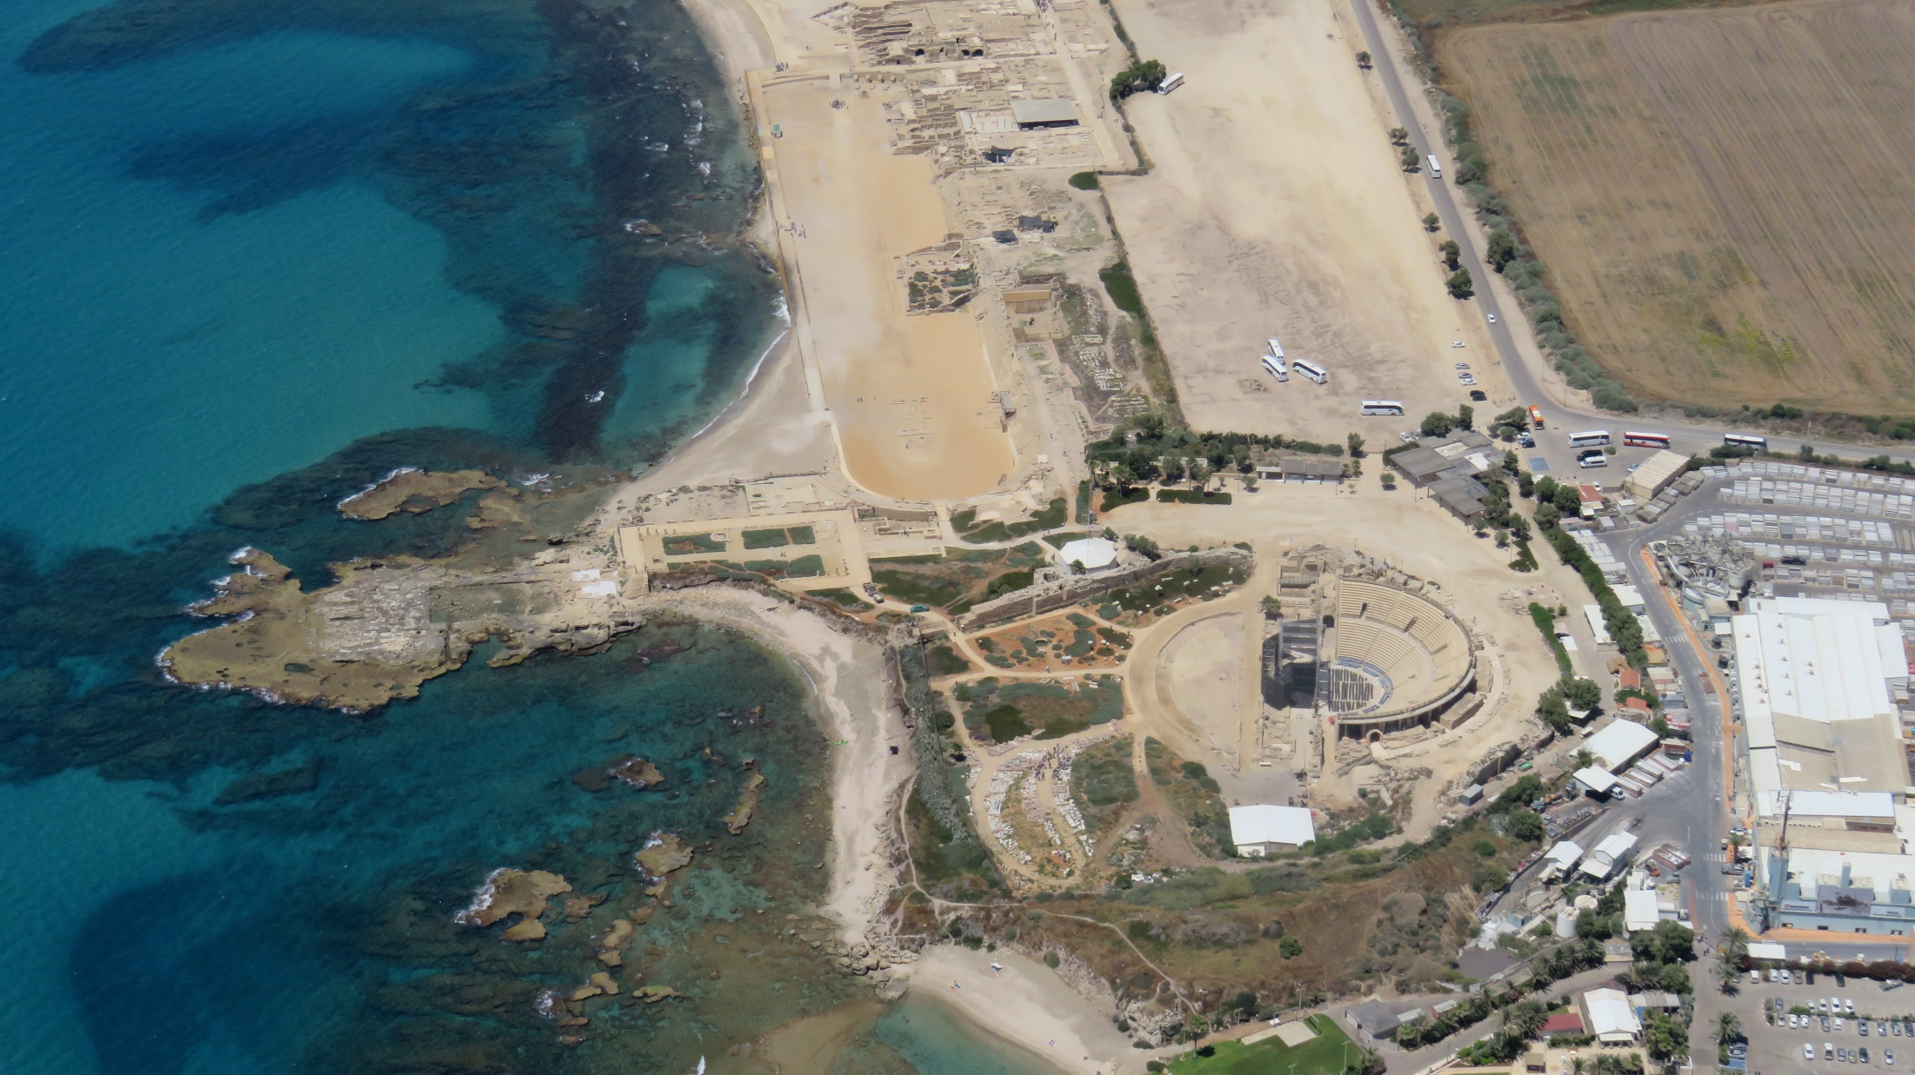

Slide 46
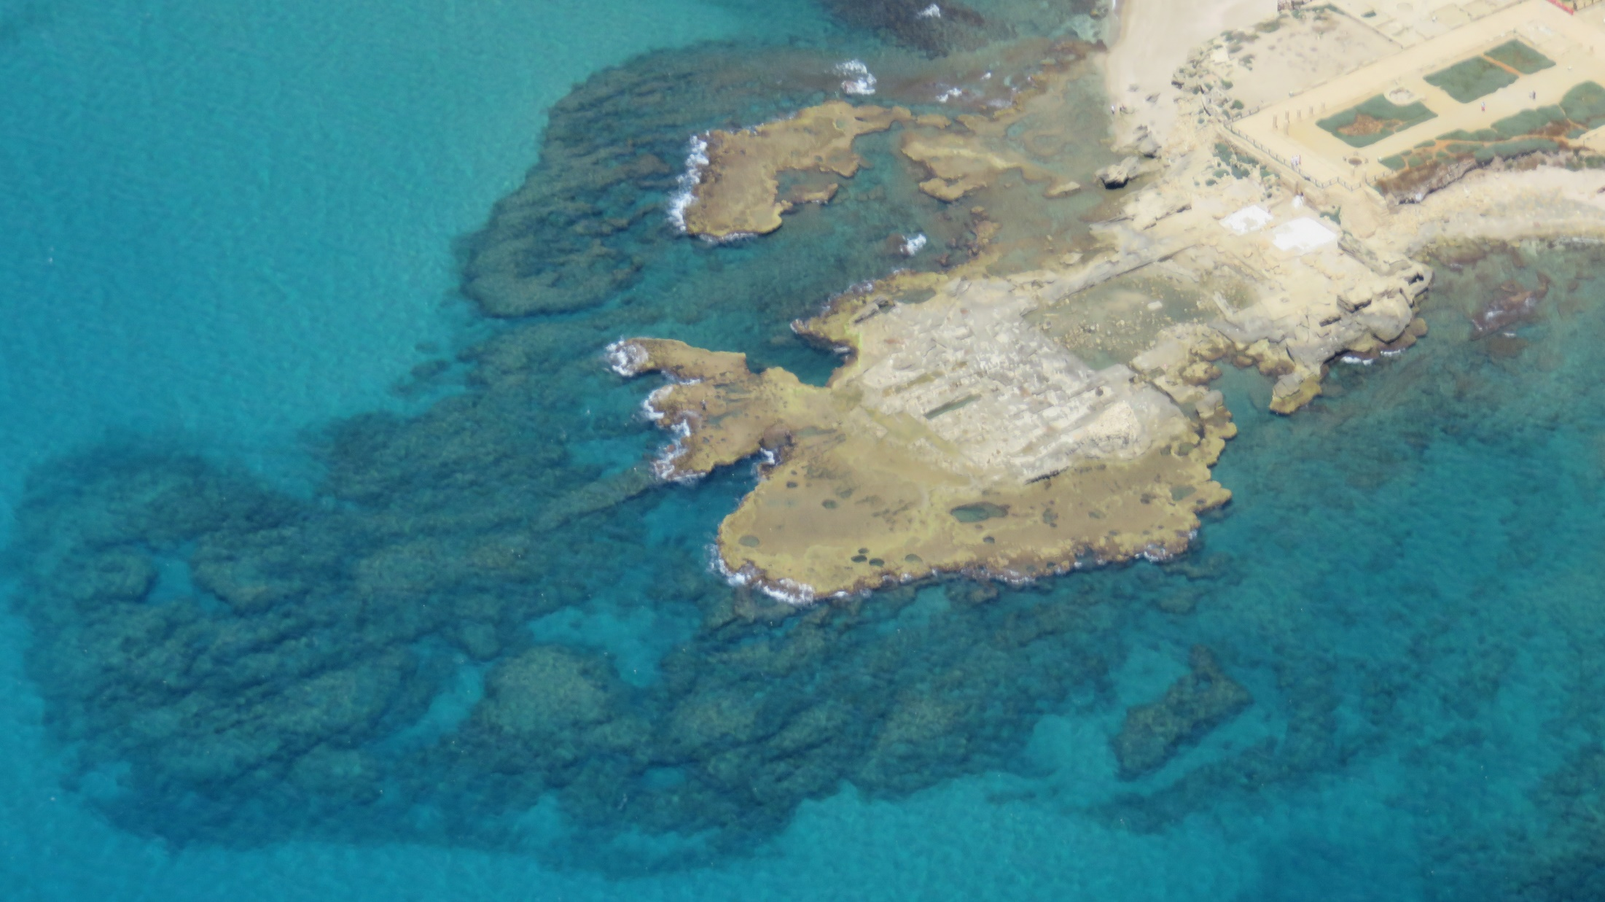

Slide 47
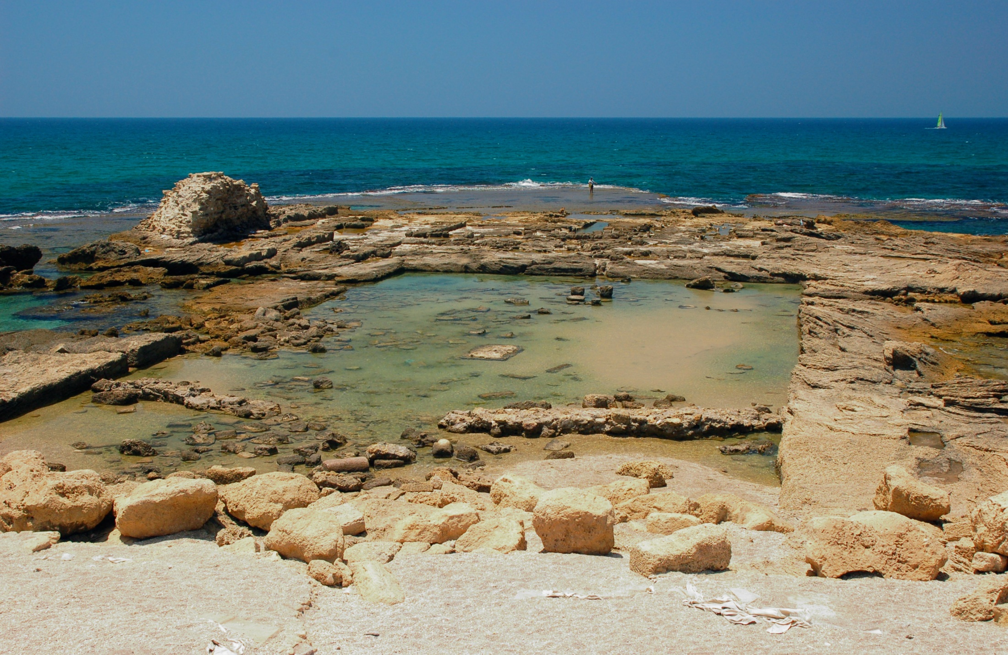

Slide 48
Acts 18:19-22
They came to Ephesus, and he left them there. Now he himself entered the synagogue and reasoned with the Jews. When they asked him to stay for a longer time, he did not consent, but taking leave of them and saying, "I will return to you again if God wills," he set sail from Ephesus. When he had landed at Caesarea, he went up and greeted the church, and went down to Antioch.

Slide 49
Acts 21 Excerpts
When we had finished the voyage from Tyre, we arrived at Ptolemais, and after greeting the brethren, we stayed with them for a day. On the next day we left and came to Caesarea, and entering the house of Philip the evangelist, who was one of the seven, we stayed with him… After these days we got ready and started on our way up to Jerusalem. Some of the disciples from Caesarea also came with us, taking us to Mnason of Cyprus, a disciple of long standing with whom we were to lodge. After we arrived in Jerusalem, the brethren received us gladly.

Slide 50
Acts 23 Excerpts
(The commander has learned of a plot to kill Paul)
He called two centurions and said, "Get 200 soldiers ready to proceed to Caesarea, with 70 horsemen and 200 spearmen.“ They were to provide mounts to put Paul on and bring him safely to Felix the governor… When these had come to Caesarea and delivered the letter to the governor, they also presented Paul. When he had read it, he asked from what province he was, and when he learned that he was from Cilicia, he said, "I will give you a hearing after your accusers arrive also," giving orders for him to be kept in Herod's Praetorium.

Slide 51
Acts 24:24-27
Felix arrived with Drusilla, his Jewish wife and sent for Paul and heard him speak about faith in Christ. But as he discussed righteousness, self-control and judgment, Felix became frightened and said, "Go away for the present, and when I find time I will summon you.” At the same time he was hoping money would be given him by Paul; therefore he used to send for him quite often and converse. But after two years passed, Felix was succeeded by Festus, and wishing to do the Jews a favor, Felix left Paul imprisoned.

Slide 52
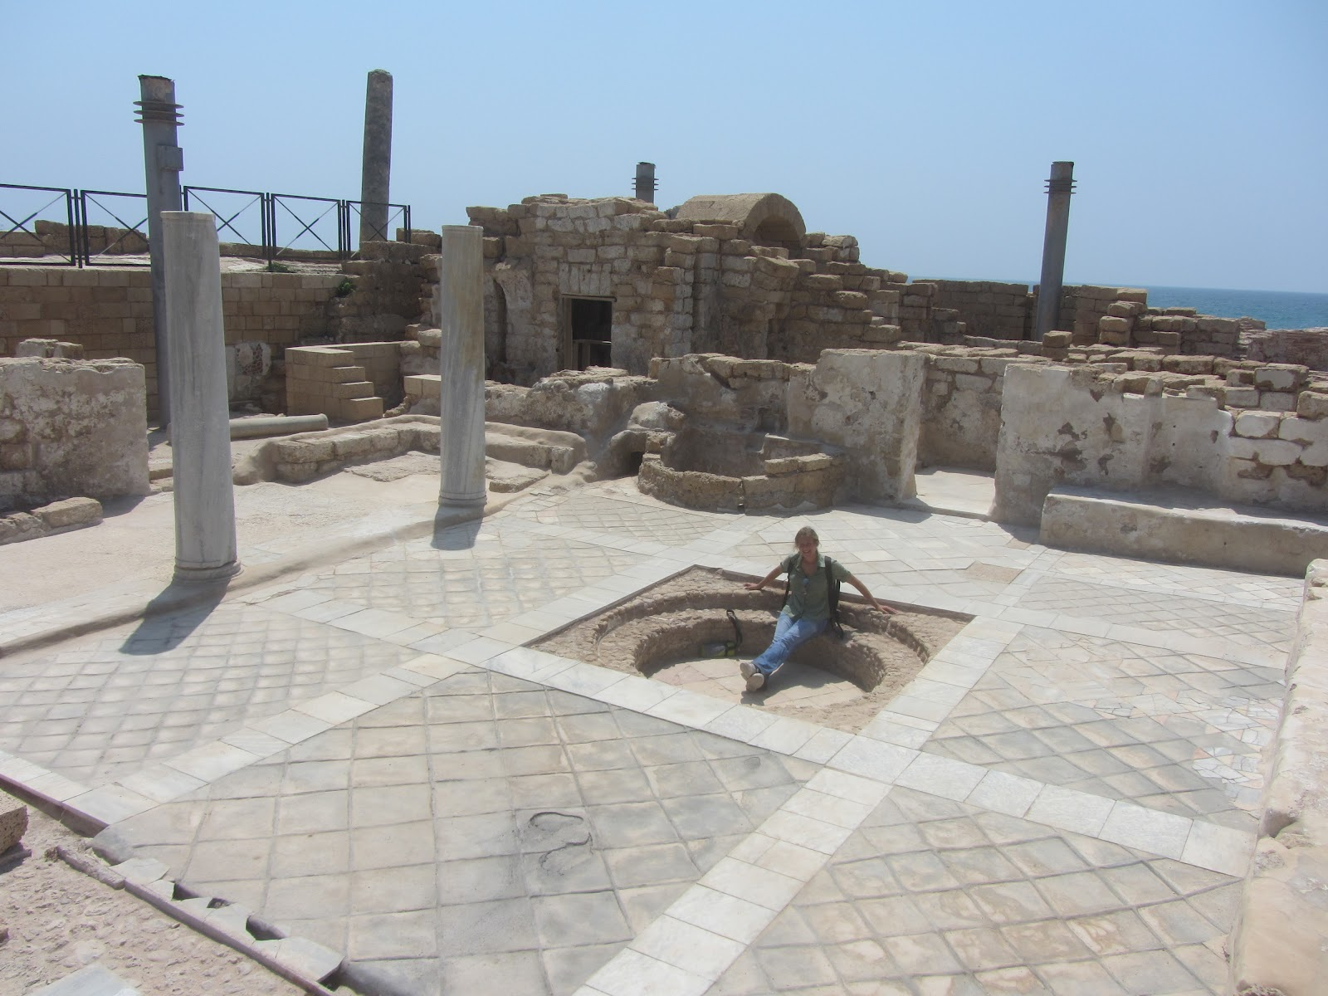

Slide 53
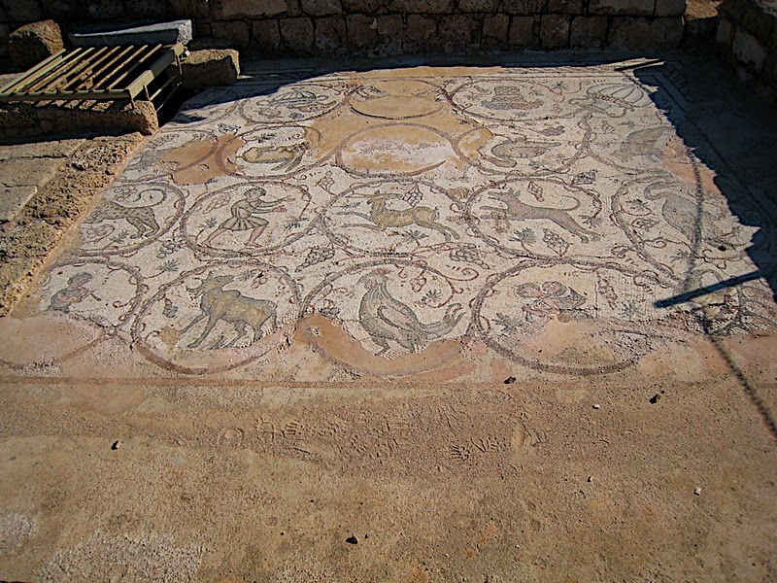

Slide 54
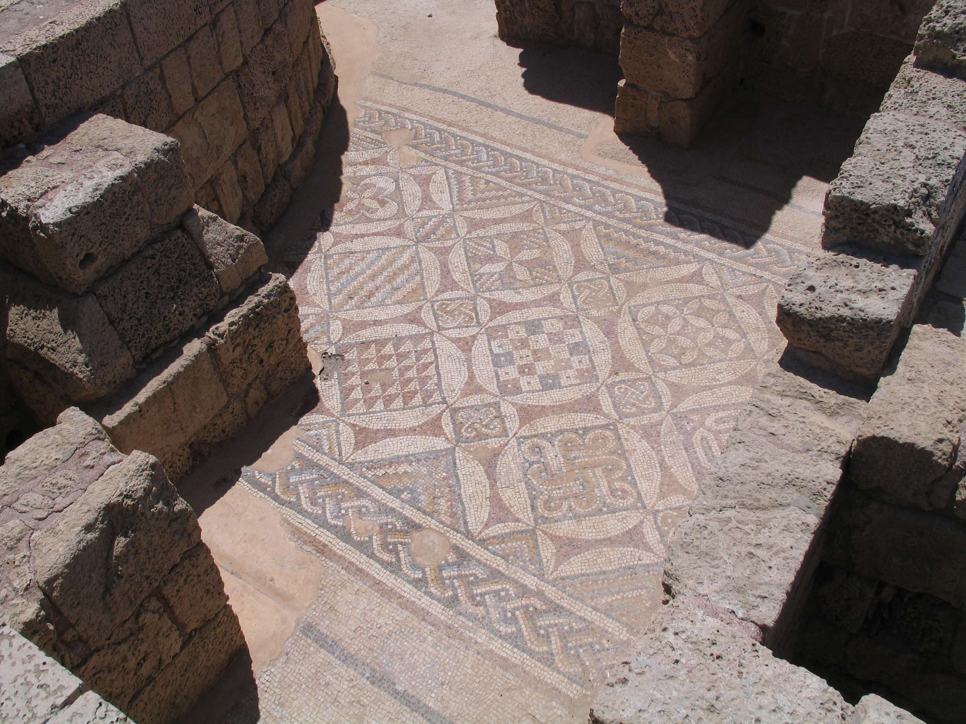

Slide 55
Acts 25 & 26 Excerpts
Festus went to Caesarea and several days later, King Agrippa (II – great grandson of Herod the Great) and Bernice arrived. So, Agrippa, Bernice, the commanders, and prominent men assembled. While Paul was offering his defense, Festus said in a loud voice, "Paul, you are out of your mind! Your great learning is driving you mad.“ But Paul said, "I am not out of my mind but utter words of sober truth. For the king knows about these matters, and I speak to him with confidence, since I am persuaded none of these things escape his notice. King Agrippa, do you believe the Prophets? I know that you do.” Agrippa replied, "In a short time you will persuade me to become a Christian.?” And Paul said, "I would to God, that whether in a short or long time, not only you, but also all who hear me this day, might become such as I am, except for these chains.”

Slide 56
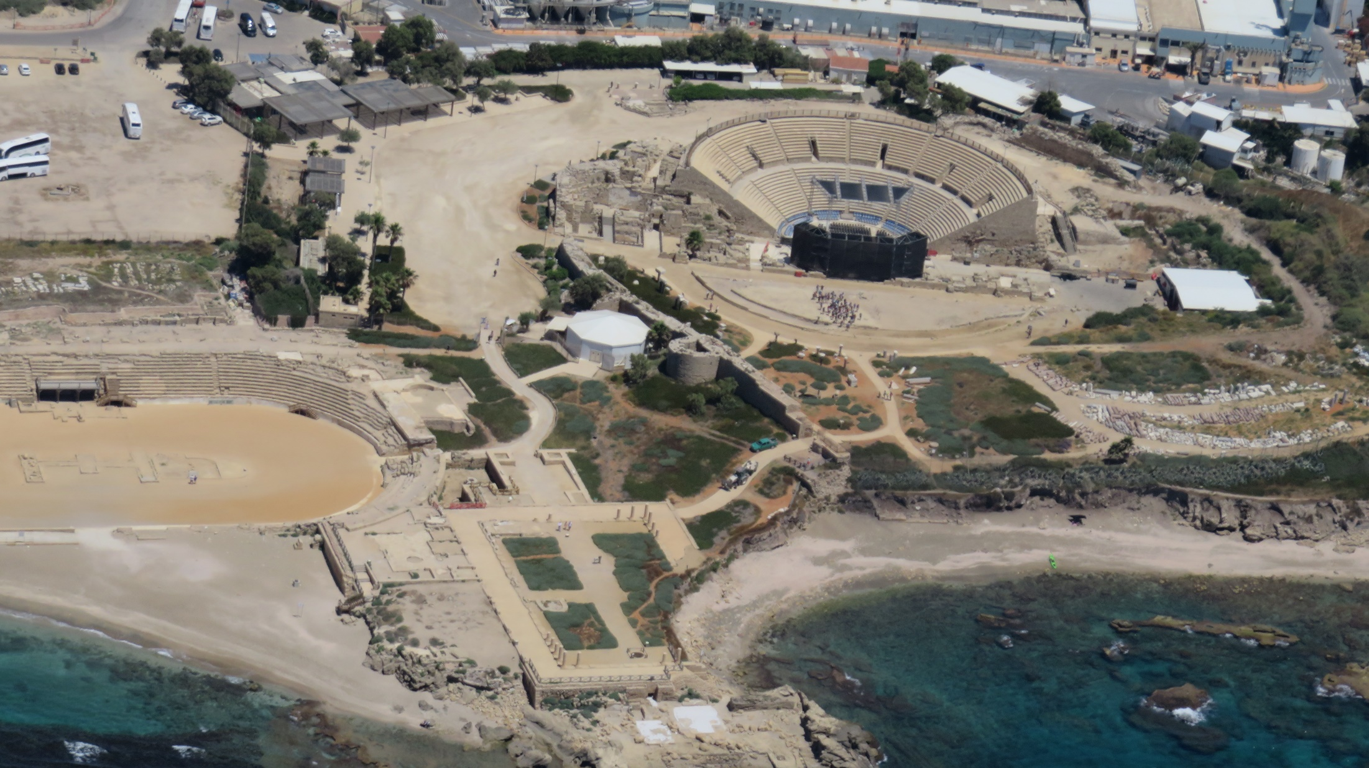

Slide 57
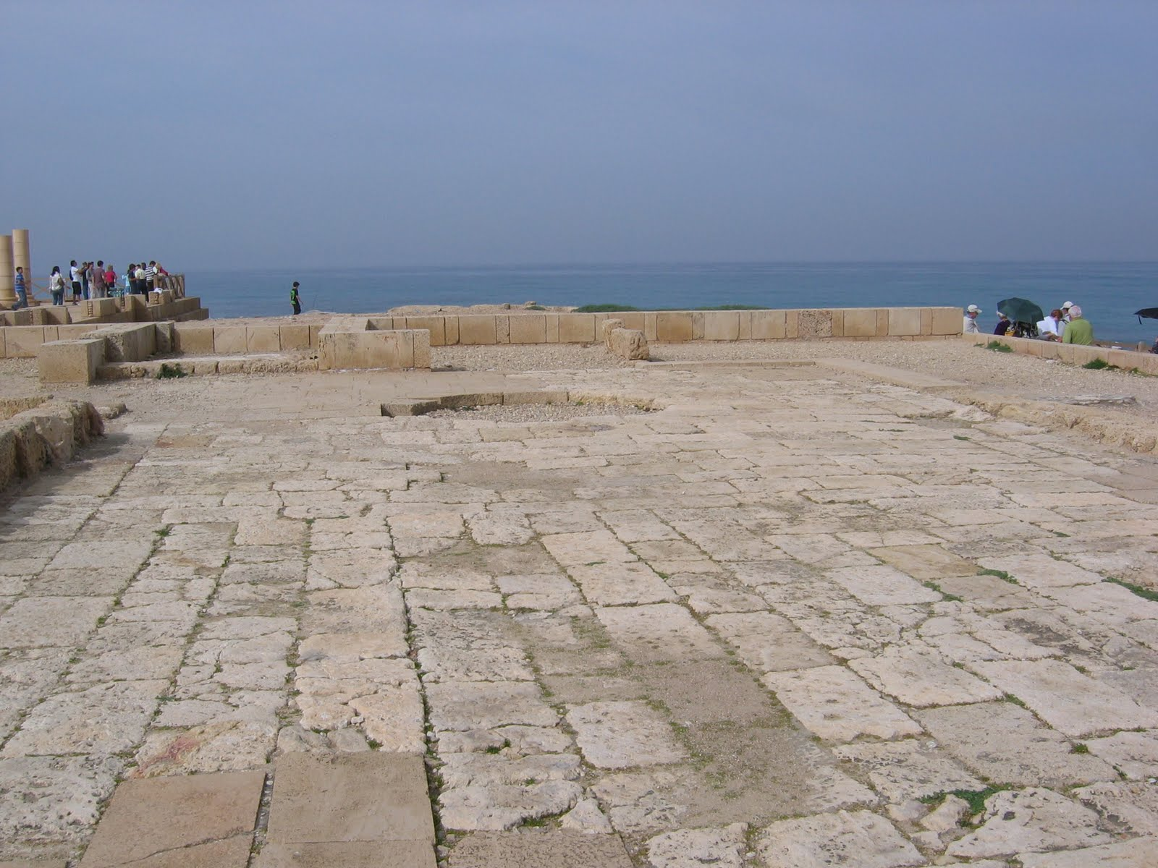

Slide 58
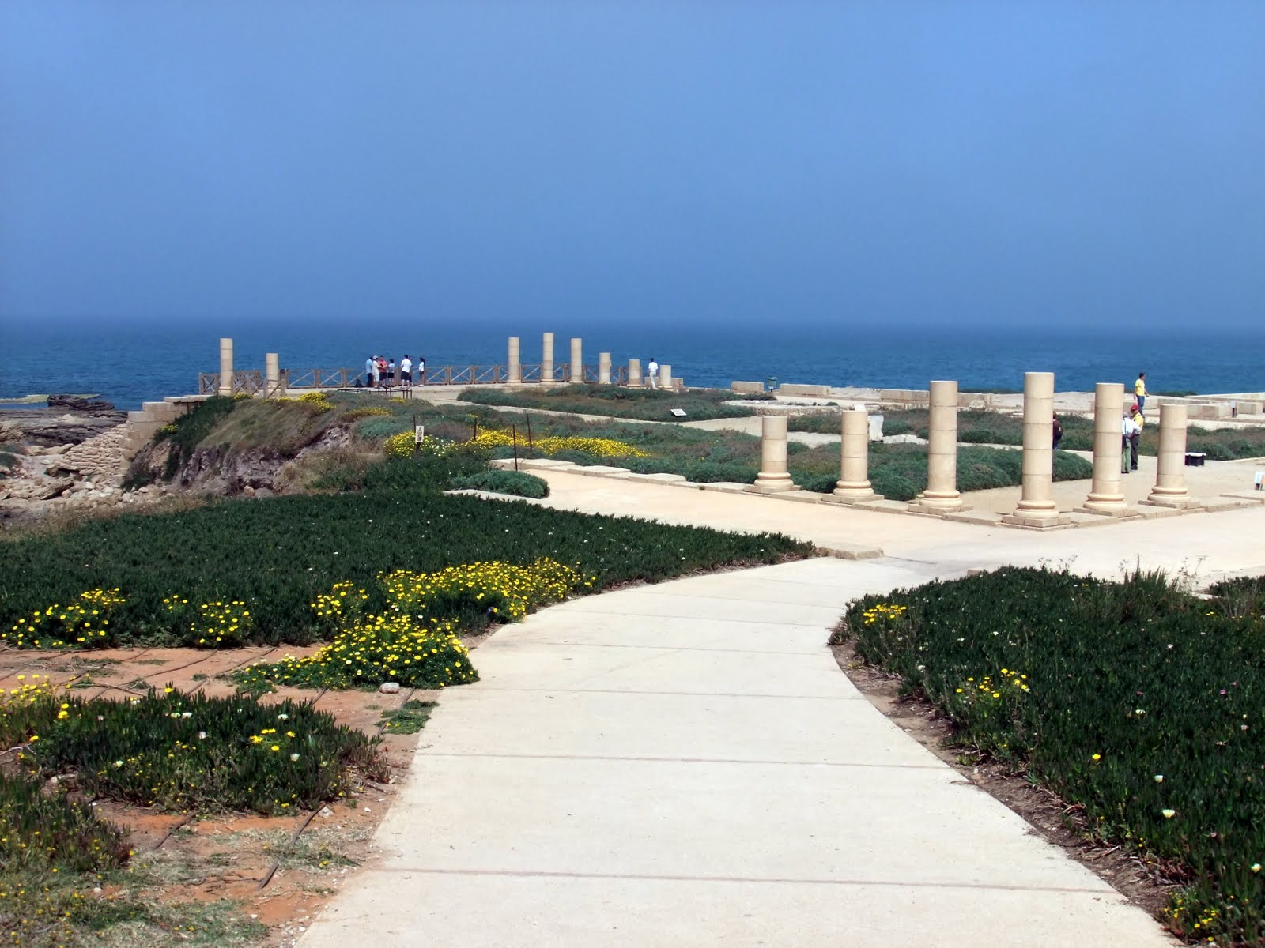

Slide 59


Slide 60
Acts 26 & 27 Excerpts
The king stood up and the governor and Bernice, and those who were sitting with them and when they had gone aside, they began talking to one another, saying, "This man is not doing anything worthy of death or imprisonment." And Agrippa said to Festus, "This man might have been set free if he had not appealed to Caesar.” When it was decided that we would sail for Italy, they proceeded to deliver Paul and some other prisoners to a centurion of the Augustan cohort named Julius.

Slide 61


