Slide 1
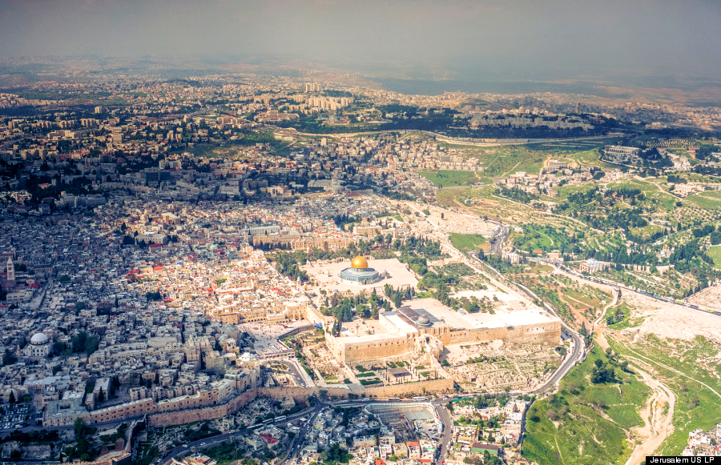
Jerusalem in the Old Testament - September 10, 2017

Slide 2
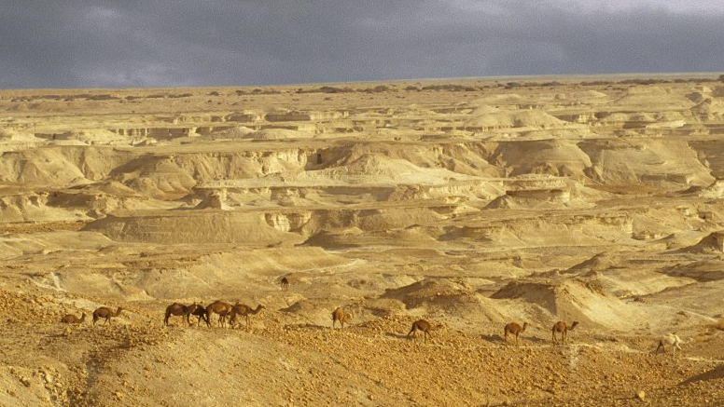
My first vision of Israel

Slide 3
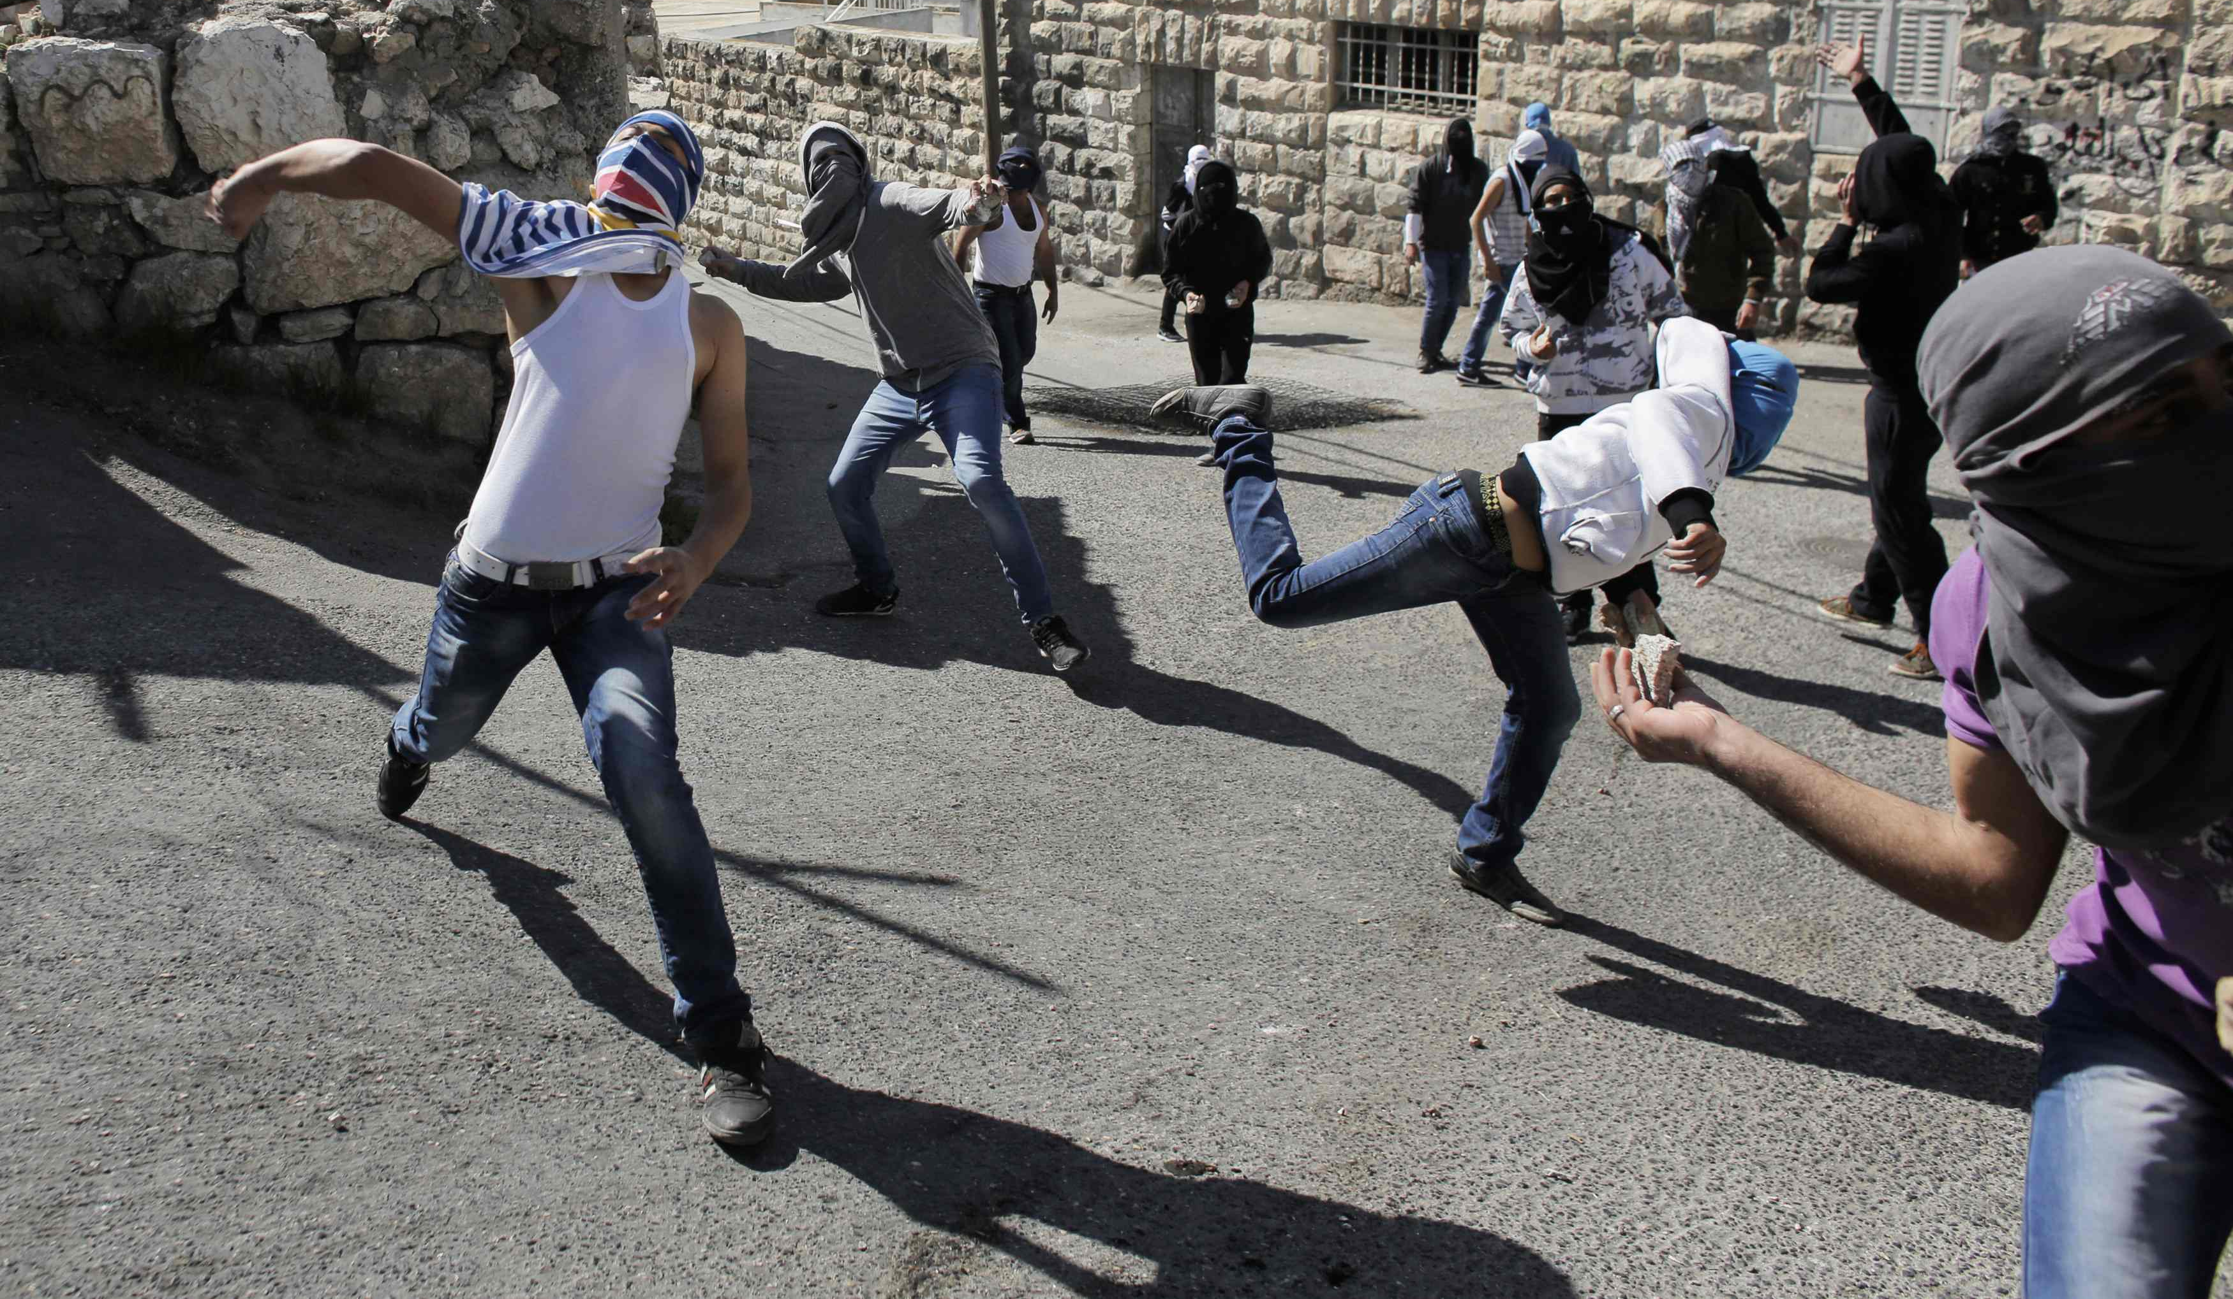
My second vision of Israel

Slide 4
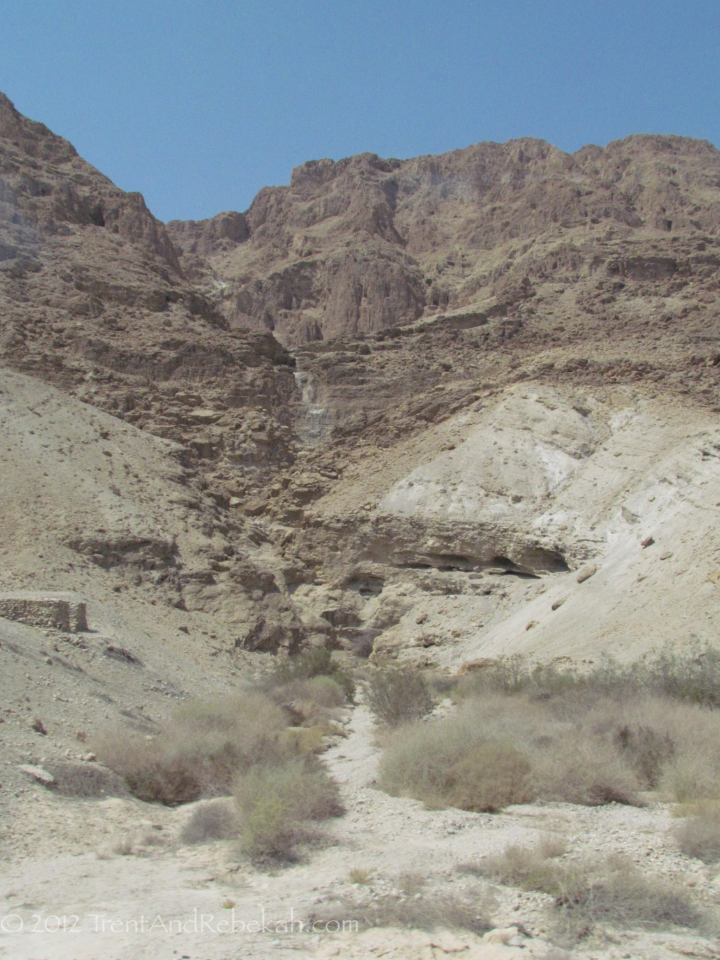

So, I had no desire to go

Slide 5
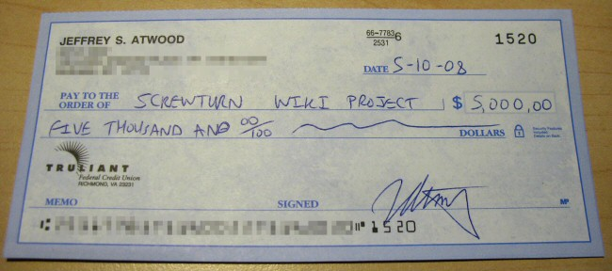
Forced against my will...
A good hearted woman
Larry & Donna Haverstock

Slide 6
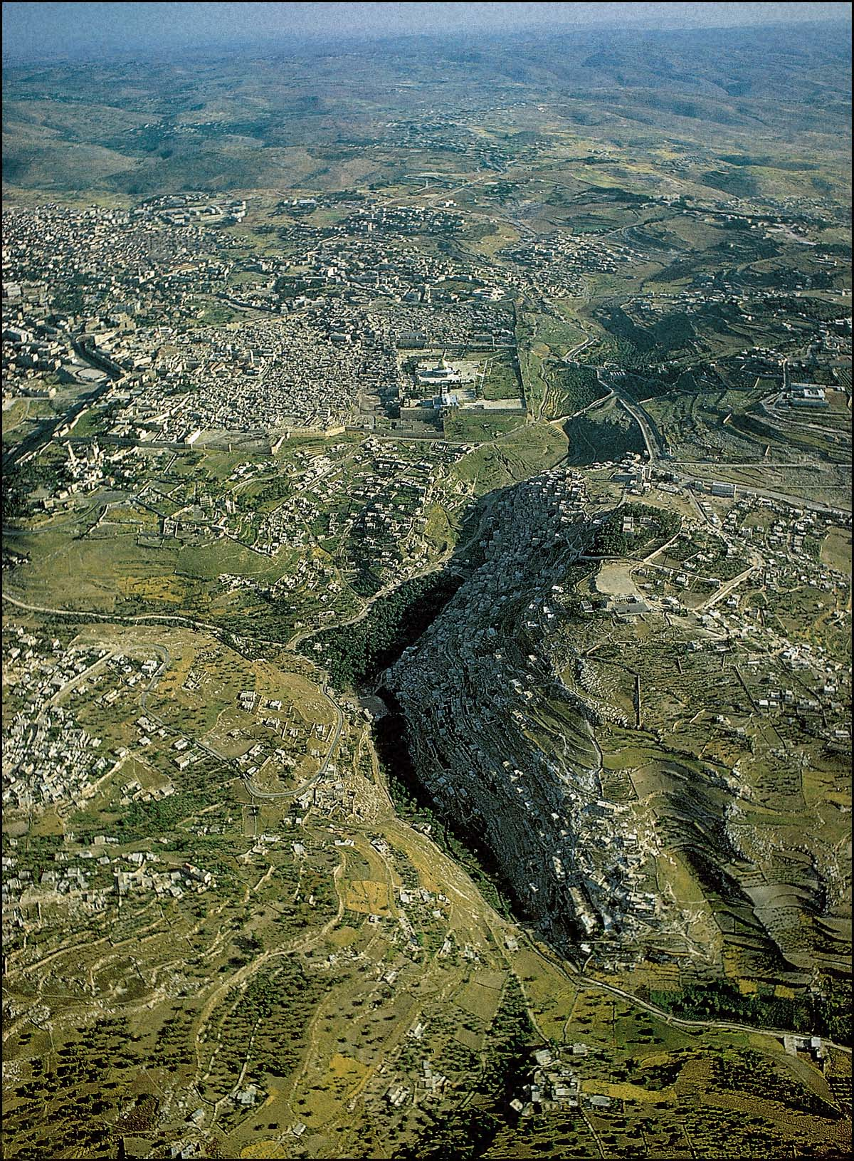
GENESIS 14:18-20
4,000 years ago

Slide 7
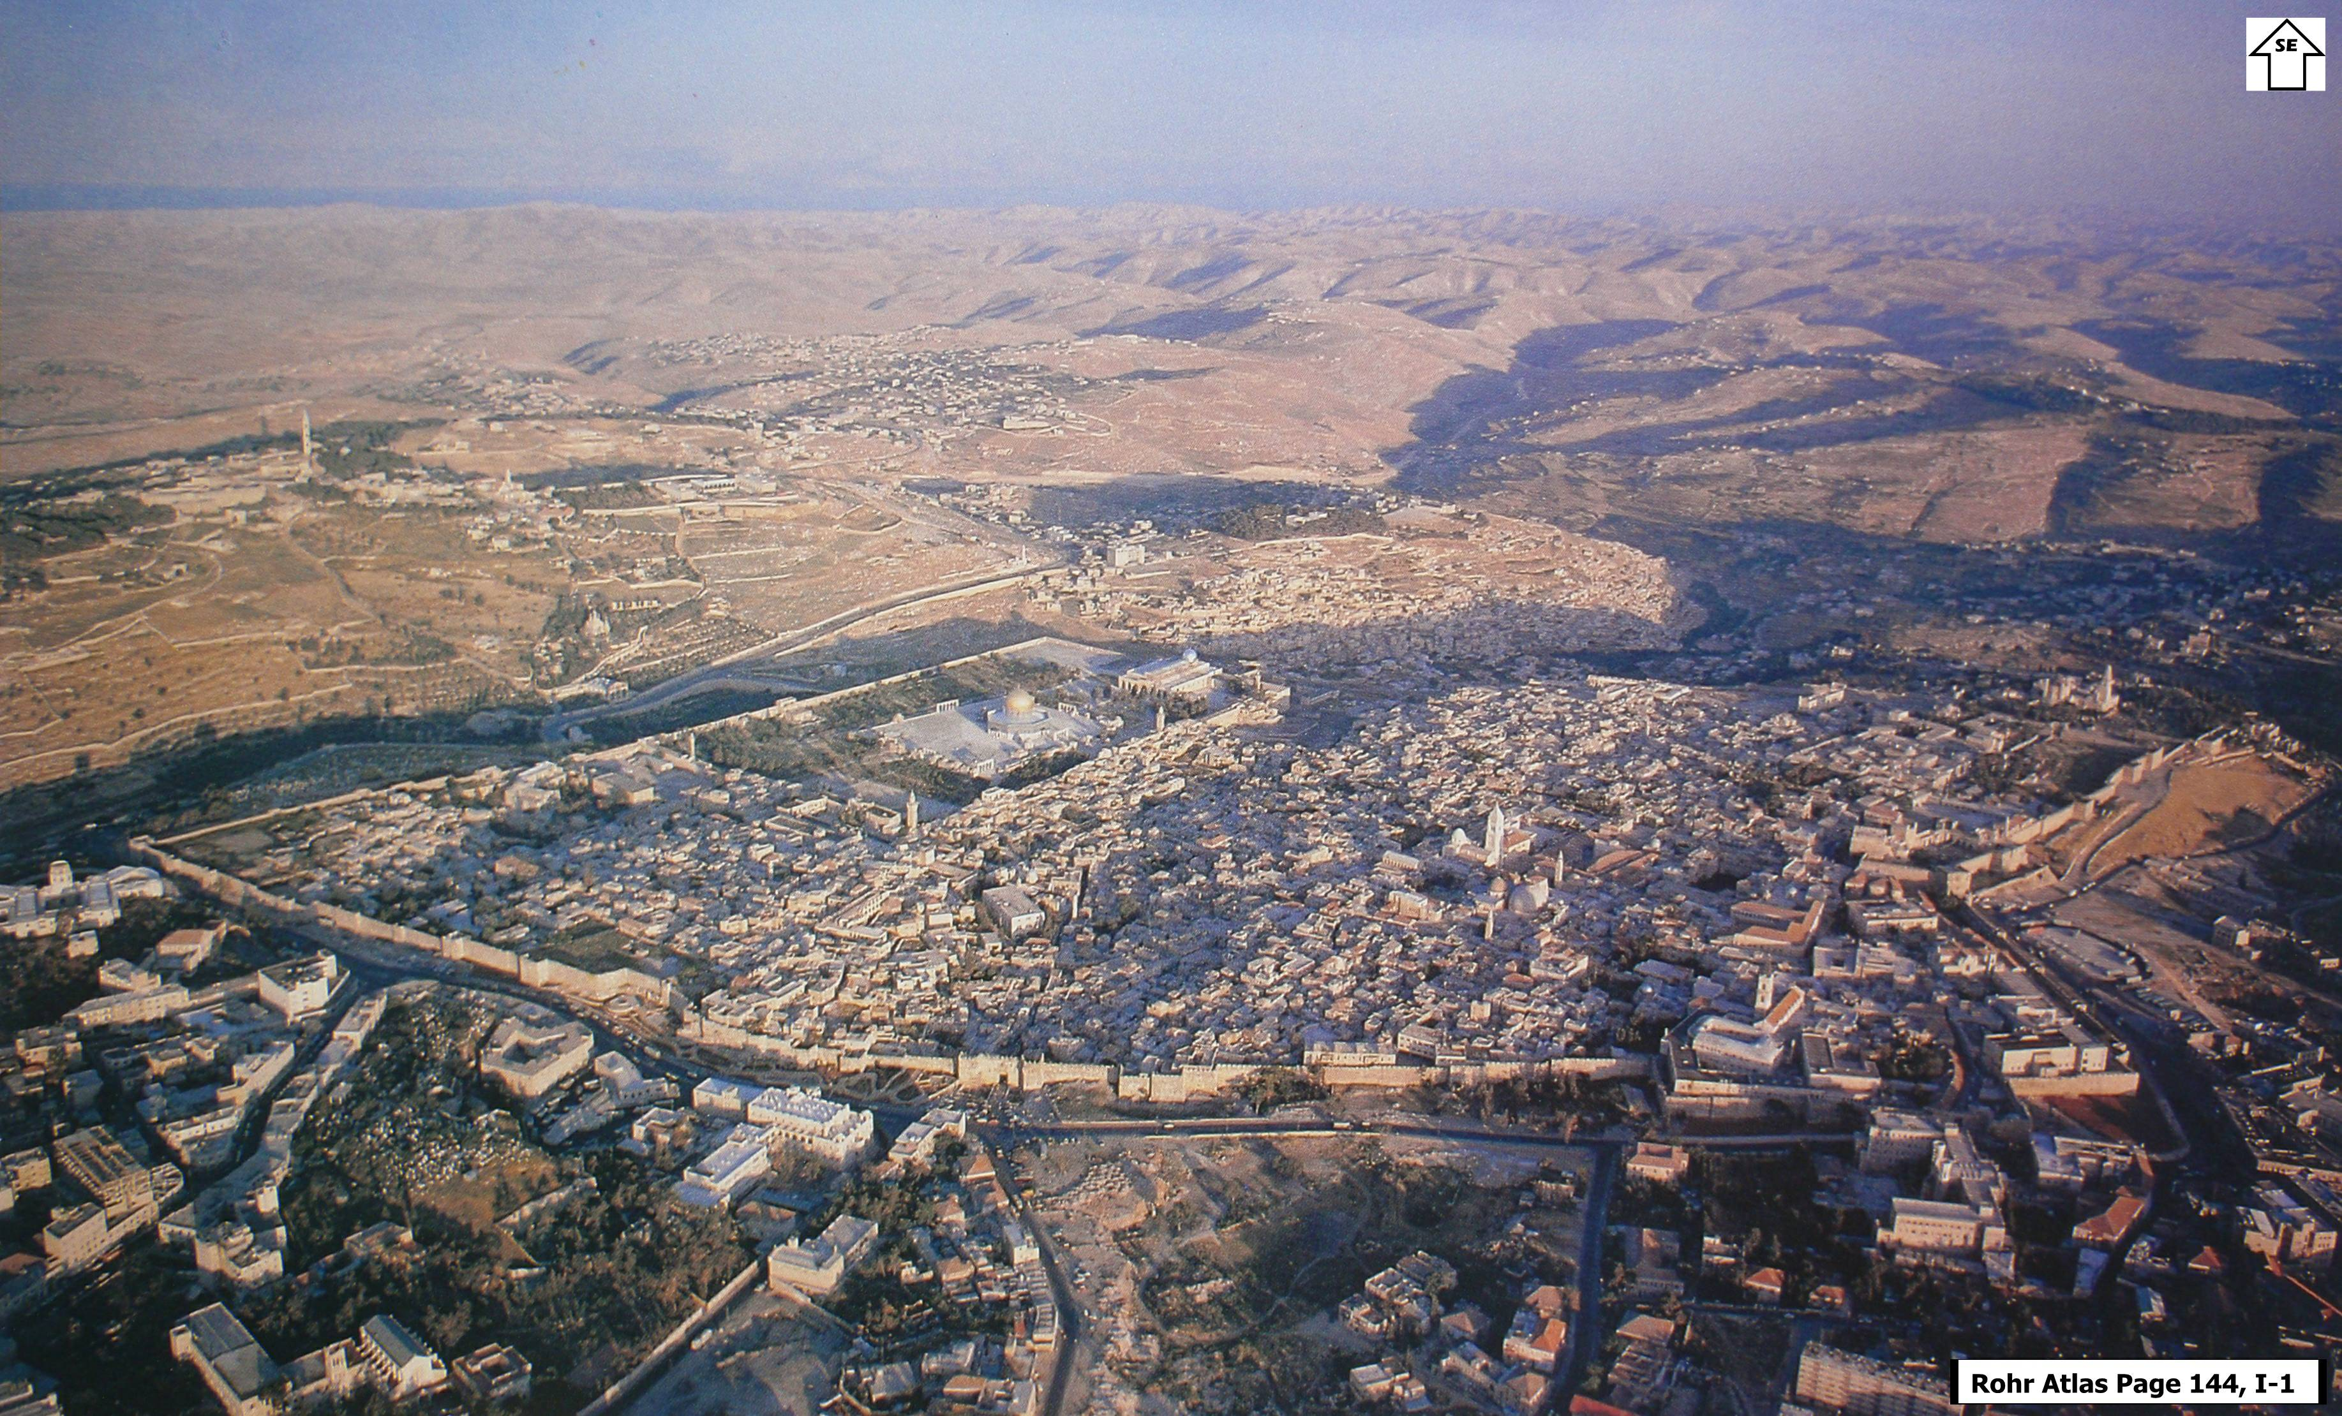
JOSHUA 10:1-4 3,500 years ago

Slide 8
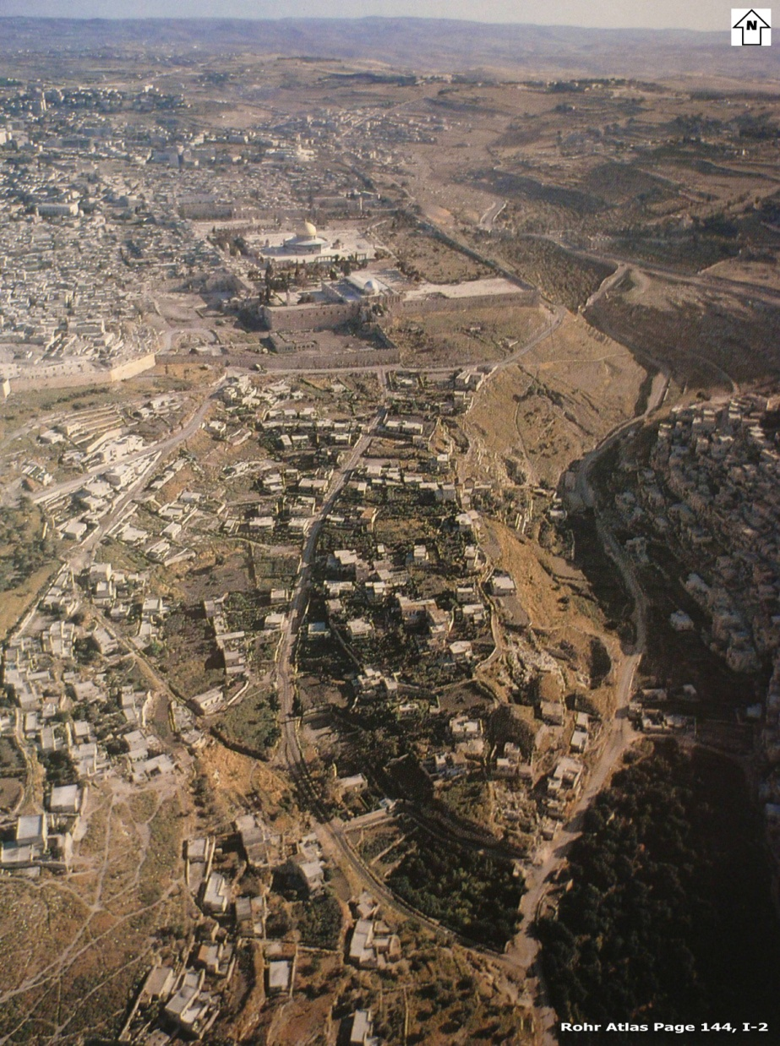
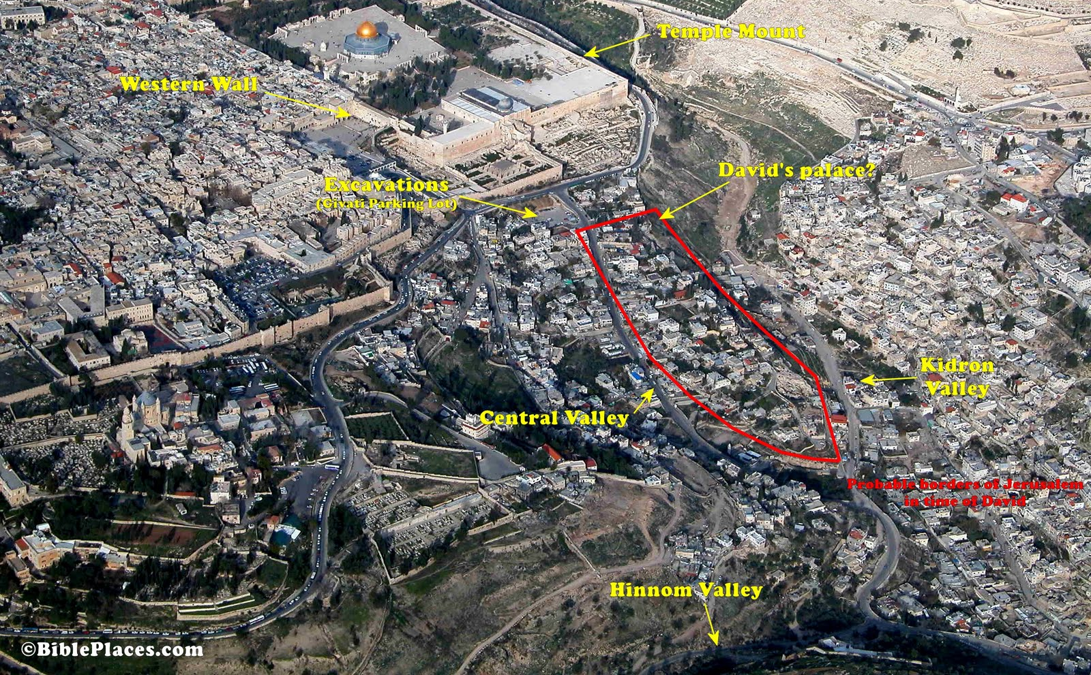
2 SAMUEL 5:6-9
3,000 years ago

Slide 9
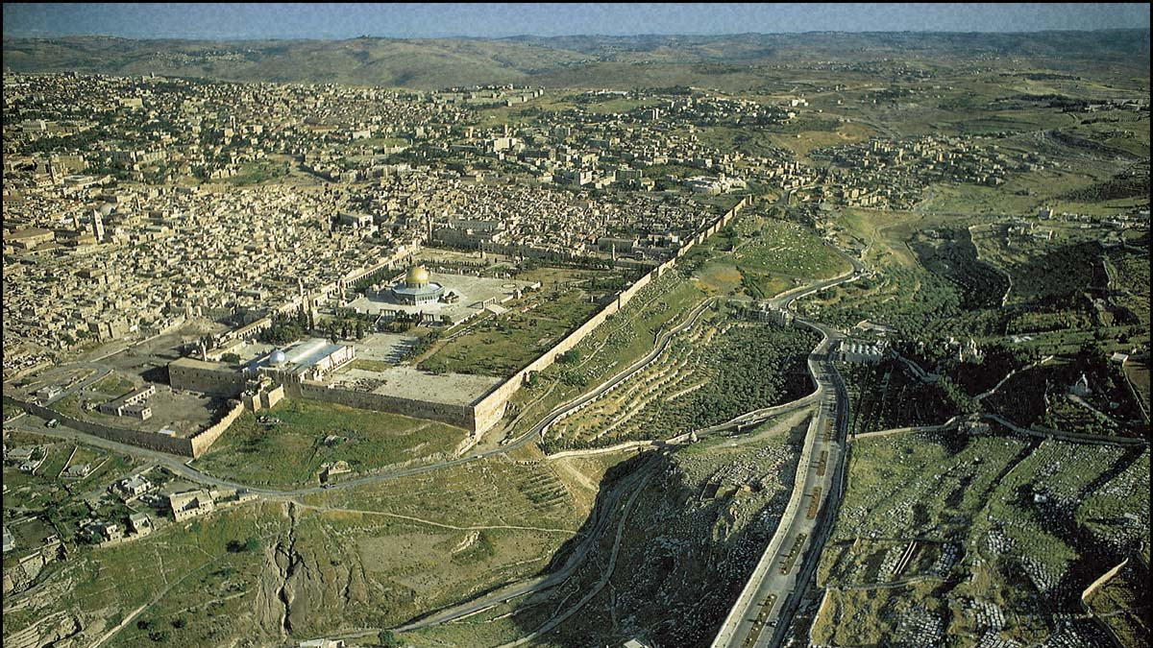
1 KINGS 6:1, 38 966-959 BC

Slide 10
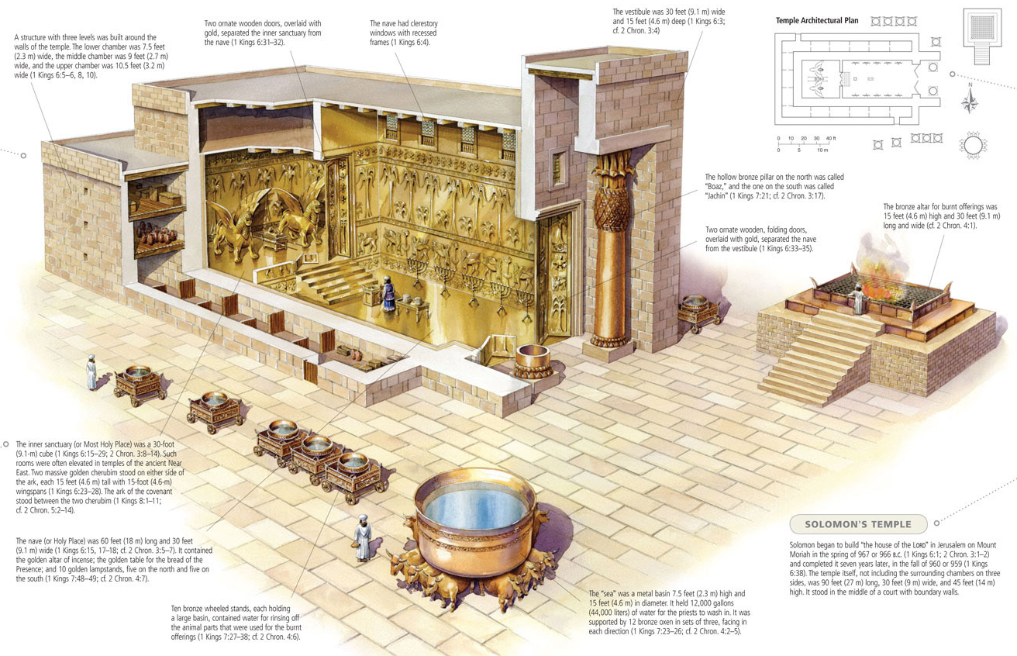

Slide 11
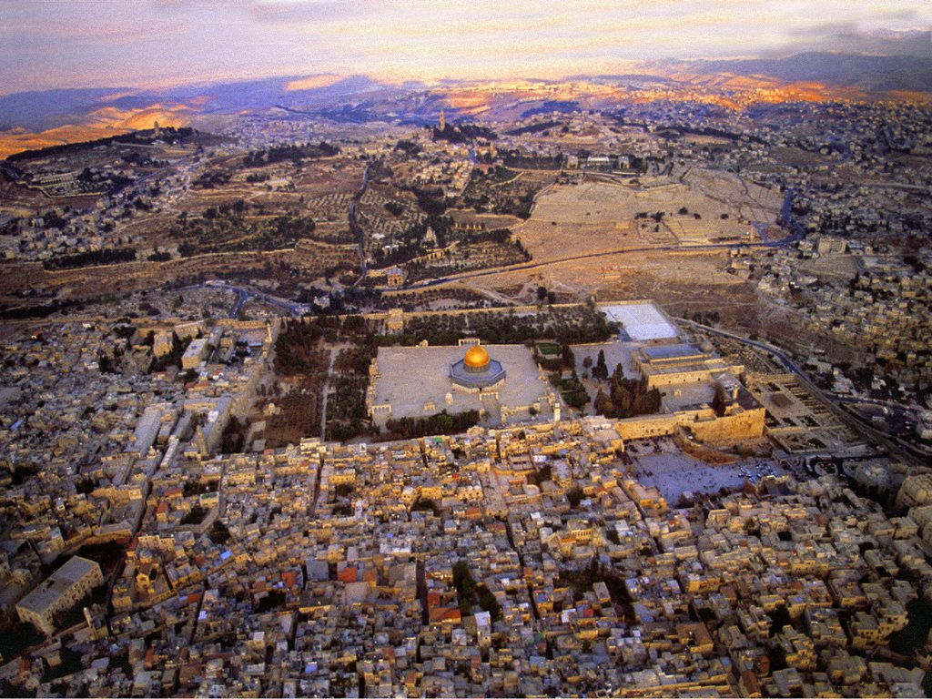
2 Kings 18:1-8 2,700 years ago

Slide 12

Hezekiah: 11 chapters, named 129 times in scripture
2 Kings 20:20 “As for the other events of Hezekiah’s reign, all his achievements and how he made the pool and the tunnel by which he brought water into the city…”
2 Chronicles 32:30 “It was Hezekiah who blocked the upper outlet of the Gihon spring and channeled the water down to the west side of the City of David.”

Slide 13
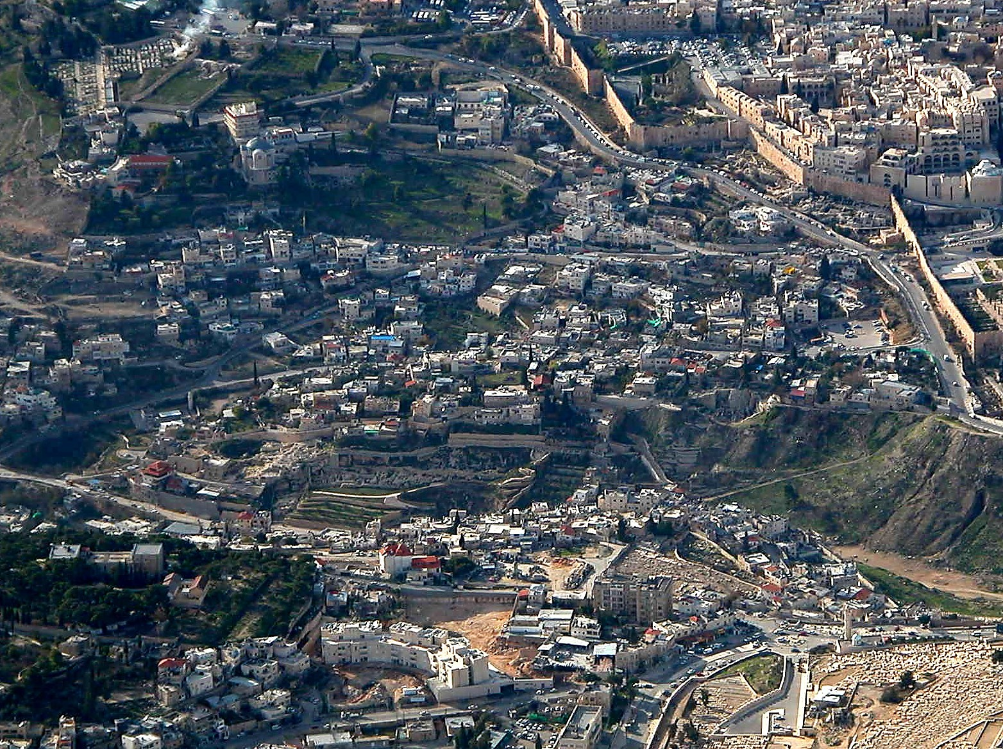
City of David aerial from east close-up
Pool of Siloam
Gihon Spring
City of David aerial from east close-up

Slide 14
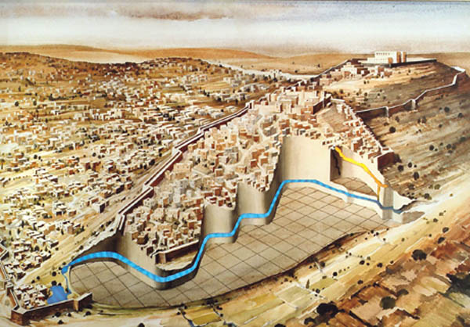
Only 11 ¾” slope in a fifth of a mile !
100’ deep under rock, 1,750 feet long (straight line of 1,070 feet)

Slide 15
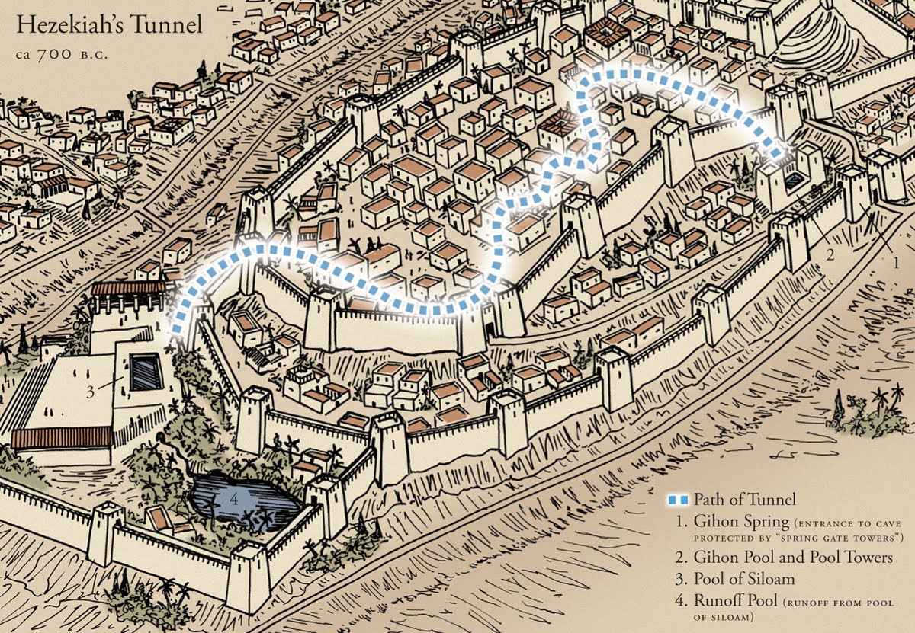

Slide 16
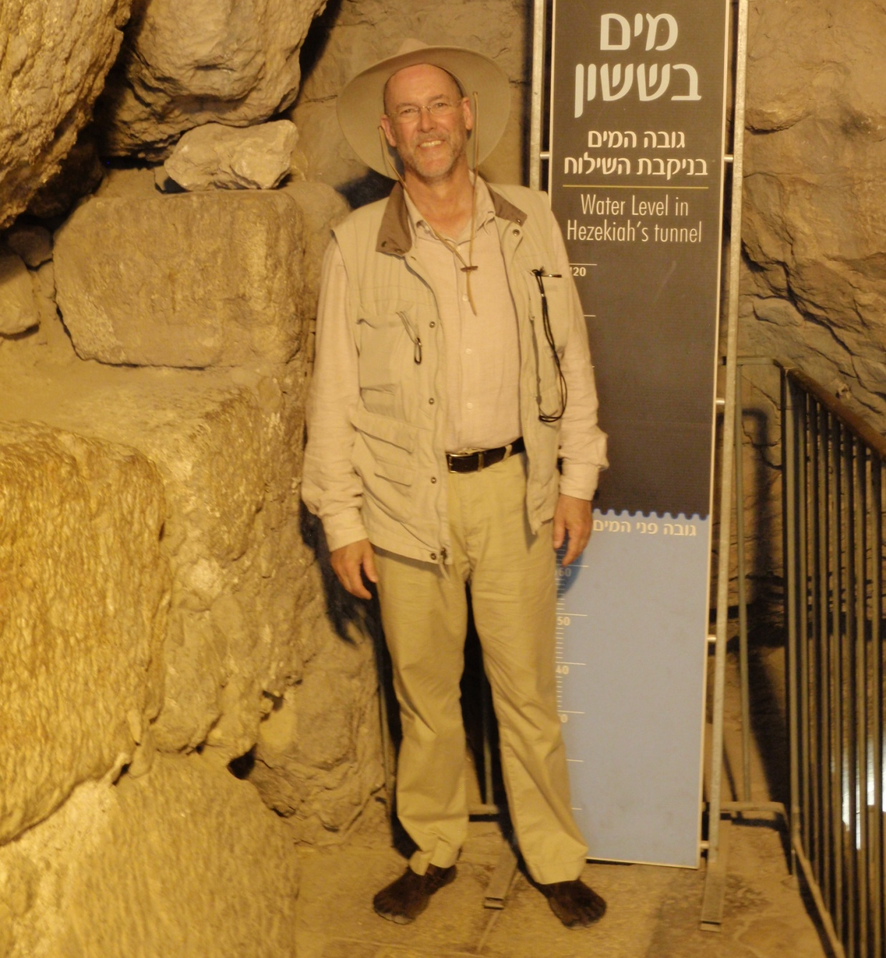
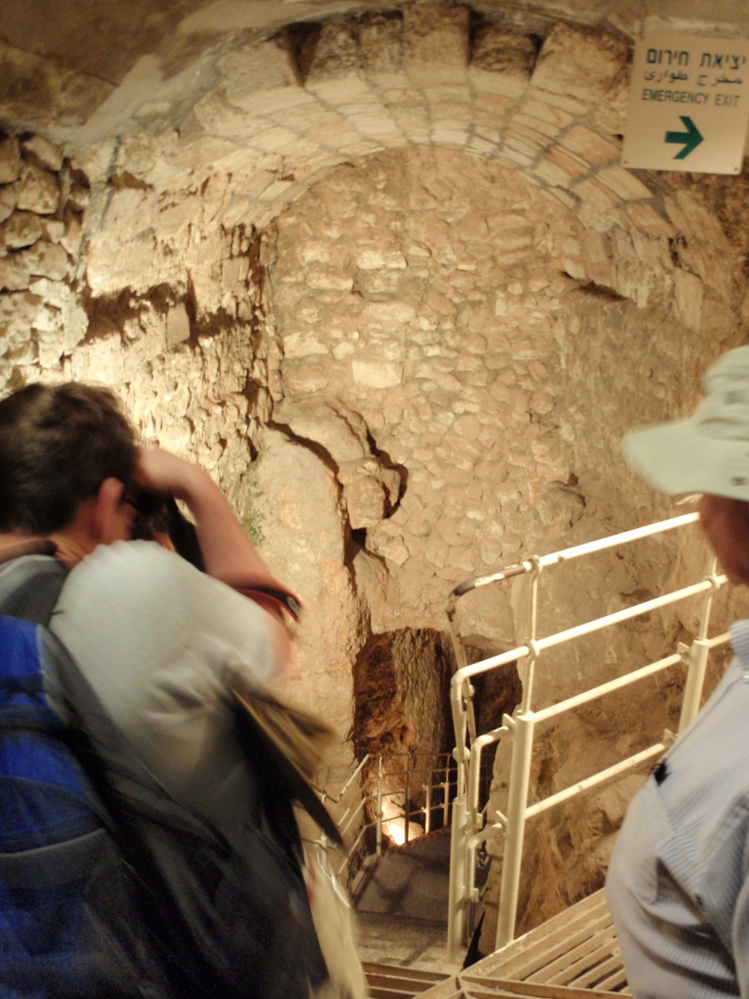

Slide 17
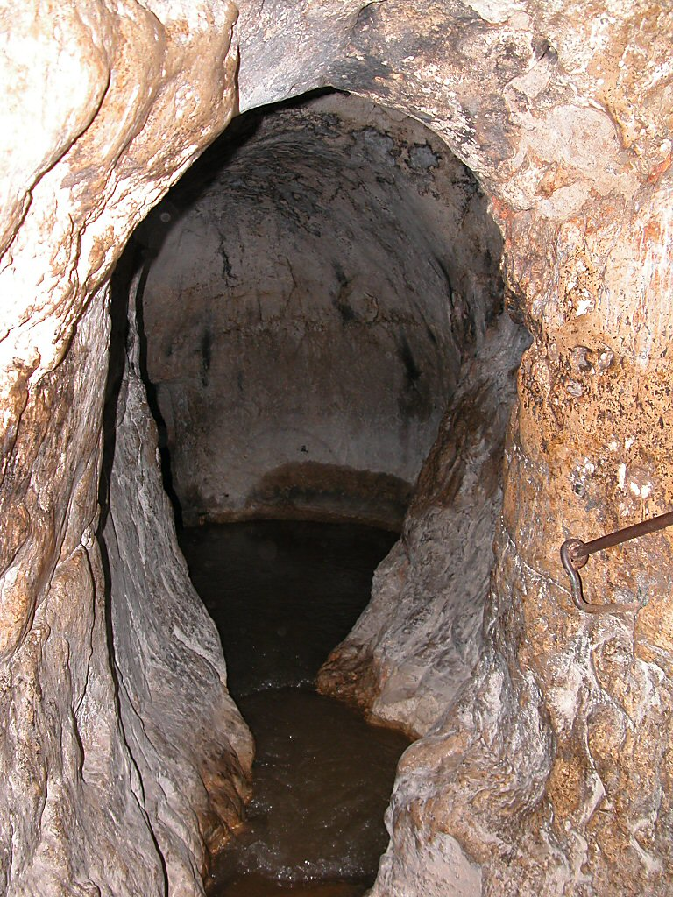
Gihon Spring
Gihon Spring
Notes:
The Gihon Spring
The Gihon Spring is the only spring of Jerusalem.
It is a siphonic, karstic spring, and the name means “gushing” - it surges and the sound can be easily heard. The average gush is about forty minutes and the average period between gushes is six to eight hours, leading to a flow of approximately 317,000 gallons (1,200 cu m) per day. There is believed to be enough water to support a population of about 2,500.
In antiquity, people went up to the cave, whereas today’s visitors go down, because the valley has been filled in. The water ran into the Kidron Valley before Hezekiah’s Tunnel diverted it to the Lower Pool.
The cave is a natural one, but it has been widened. A Mameluke building with Islamic inscriptions was constructed over it.
The Gihon is known as the Fountain of the Virgin Mary (Ein Sitti Miryam – St. Mary’s Spring) based on the Crusader tradition that Mary came here to fetch water and wash the swaddling clothes. It was called by the natives in 1841 the “Mother of Steps” (Ein Umm ed-Daraj) because of the bedrock steps leading to the spring. It is also known as the “Dragon’s Well” (Neh 2:13).
“There seems to be nothing which can be regarded as an allusion to the Fountain of Mary, during the long series of ages from the time of Josephus down to the latter part of the fifteenth century” (Robinson 1841 I: 496).
“The most spectacular of Storrs’s achievements concerned water. When British troops entered the city there were three sources of water supply: the rainwater stored in cisterns under houses, most of which the British considered unfit for human consumption; the water brought by a Turkish-laid pipe from Solomon’s Pools to the south at a rate of up to 20,000 gallons a day; and the water from the Gihon Spring in the Kidron Valley brought into the city by vendors using unhygienic goatskins. The Gihon Spring water itself was, in the words of the official British military history, ‘practically liquid sewage’” (Gilbert 1996: 64-65).

Slide 18
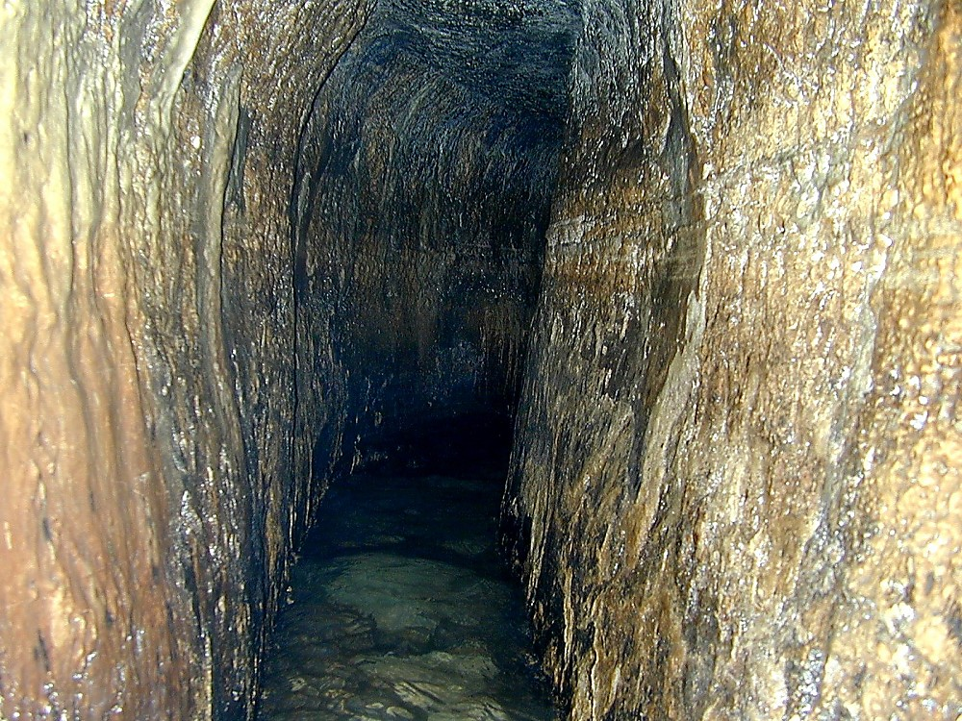
Hezekiah's Tunnel
Notes:
Hezekiah’s Tunnel: History of Study (by Robinson)
Quaresmius in ca. 1625 wrote that his friend Vinhouen tried unsuccessfully to explore what we know as Hezekiah’s Tunnel. He said that a Pater Julius had gone through a few years before but he said nothing else of the canal, indicating that it hadn’t been fully explored. All other references up to 1839 were slight and confused, such that in 1839 a writer could say that it was uncertain whether the water flowed from the Virgin’s Fountain to Siloam or vice versa.
Locals in Robinson’s time believed that the two were connected, but no one had explored it, nor could they give any definite information about it. On April 27, with no one around and with the water level low, Robinson set out to explore it. He started at Siloam. The water was not more than a foot high, most places it was about 3-4 inches. The bottom was covered with sand. He accurately describes the height all the way, but he obviously missed the Siloam Inscription.
“At the end of 800 feet, it became so low, that we could advance no further without crawling on all fours, and bringing our bodies close to the water. As we were not prepared for this, we thought it better to retreat, and try again another day from the other end. Tracing therefore upon the roof with the smoke of our candles the initials of our names and the figures 800, as a mark of our progress on this side, we returned with our clothes somewhat wet and soiled” (Robinson 1841 I: 501-2).
Hezekiah’s Tunnel and the 6th century B.C. tunnel of Euphalios in Greece (which is 0.6 mi., or 1 km, long) are considered the greatest works of water engineering technology in the pre-classical period.

Slide 19
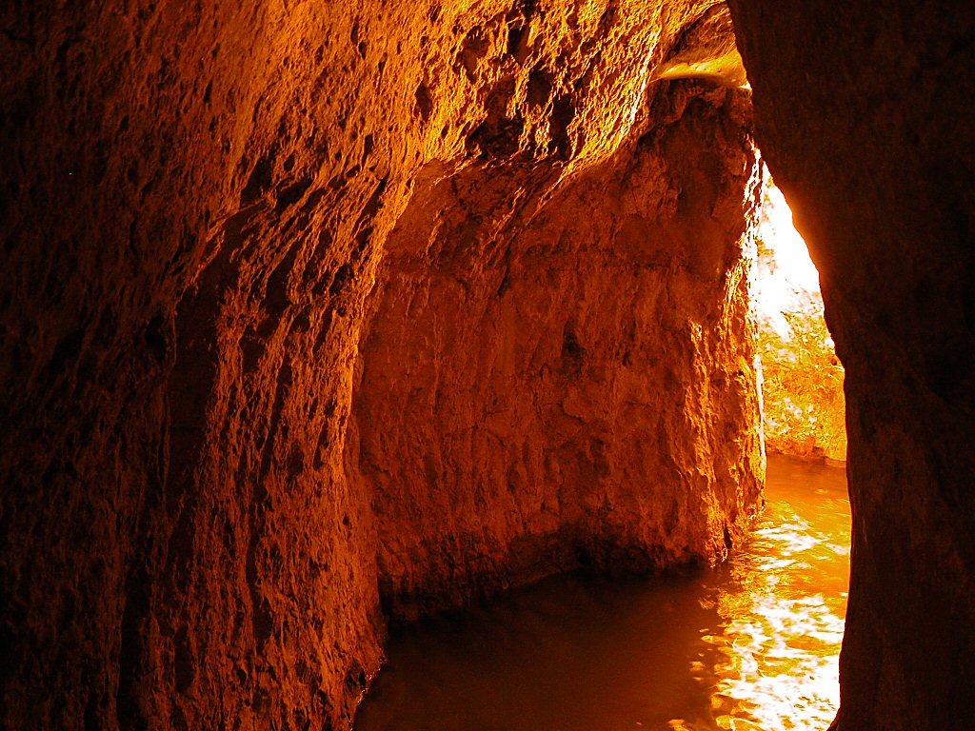
Hezekiah's Tunnel
Notes:
Purpose of Hezekiah’s Tunnel
The purpose of the tunnel was to bring water from the Gihon Spring to the Pool of Siloam.
Hezekiah blocked the Gihon Spring and channeled water to the other side of the hill (2 Chr 32:30)
The name Gihon means “gushing.” This describes the phenomenon of the regular increase of water flow.
Edward Robinson: “My companion was standing on the lower step near the water, with one foot on the step and the other on a loose stone lying in the basin. All at once he perceived the water coming into his shoe; and supposing the stone had rolled, he withdrew his foot to the step; which however was also now covered with water. This instantly excited our curiosity; and we now perceived the water rapidly bubbling up from under the lower step. In less than five minutes it had risen in the basin nearly or quite a foot; and we could hear it gurgling off through the interior passage. In ten minutes more it had ceased to flow; and the water in the basin was again reduced to its former level….Meanwhile a woman of Kefr Selwan came to wash at the fountain. She was accustomed to frequent the place every day and from her we learned, that the flowing of the water occurs at irregular intervals; sometimes two or three times a day, and sometimes in summer once in two or three days” (Robinson 1841: 506-7).

Slide 20
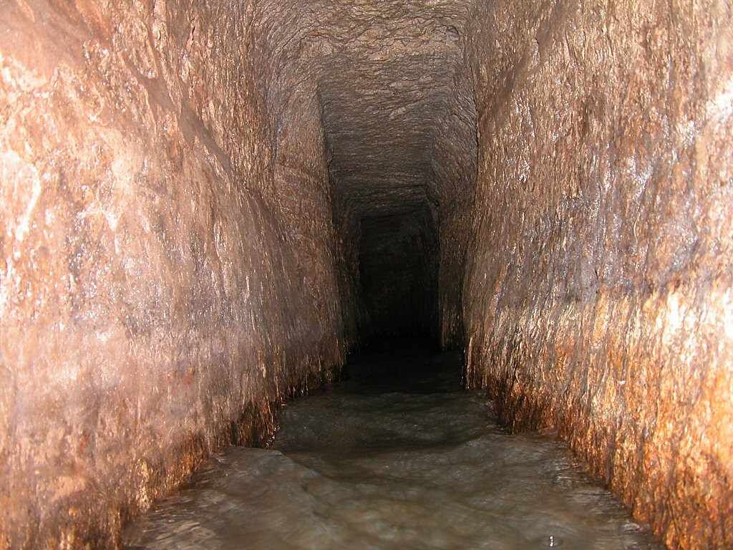
Hezekiah's Tunnel
Notes:
Construction of the Tunnel
The tunnel’s length is 1750 feet (533 m). If it had been dug in a straight line, the length would be 1,070 feet (335 m). It is 65 percent longer as carved.
The reason for the curved shape of the tunnel is not known. Scholars have offered different ideas.
According to R. A. S. Macalister, Hezekiah’s tunnel was considered a “‘pathetically helpless piece of engineering’ due to its random windings, which could have been avoided if an Egyptian engineer had been in charge of its construction” (Bunimovitz 1995: 61).
Henry Sulley, an architect, was the first, in 1929, to suggest that Hezekiah’s tunnel followed a natural crack in the rock.
Gill argued that the two crews of diggers followed a natural karstic dissolution channel. This idea seems to be followed by archaeologists today. Gill does not have a good answer for why there were false turns and three false tunnels (all to the south of the meeting point) if it was a natural karst.
Abells and Arbit offer a different explanation: “Our explanation of the confidence of Hezekiah’s workers is based on an important detail in the construction of the Siloam Channel. The Siloam Channel begins at a level three metres above the Gihon Spring, which necessitated the construction of a second damming wall (Wall i). It is worth noting that the raising of the water level at the spring by three metres would cause the water to flow ‘uphill’ through the karstic dissolution channel and appear somewhere above the present location of the Siloam Pool. The relationship between the appearance of the water at the Siloam end of the dissolution channel and the raising of the water level at the spring could have been recognized and thereby have been known to Hezekiah’s workers. If, as some believe, the Siloam Channel was built at the time of King Solomon and its irrigation feature was the source of water for his gardens then the rate of flow via the karstic channel may have been affected during the periodic maintenance of Wall i over the two-hundred-year hiatus between Solomon and Hezekiah. If, however, the Siloam Channel was constructed closer to the time of Hezekiah then the appearance of water at the Siloam Pool end could easily have been associated with the Gihon Spring as its source. In either case, it should be clear that it was the effect of Wall i that gave the workers the assurance of success of meeting. With this knowledge, Hezekiah’s workmen could be divided into two crews, working simultaneously. At the price of following a circuitous 513-metre course (instead of the 320-metre straight-line distance) they gained complete confidence that the project would conclude with the successful meeting of the two work crews” (Abells and Arbit 1995b: 6).
Although narrow and low in parts, the tunnel can be waded through. The water is normally about 2 feet (0.6 m) deep. Due to the siphon effect, it occasionally does rise, but only by about 6-8 inches (15-20 cm).
The tunnel descends only 12.5 inches (32 cm) over 1,750 feet (533 m).

Slide 21
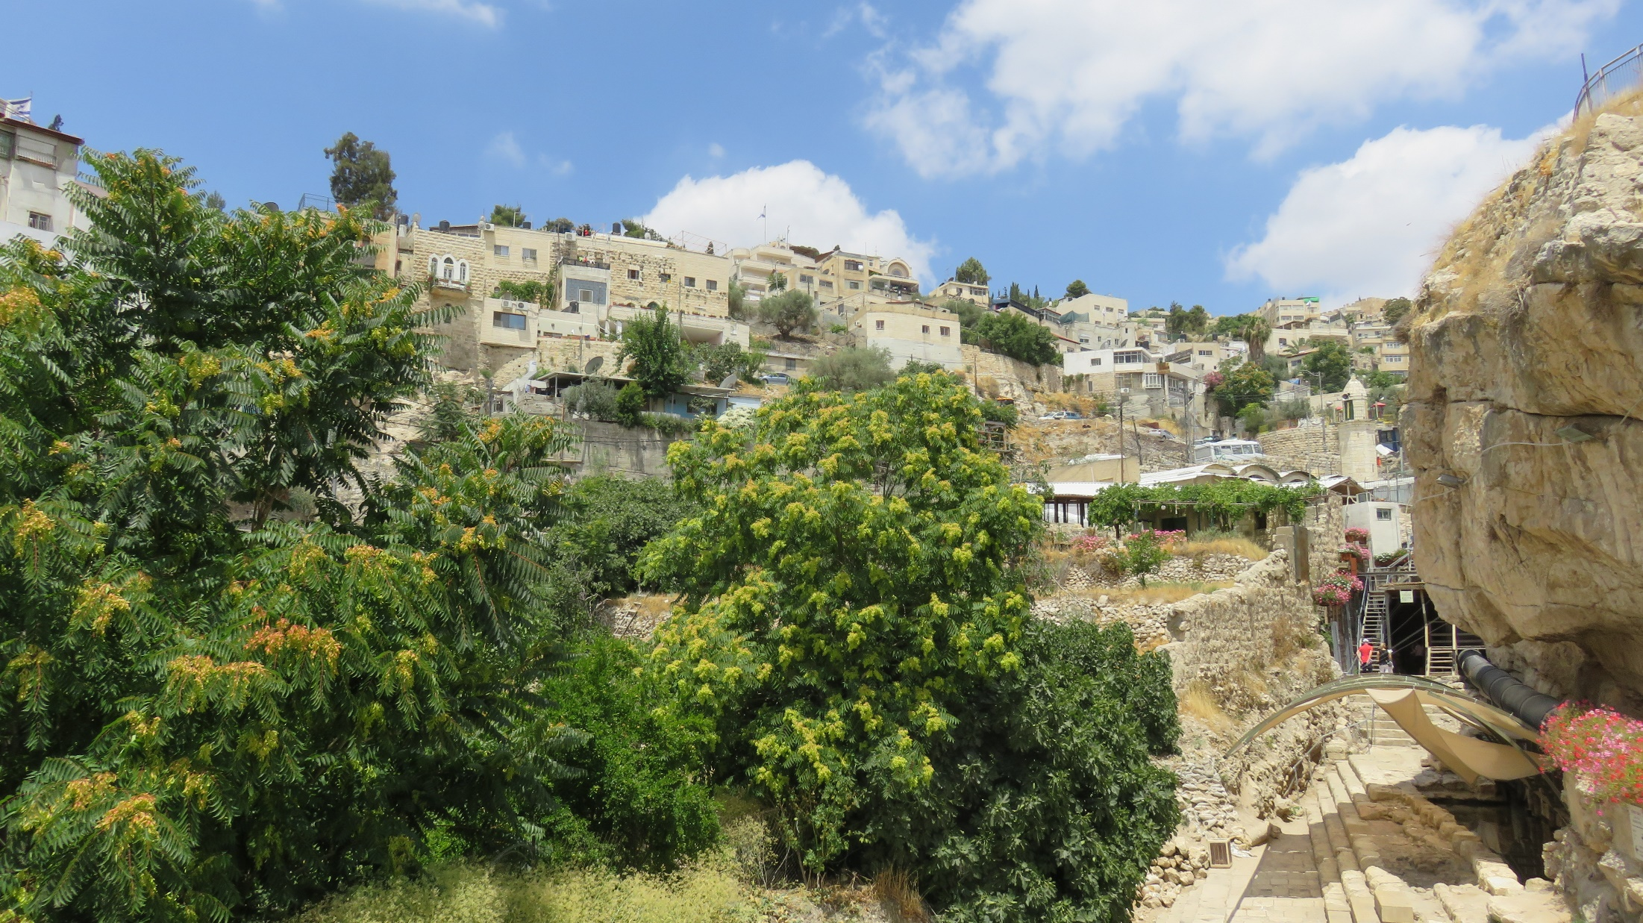

Slide 22
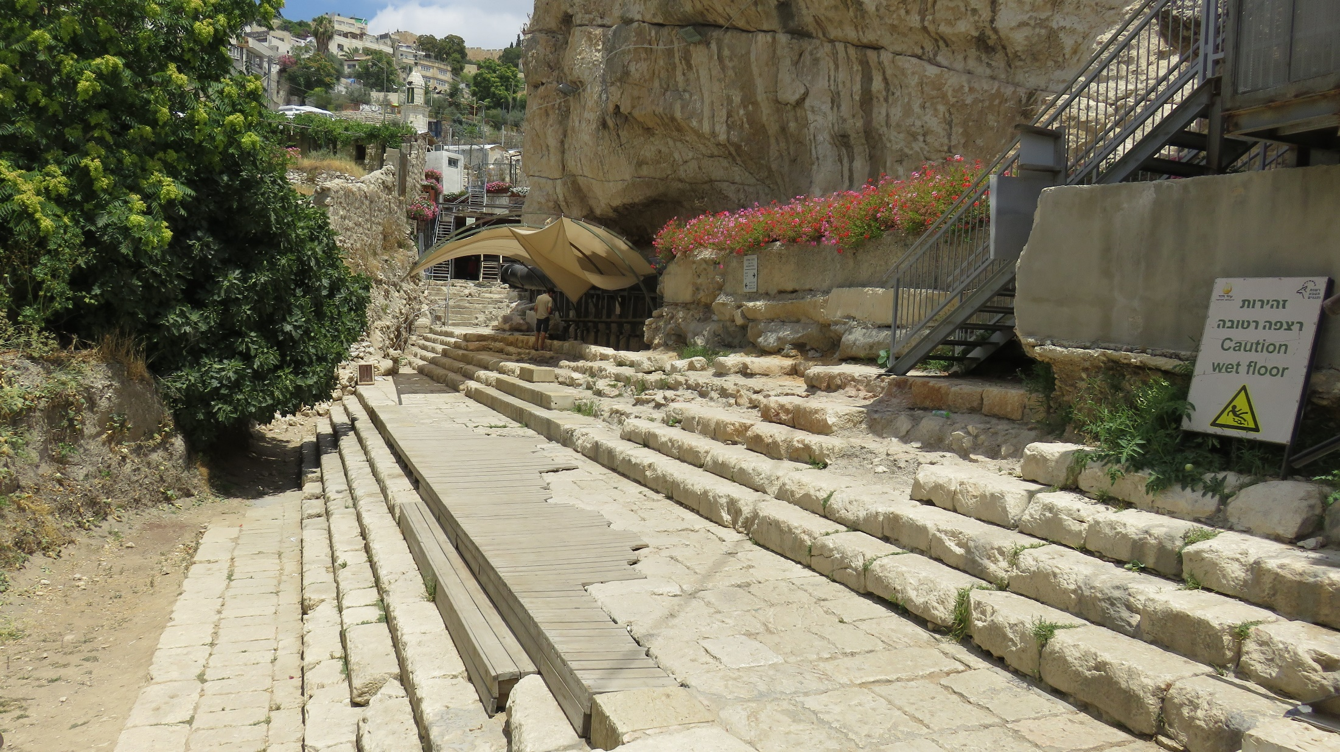
They were saying to him, "How then were your eyes opened?"
He answered, "The man who is called Jesus made clay,
and anointed my eyes, and said to me, 'Go to Siloam and wash’;
so I went away and washed, and I received sight." (John 9:10-12 )

Slide 23
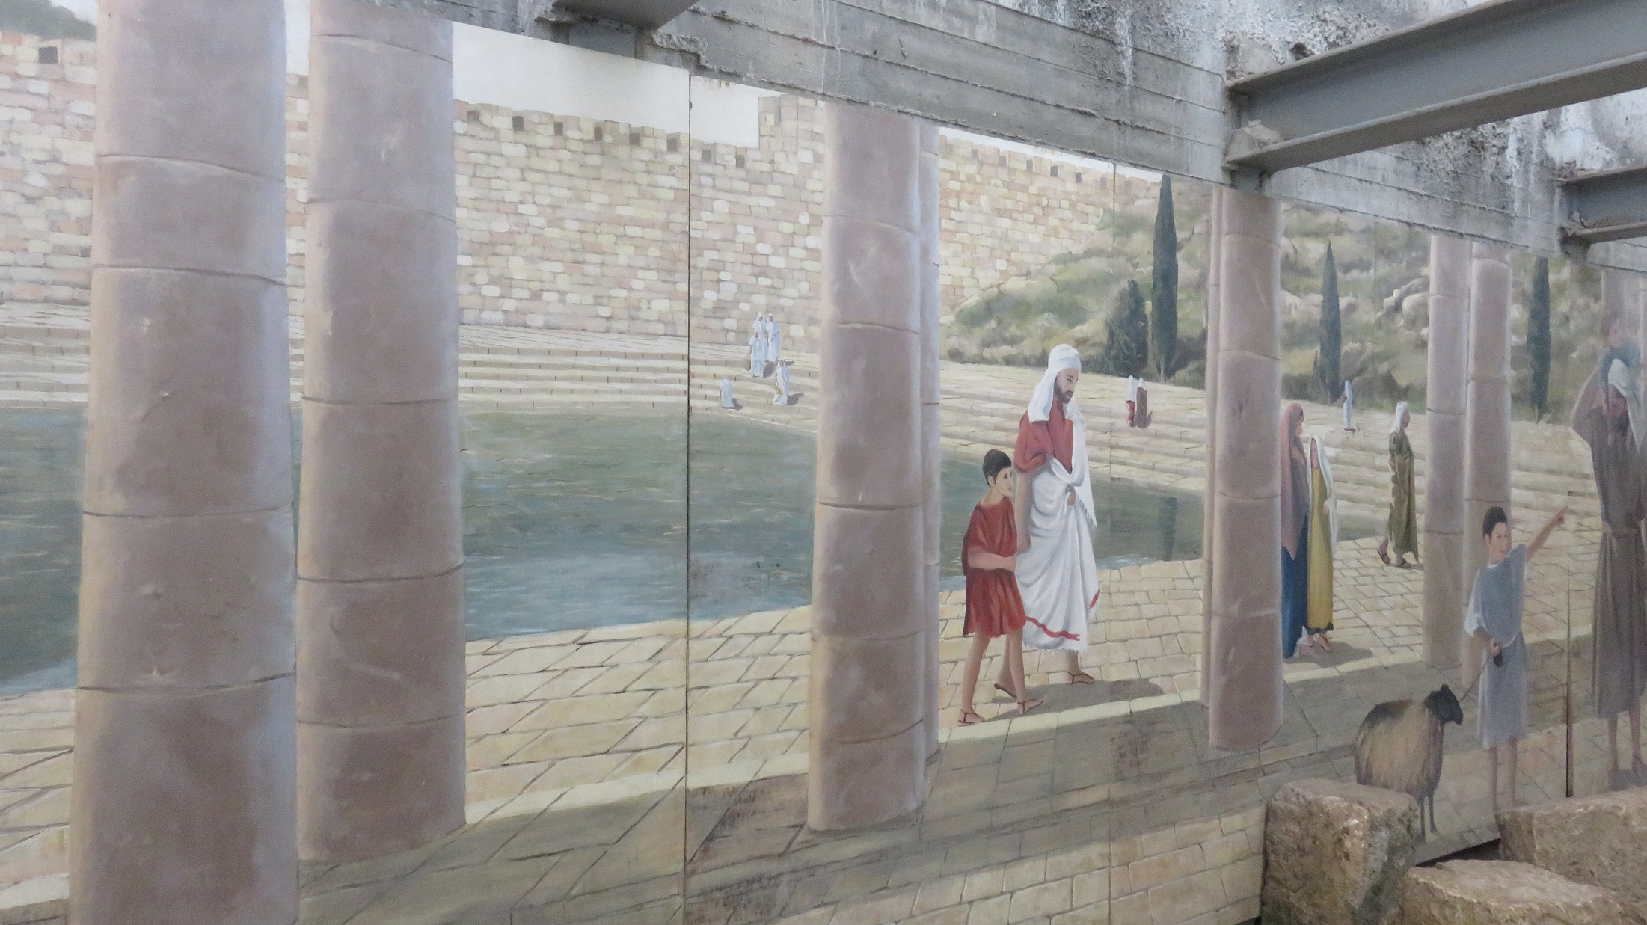

Slide 24
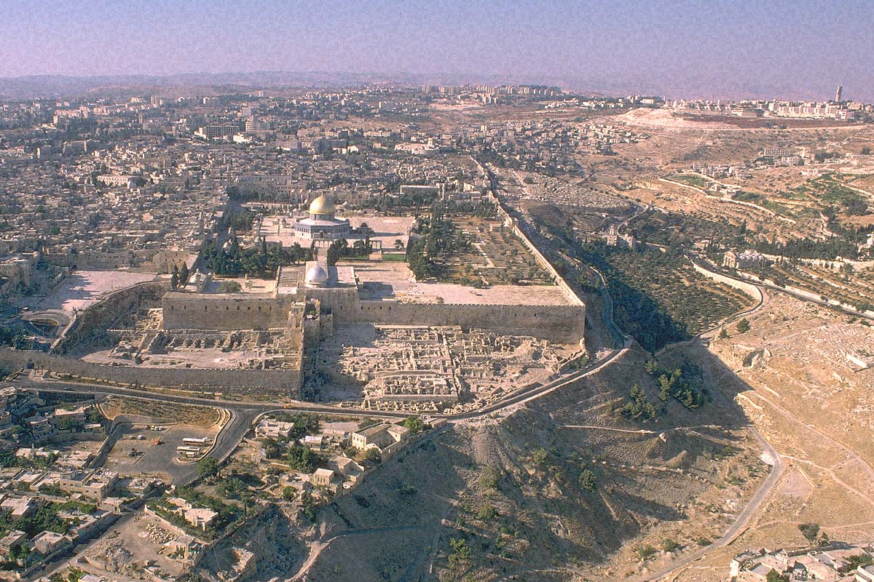
Egypt, Arabia, Syria, & Civil Wars conquer her until Babylon in 586 B.C.

Slide 25
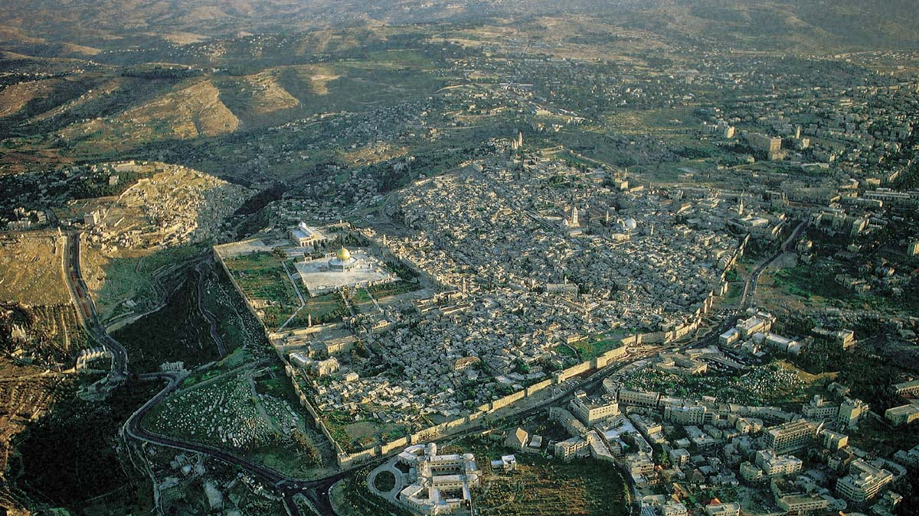
Ezra & Nehemiah rebuild city, walls, and Temple

Slide 26
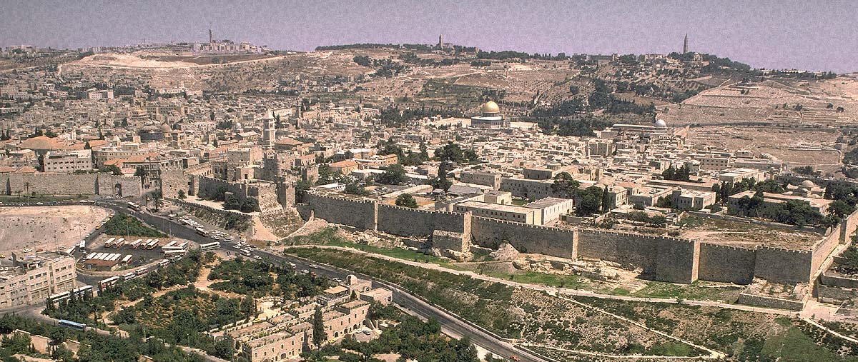
B.C. Alexander the Great takes over
Racked with war for next 300 years

Slide 27
“...there have been at least 118 separate conflicts in and for Jerusalem during the past four millennia... from local religious struggles to strategic military campaigns... Destroyed completely at least twice, besieged twenty-three times, attacked an additional fifty-two times, and captured and recaptured 44 times. There have been 20 revolts and innumerable riots... Jerusalem has only changed hands completely peacefully twice in the past 4,000 years.”
Jerusalem Besieged: From Ancient Canaan to Modern Israel
(Eric H. Cline, Ann Arbor: Univ of Michigan Press, 2004)

Slide 28
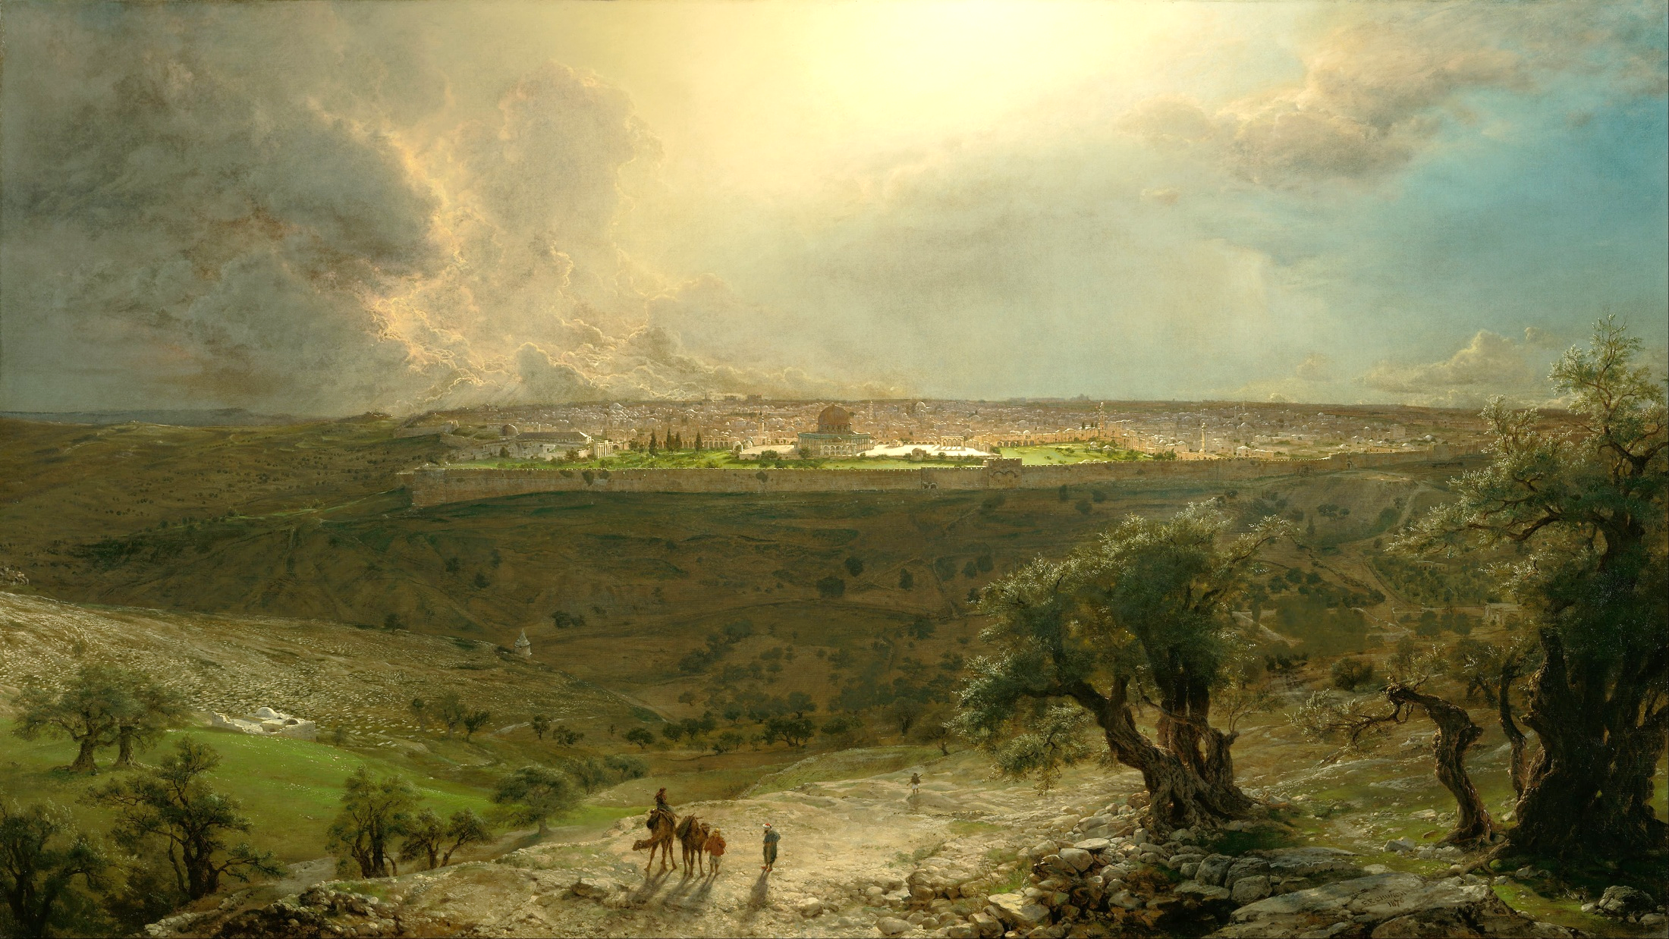
What Does “JERUSALEM” Mean?
“City of Peace”

Slide 29
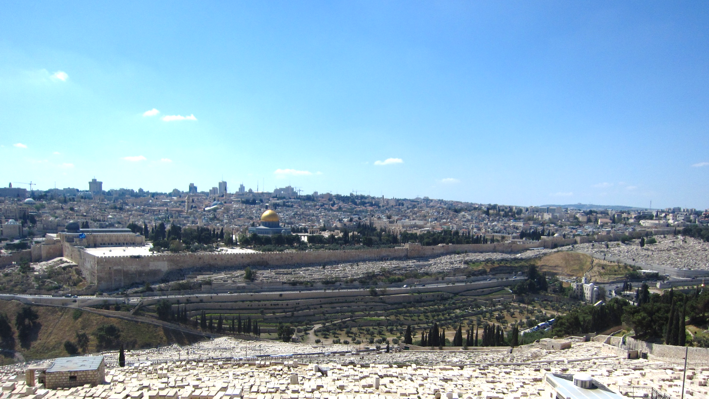
2 Chronicles 6:3-6
Psalm 2:4-6
Isaiah 2:1-4
Zechariah 8:3
GOD’S NAME
MESSIAH’S THRONE
SOURCE OF THE GOSPEL
CITY OF TRUTH

Slide 30
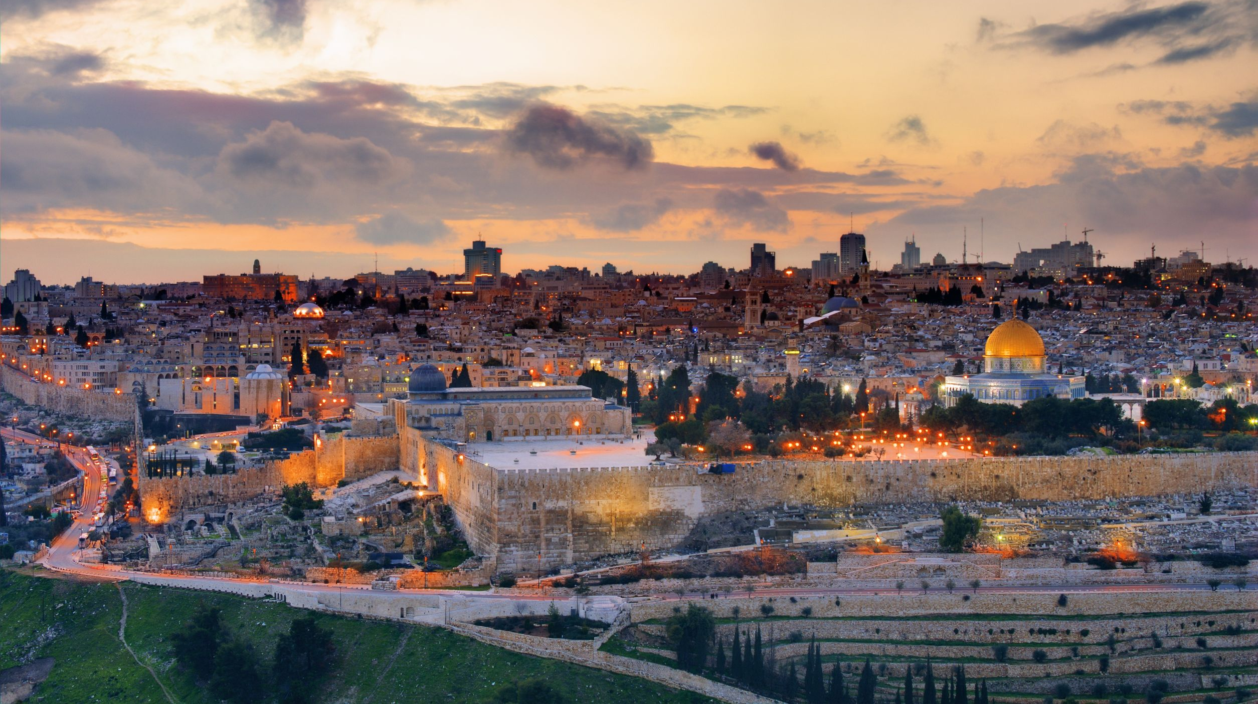
Our citizenship is in heaven, from which also we eagerly wait for a Savior, the Lord Jesus Christ; who will transform the body of our humble state into conformity with the body of His glory, by the exertion of the power that He has even to subject all things to Himself. (Philippians 3:20f)

