Slide 1
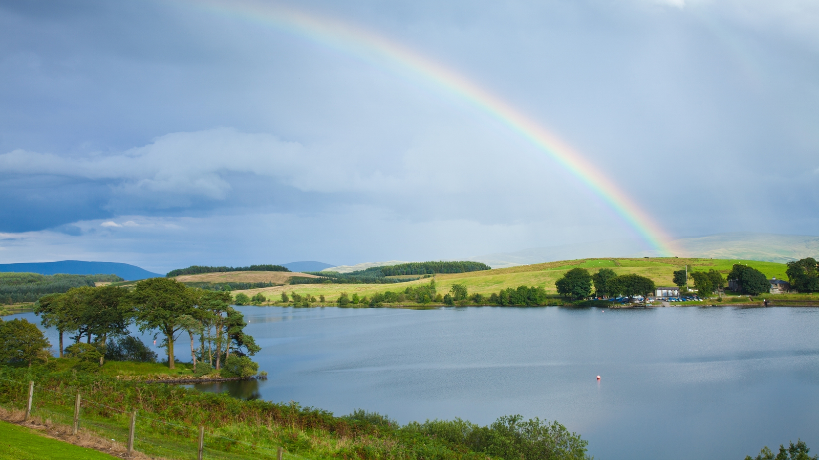
A Land Flowing
With Milk And Honey
September 10, 2017

Slide 2

Judges 5:31
Let those who love God be like
the rising of the sun in its might.
Acts 2:2
There came from heaven a noise like
a violent rushing wind
More than a THOUSAND of these in Scripture !
Psalm 37:1f
Do not fret because of evildoers. Be not envious toward wrongdoers. For they will wither like
the grass and fade like the green herb.

Slide 3
Psalm 133
Behold, how good and how pleasant it is for brothers to dwell together in unity!
It is like the precious oil upon the head, coming down upon the beard, even Aaron’s beard, coming down upon the edge of his robes.
It is like the dew of Hermon coming down
upon the mountains of Zion…

Slide 4
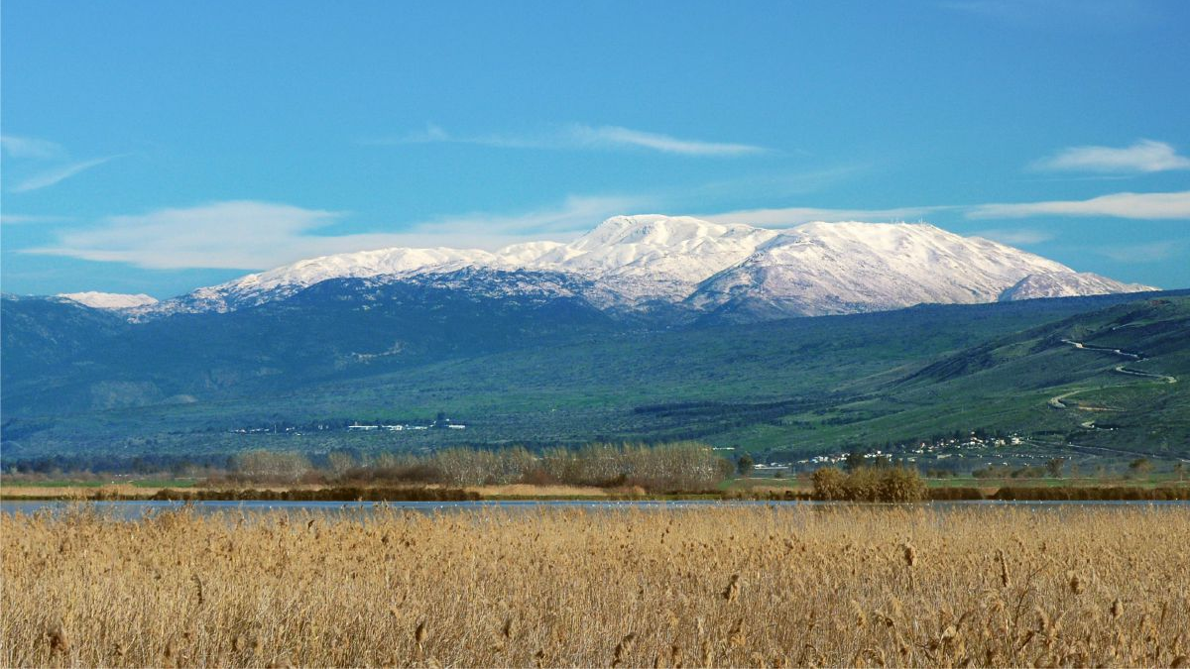
Psalm 133 for brothers to dwell together in unity
is like the dew of Hermon

Slide 5
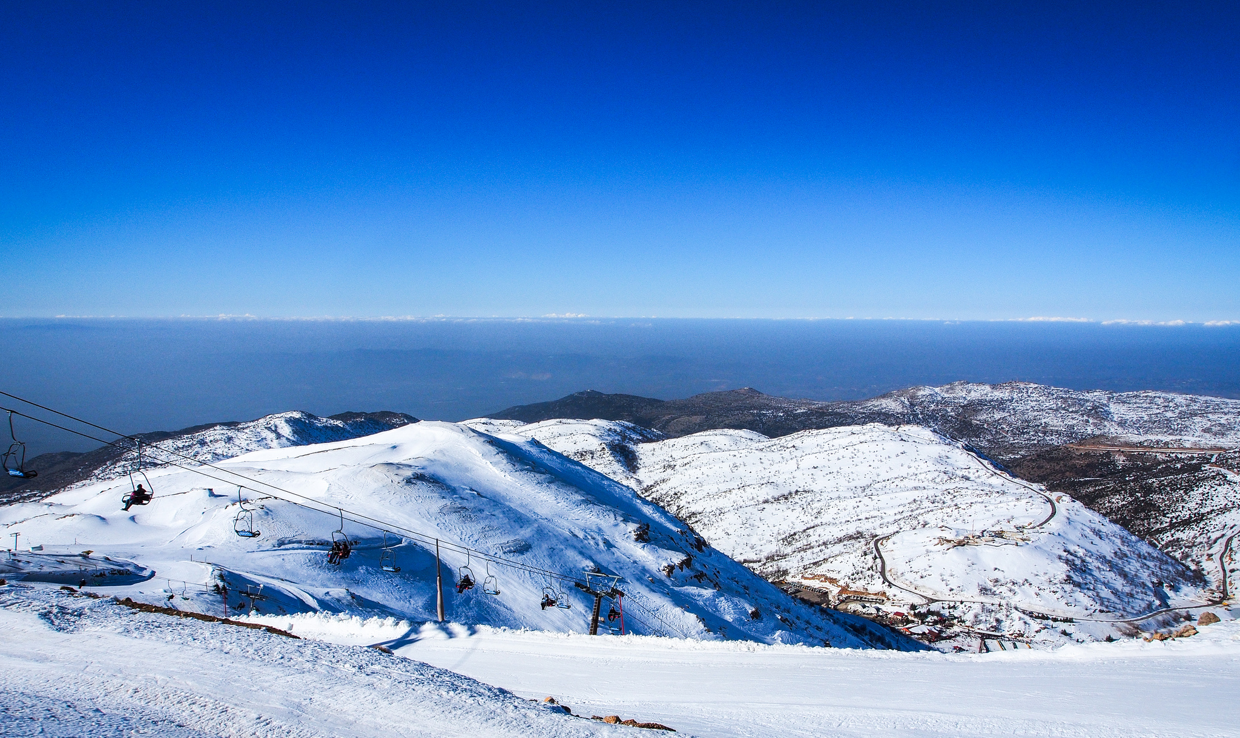
Did you know Mount Hermon is 9,000 feet high?
And has a great ski resort with three lifts?

Slide 6
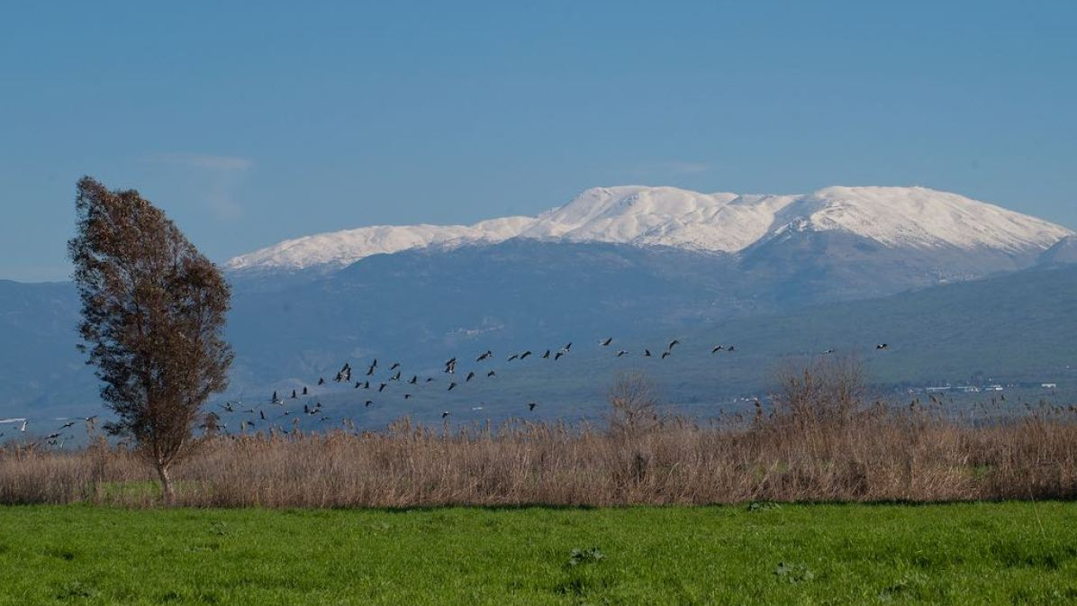
Did you know …
100’s of MILLIONS of birds migrate through Israel every year?
540 different SPECIES travel through Israel every year!
Israel is the center of the bird watcher’s universe

Slide 7
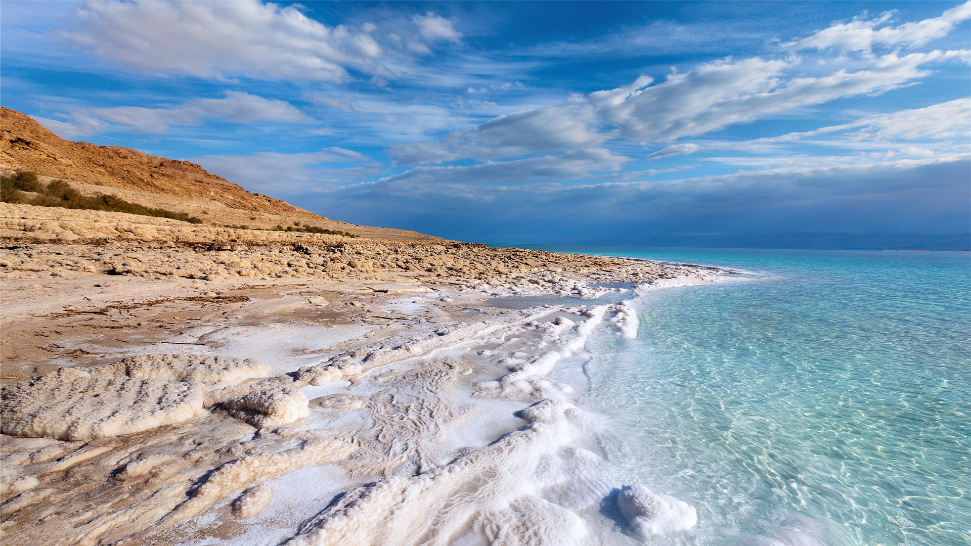
Did you know …
Dead Sea (Salt Sea) is named 9 times in the Bible?

Slide 8
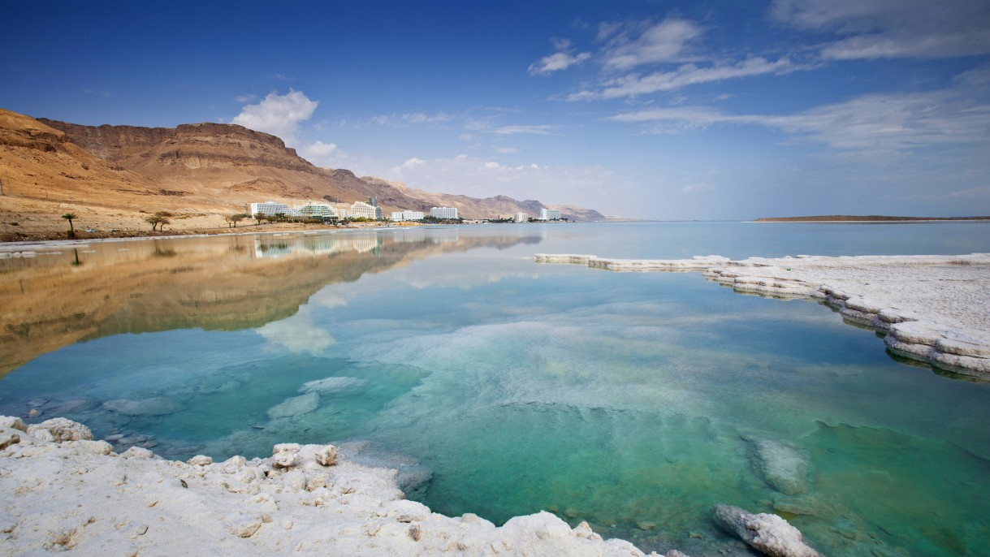
Sodom & Gomorrah, Jericho, En Gedi, Qumran, Masada
Moses, Joshua, David, Herod the Great
60 Miles long and 10 miles wide
978 feet deep

Slide 9

GENESIS 12:1-3
The promises to Abraham are the theme of the entire Bible.
These promises are presented to Abraham FIVE TIMES !
“A Land” is mentioned FOUR OUT OF FIVE TIMES !

Slide 10
GENESIS 12:1-3
The Lord said to Abram, "Go forth from your country, and from your relatives and from your father's house, to the land which I will show you; and I will make you a great nation, and I will bless you, and make your name great; and so you shall be a blessing; and I will bless those who bless you, and the one who curses you I will curse. And in you all the families of the earth will be blessed."

Slide 11
GENESIS 13 - 25
Shechem, Bethel, Ai, the Negev,
Sodom & Gomorrah, Salt Sea, Hebron, Dan
Let’s just take one story...

Slide 12
GENESIS 14:8-11
The king of Sodom and the king of Gomorrah and the king of Admah and the king of Zeboiim and the king of Bela (that is, Zoar) came out; and they arrayed for battle against them in the valley of Siddim, against Chedorlaomer king of Elam and Tidal king of Goiim and Amraphel king of Shinar and Arioch king of Ellasar — four kings against five. Now the valley of Siddim was full of tar pits; and the kings of Sodom and Gomorrah fled, and they fell into them. But those who survived fled to the hill country.

Slide 13
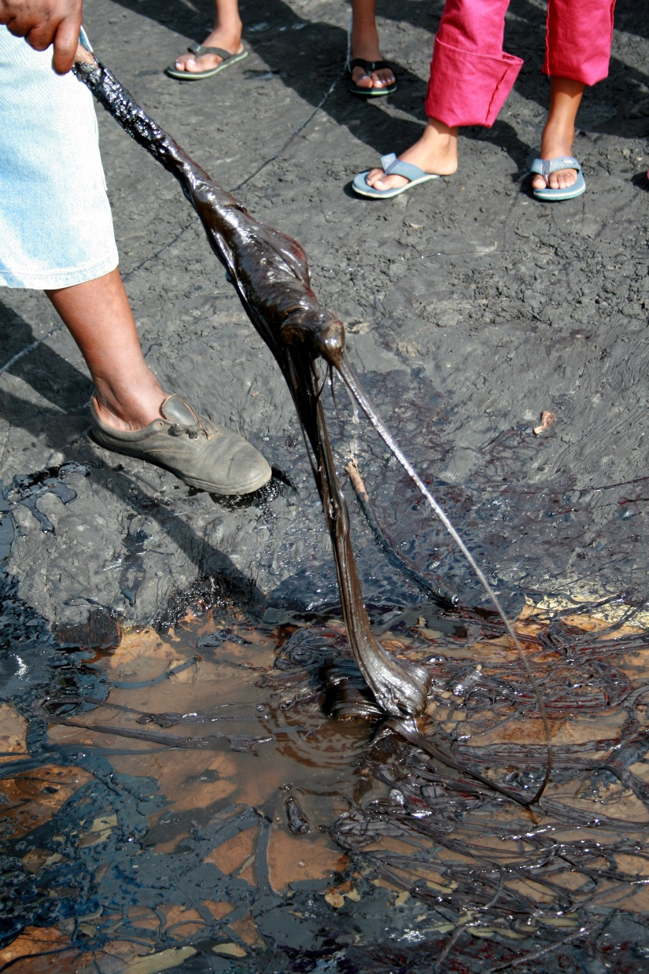
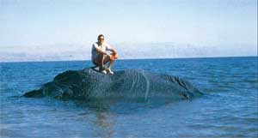
Valley of Siddim = Dead Sea Valley
Dead Sea also called “Lake Asphaltitis”
Tar or Bitumen is naturally produced there

Slide 14

“A Land Flowing With Milk And Honey”
8 Times
6 Times
5 Times
Exodus 3:8
Exodus 3:17
Exodus 13:5
Exodus 33:3
Leviticus 20:24
Numbers 13:27
Numbers 14:8
Numbers 16:13f
Deuteronomy 6:3
Deuteronomy 11:9
Deuteronomy 26:9
Deuteronomy 26:15
Deuteronomy 27:3
Deuteronomy 31:20
Joshua 5:6
Jeremiah 11:5
Jeremiah 32:22
Ezekiel 20:6
Ezekiel 20:15

Slide 15
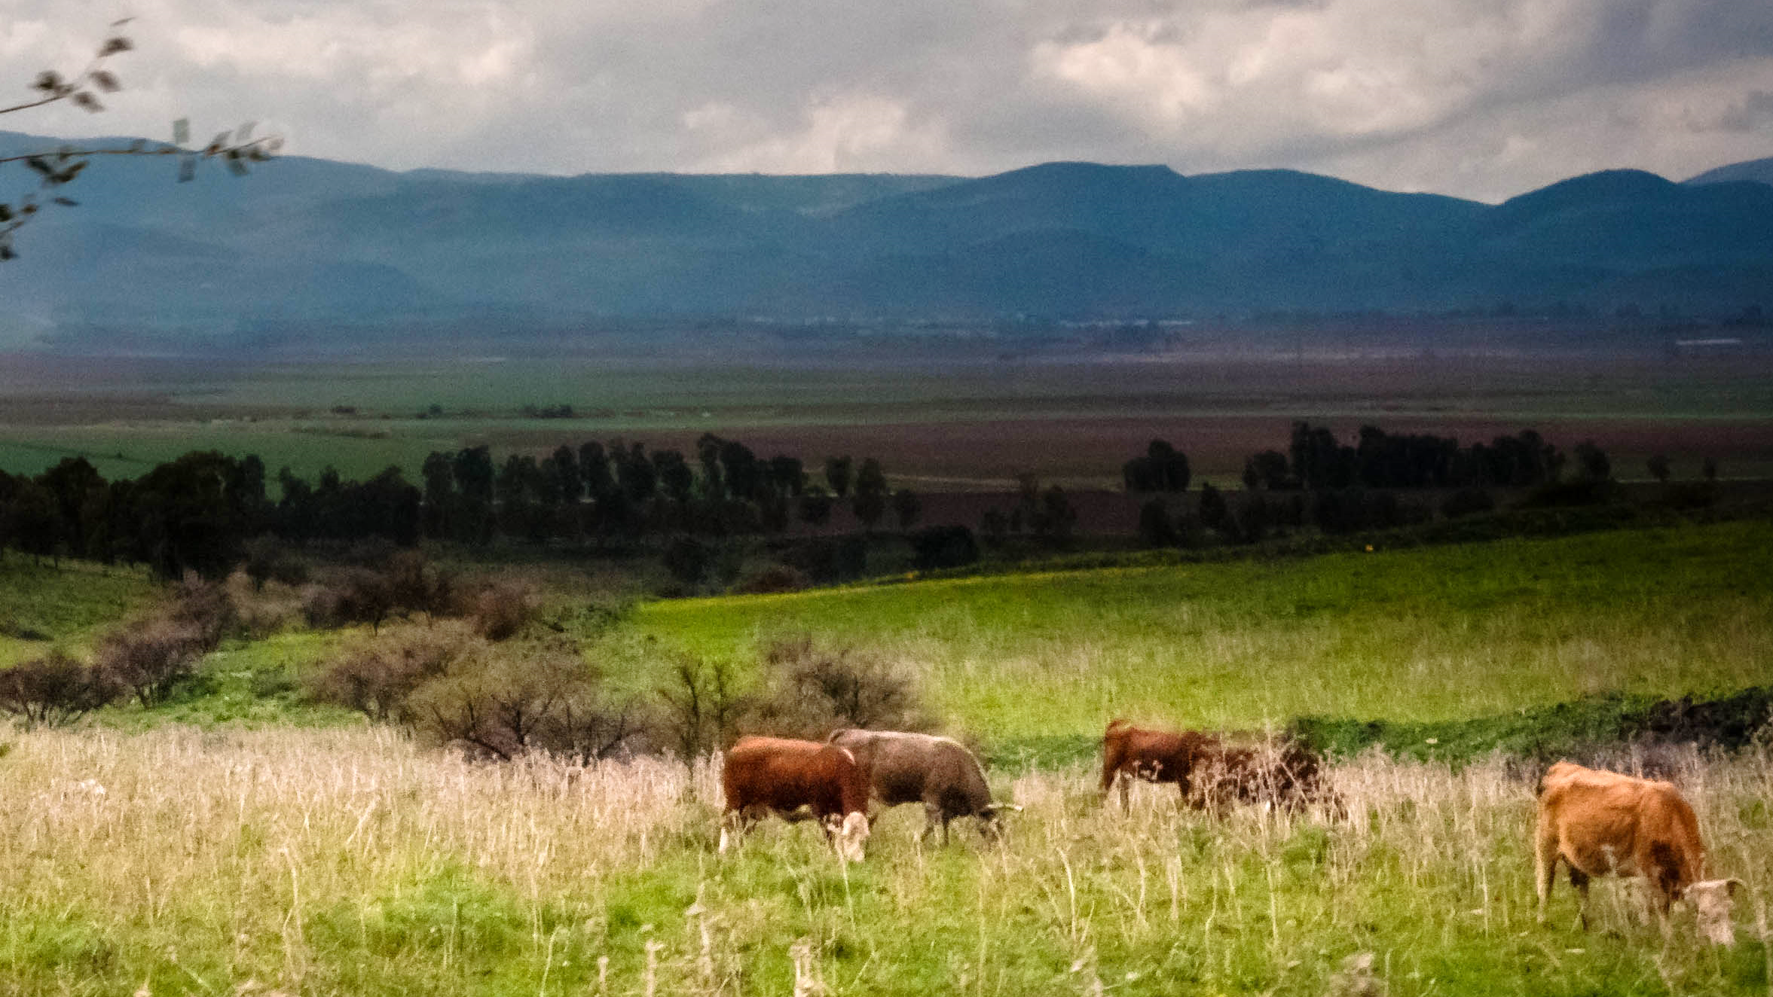
A Land Flowing With Milk…

Slide 16
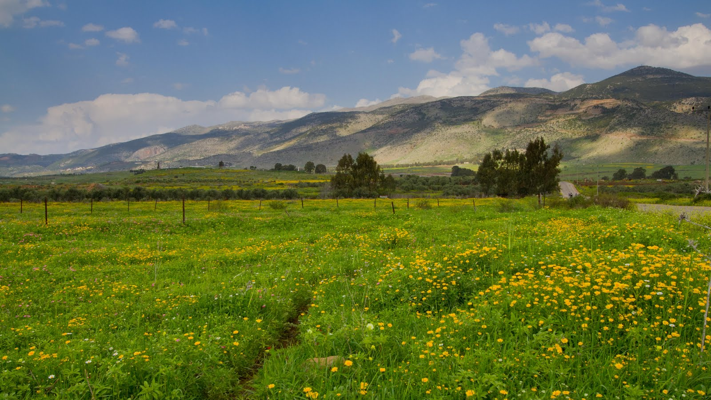
A Land Flowing With Honey…

Slide 17
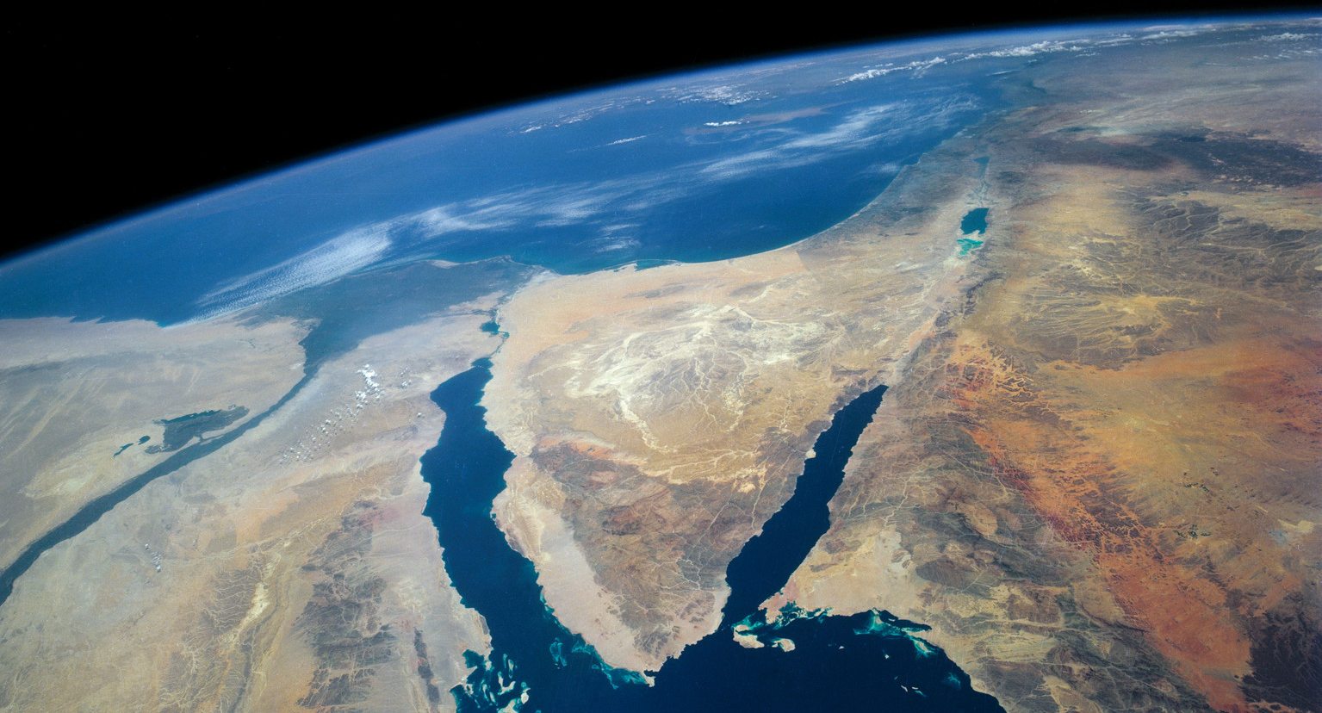
Gulf of Suez
Gulf of Aqaba

Slide 18
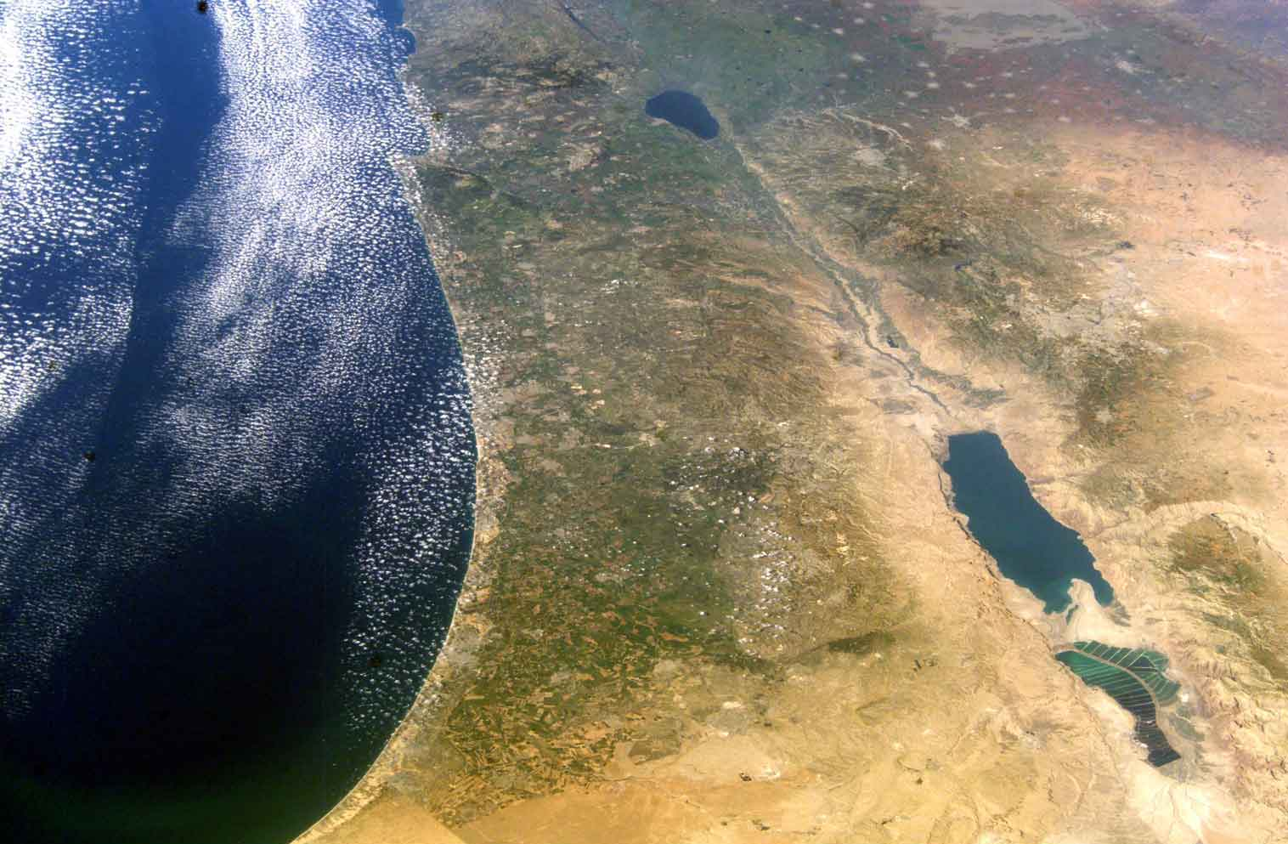
“Dan to Beersheba” = 150 miles
Joppa to Jordan = 50 miles
Here to N. Chicago = 150 Miles
Here to Monticello
Logansport
Brazil
Franklin
Shelbyville
}
50 Miles

Slide 19
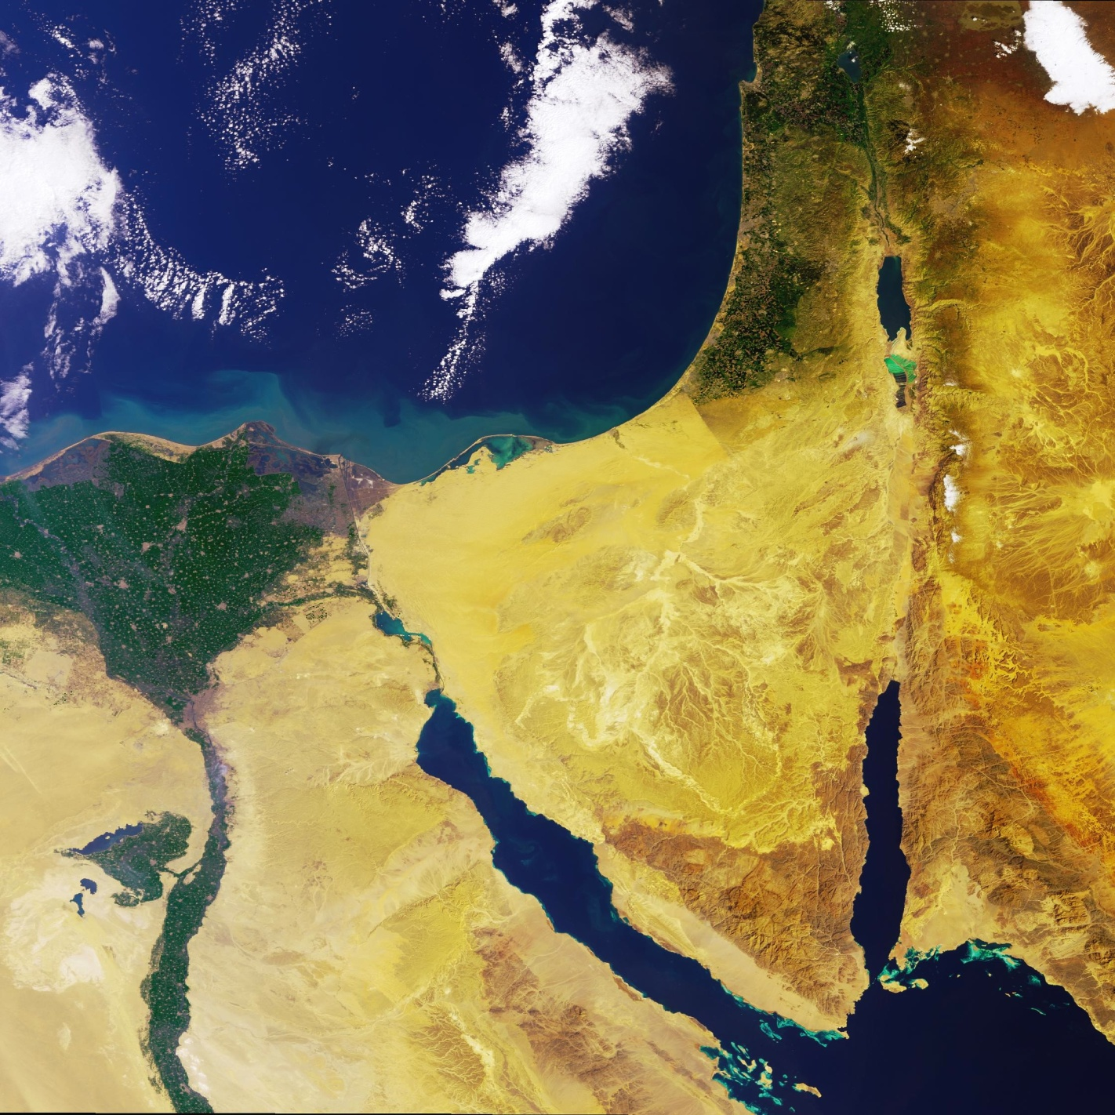
1973 – 2010
Geographically blind
Israel
Approximate Latitude of
Savannah, Dallas, San Diego
9,232 feet above sea level
Sea of Galilee is 695 feet below
Dead Sea is 1,411 feet below
Arabian
Peninsula
Egypt
&
Nile
River

Slide 20
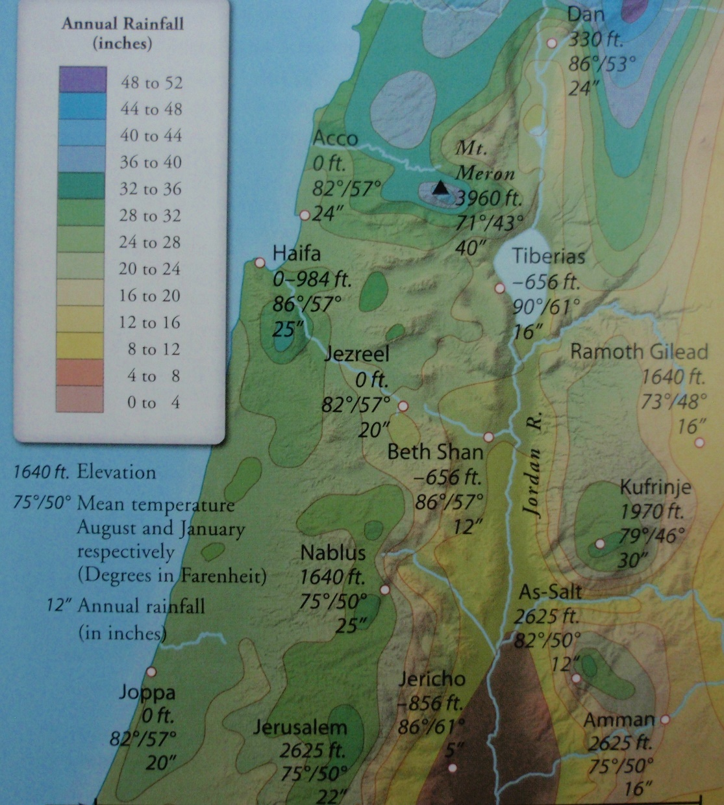
Every climate imaginable
All between here & Chicago

Slide 21
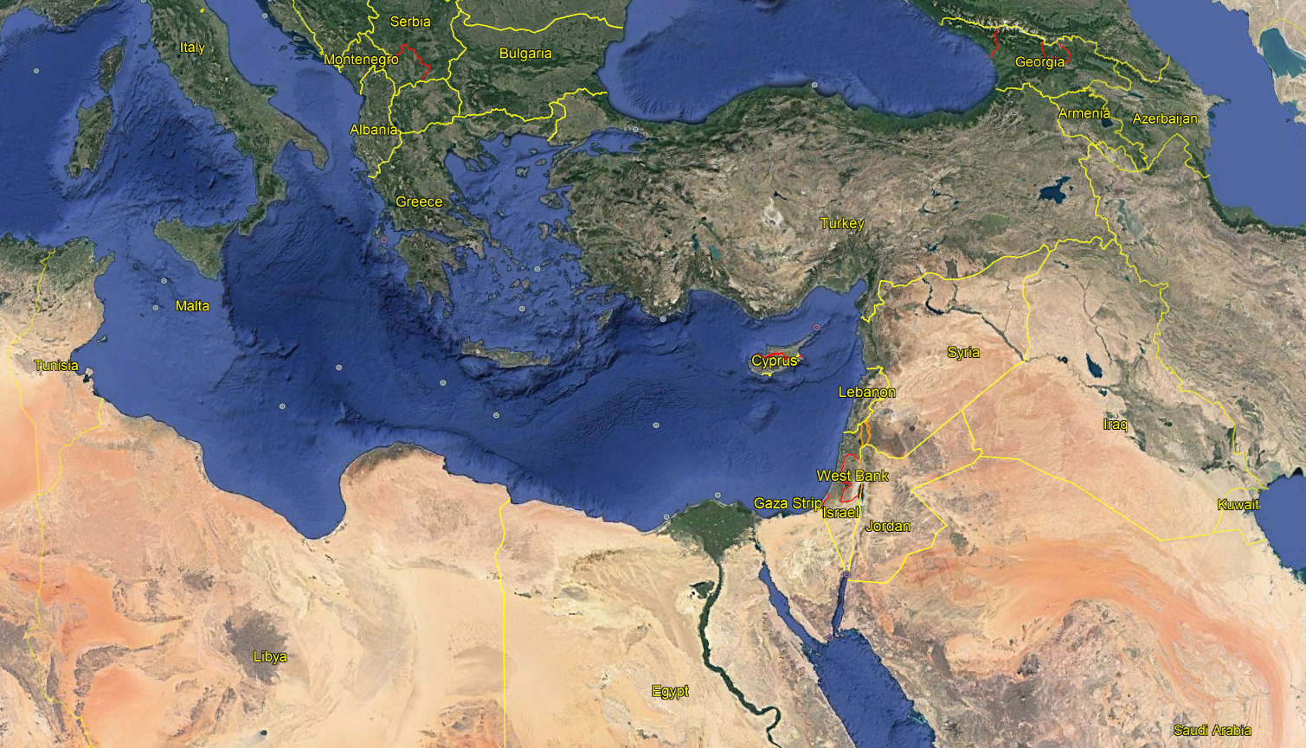

Slide 22
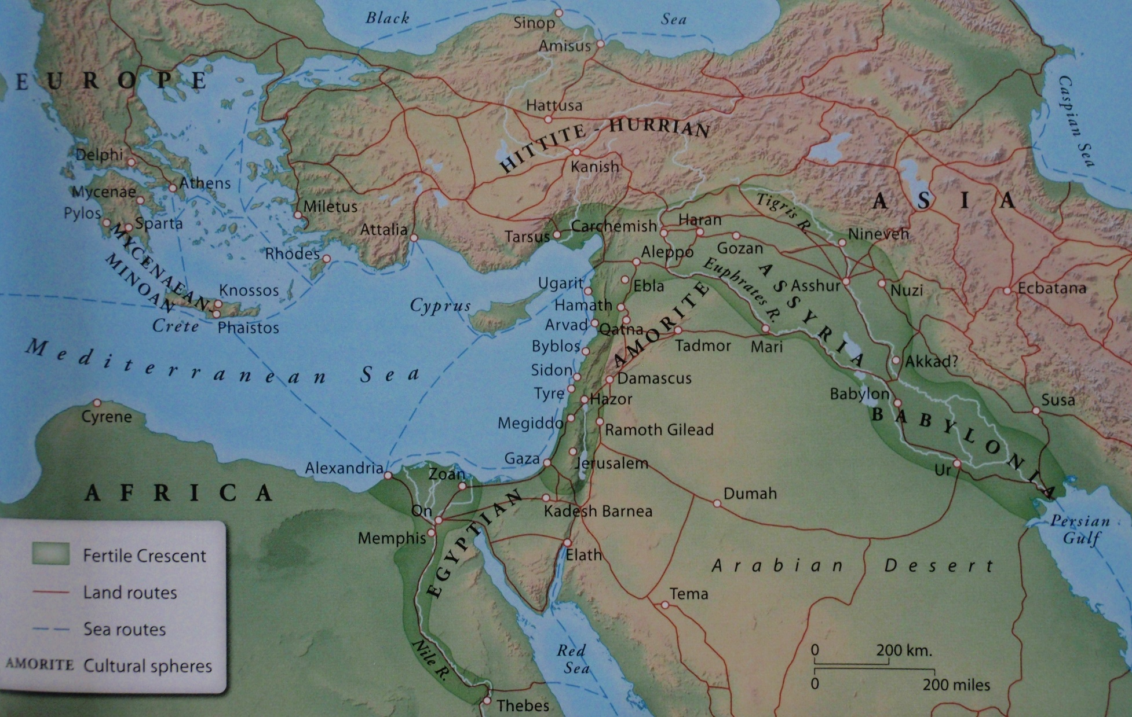

Slide 23
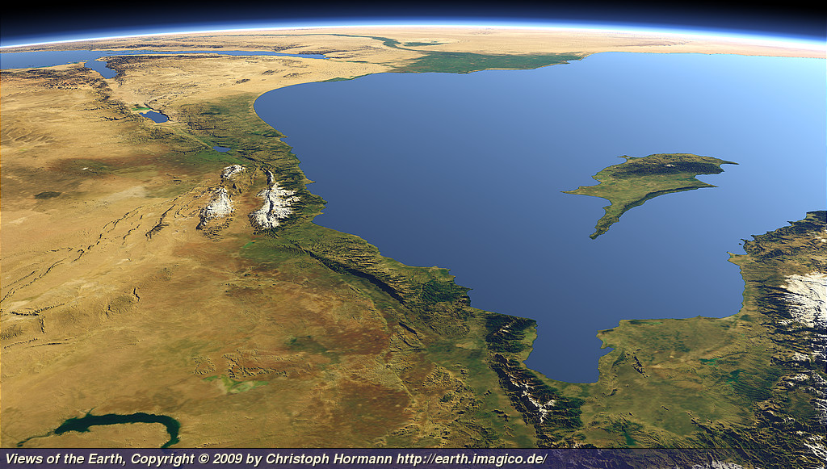
Egypt & Africa
Sinai
Cyprus
Antioch of Syria
Fertile Crescent

Slide 24
You will receive power when the Holy Spirit has come upon you; and you shall be My witnesses both in Jerusalem, and in all Judea and Samaria, and even to the remotest part of the earth. (Acts 1:8)

Slide 25
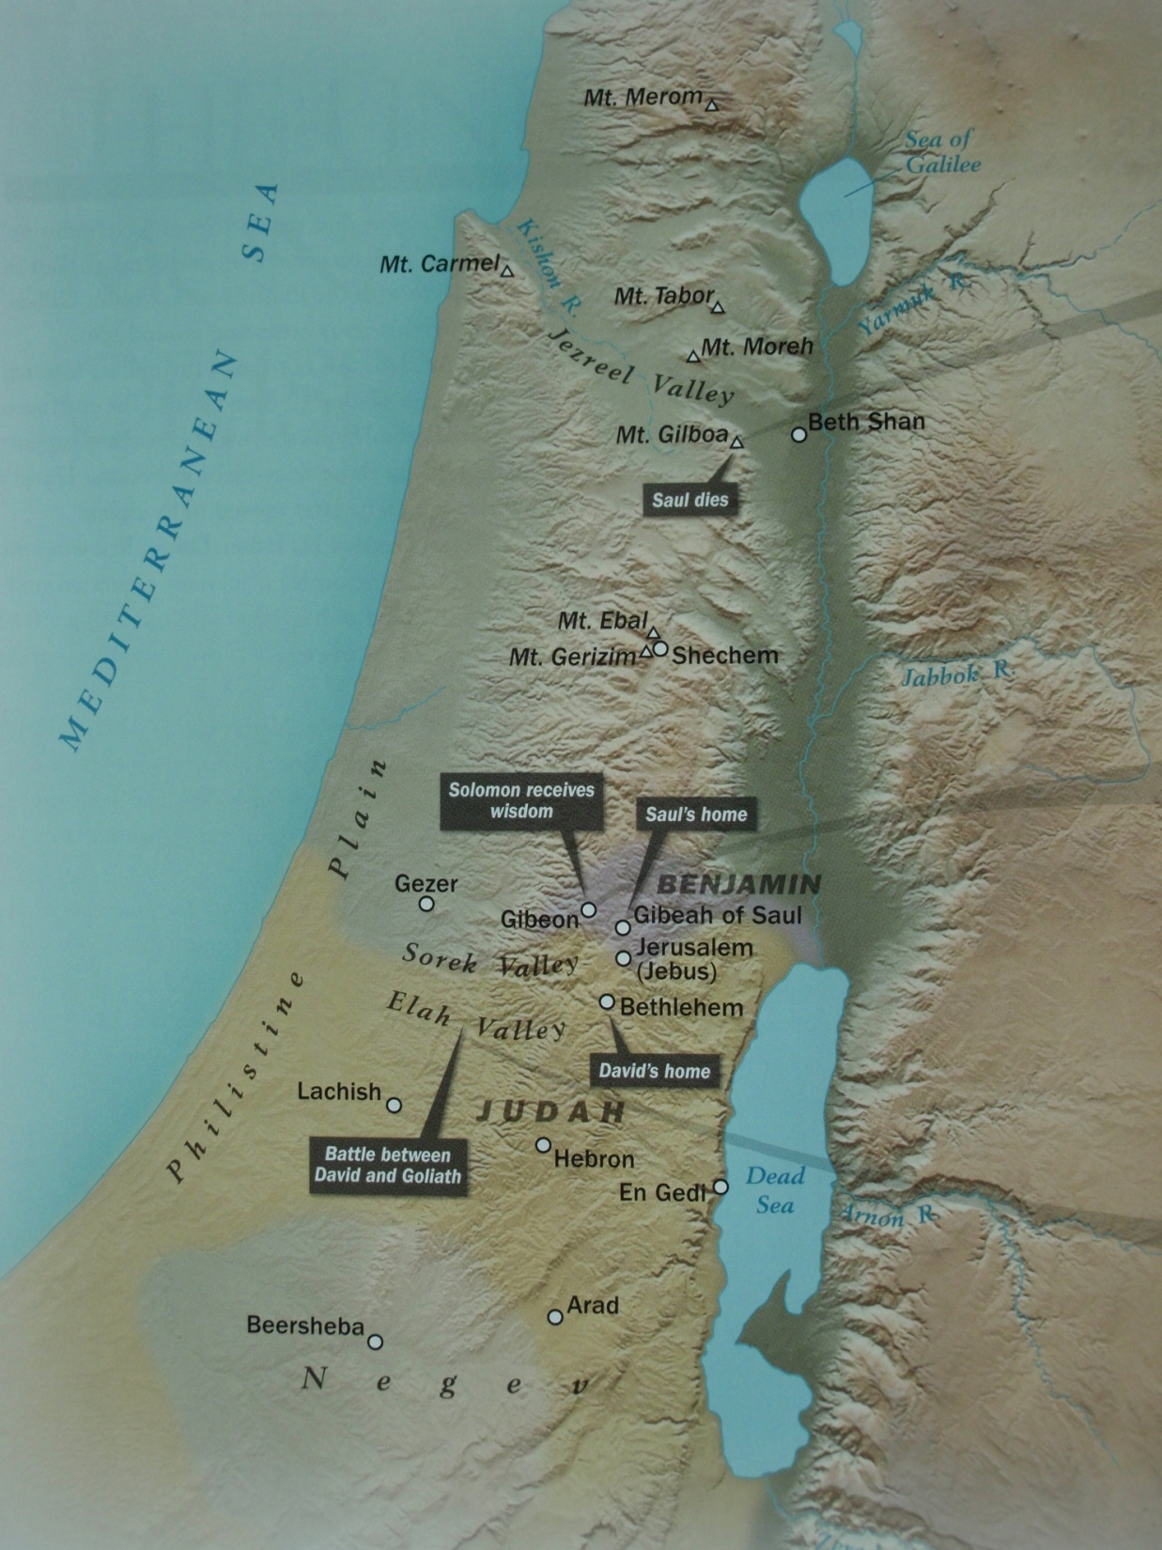
Galilee
Samaria
Judea

Slide 26
Judea
Jeusalem (2x)
Sorek Valley
Elah Valley

Slide 27
Samaria
Caesarea Maritima
Judea

Slide 28
Galilee
Jezreel Valley
Dan
Caesarea Philippi
Capernaum

Slide 29
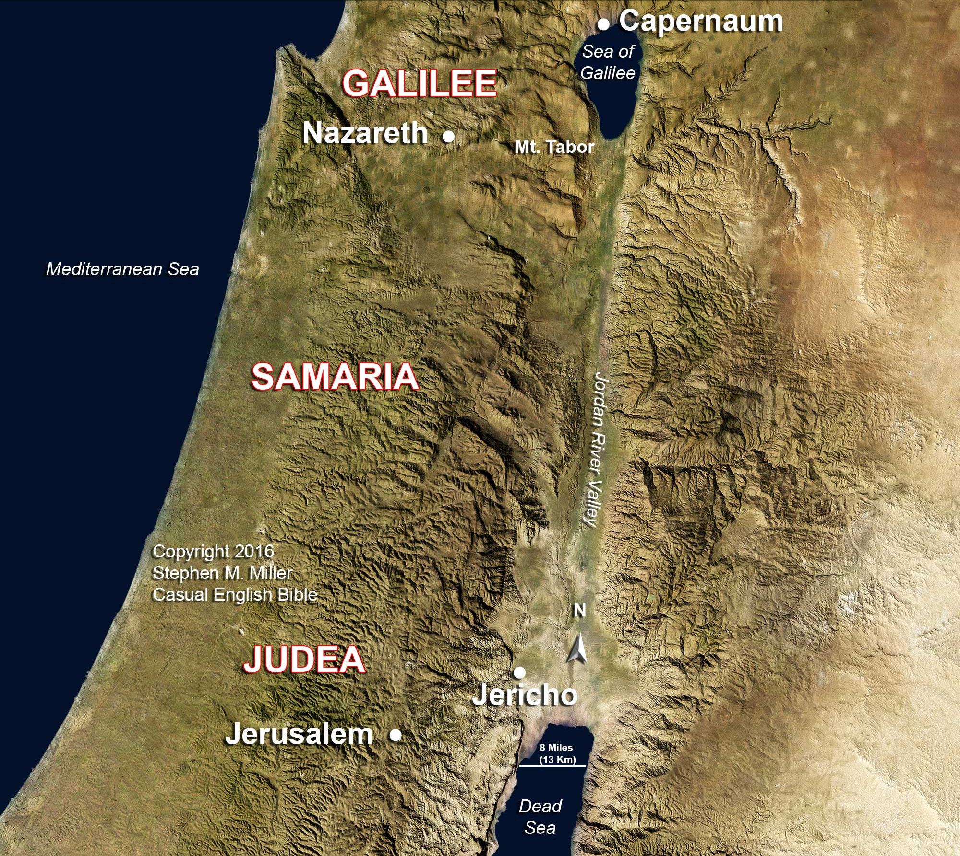

Slide 30
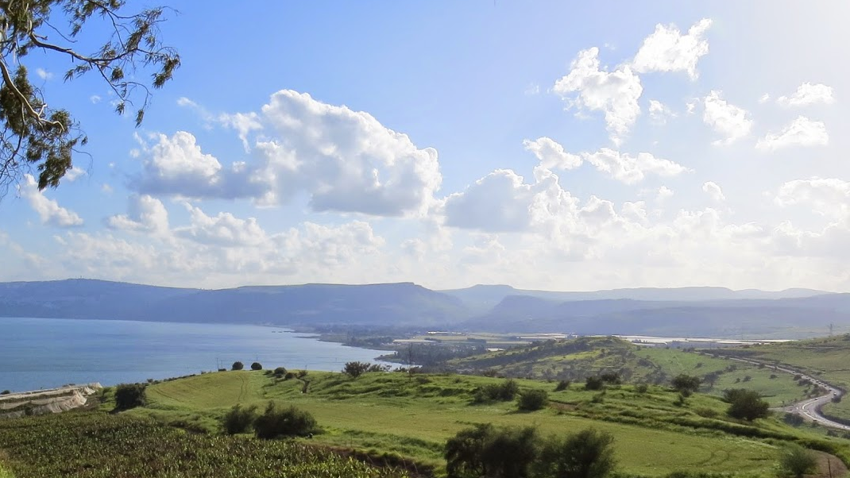
A Land Flowing With Milk And Honey
September 10, 2017

